Slide 1
Interpretable
Machine Learning
in High-Frequency Trading
DAWID LIPSKI
Match-Trade Technologies
Notes:
‹#›

Slide 2
What do we do?

Slide 3
1. We create technology for CFD brokers
Our clients (Poland):

Slide 4
2. We provide Liquidity for Forex & Crypto CFDs
3. STP Broker license (390/20) issued by the Cyprus Securities and Exchange Commission (CySEC)
4. 1000+ instruments in 9 different asset classes

Slide 5
What my team does?

Slide 6
We create High-Frequency Trading algorithms
We provide Market Making services for Cryptocurrency Exchanges
Our algorithms are used on over 30 Exchanges

Slide 7
What are High-Frequency Trading & Interpretable Machine Learning?
What can we get from combining those two disciplines?
Dawid Lipski
Match-Trade Technologies

Slide 8
Exchange 1
Exchange 2
…
Liquidity Provider
TRADING
DISCRETIONARY
ALGO TRADING
SYSTEMATIC
LOW-FREQUENCY
HIGH-FREQUENCY
SPECULATIVE
MARKET MAKING

Slide 9
Market Making characteristics
The goal: placing buy and sell orders for a particular asset simultaneously
exchange requirements for market makers
Creating the largest possible turnover
Data intervals of about a couple of milliseconds
Asymmetric Information Problem for market makers

Slide 10
Interpretable Machine Learning (XAI - Explainable AI)
Interpretability - the degree to which a human can understand the cause of a decision
„Why” becomes very important
Interpretability of standard linear models
Interpretability of more sophisticated models
Intrinsic and post-hoc interpretability
Necessity of understanding model parameters and specific predictions

Slide 11
Motivation to use Interpretable Machine Learning
False discoveries (Building ML model + backtesting)
Low signal-to-noise ratio - tough to find any patterns in data
Creating simple decision rules based on understanding the market
Avoiding latencies related to the model’s prediction
Poor accuracy of models on High-Frequency data
Finding events and anomalies inside the data

Slide 12
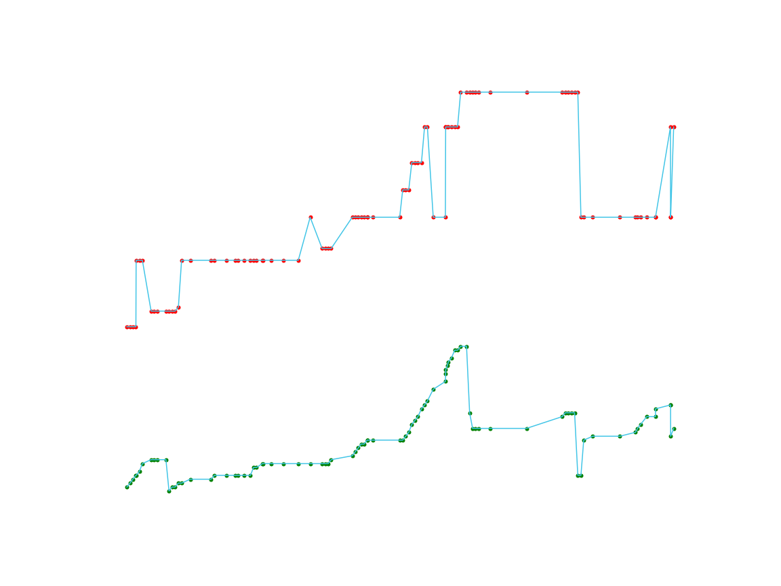
HFT REALITY

Slide 13
HFT REALITY
200 ms interval

Slide 14
“Case study”
Goal: Price return prediction
Path to reach the goal: creating simple decision rules based on the Interpretable Machine Learning
The model:
classification: 1 - price up, 0 - in other cases → an estimation of the probability that the price of a specific asset will rise within the assumed period
XGBoost
number of features: p = 25
t = 500 ms

Slide 15
Ceteris Paribus
lat. “other things equal”
Idea:
for a fixed observation we choose one feature and modify it
other p-1 features without changes
creating predictions for different values of the chosen feature
creating a plot: prediction depending on the value of the chosen feature

Slide 16
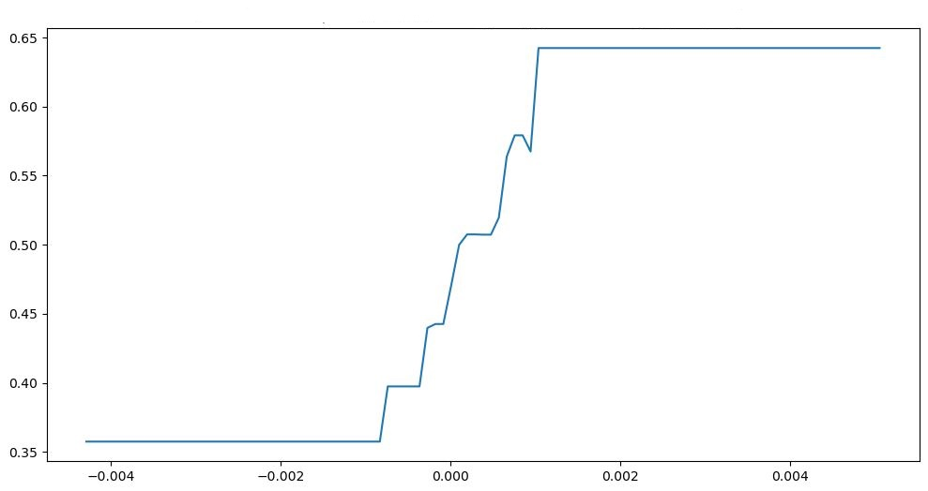
CETERIS PARIBUS - EXAMPLE 1
Notes:
Przykład - wykorzystanie zmiennej spread na podstawie Ceteris Paribus

Slide 17
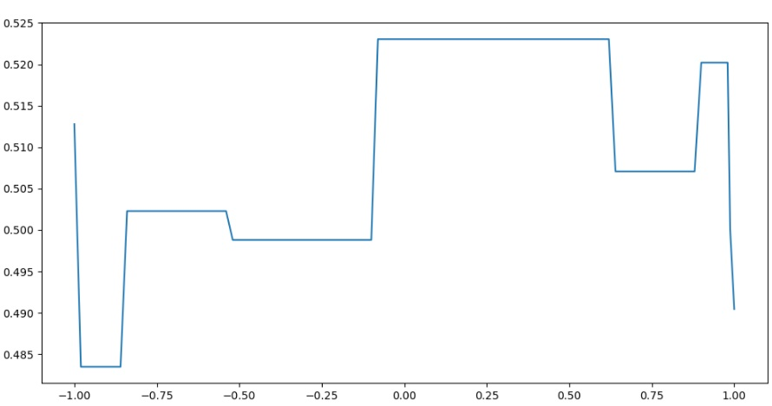
CETERIS PARIBUS - EXAMPLE 2

Slide 18
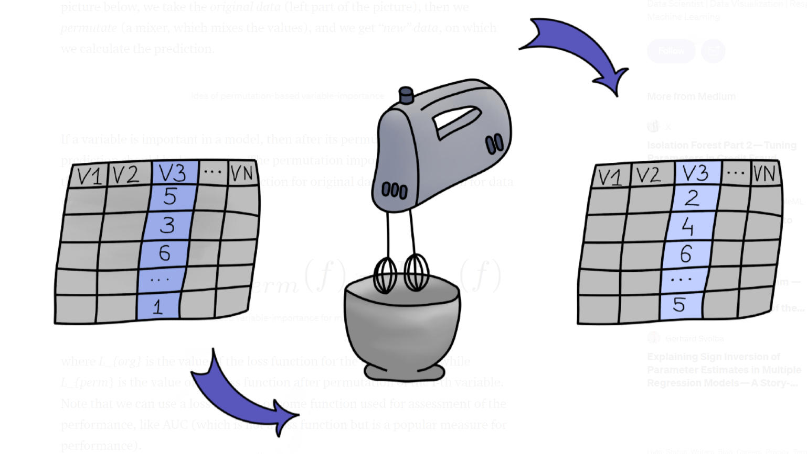
Permutation Feature Importance (PFI)
Idea - for every feature
Model evaluation after feature permutation
Change of the accuracy measure after permutation
Repeating procedure, averaging → PFI
source: https://medium.com/responsibleml/basic-xai-with-dalex-part-2-permutation-based-variable-importance-1516c2924a14

Slide 19
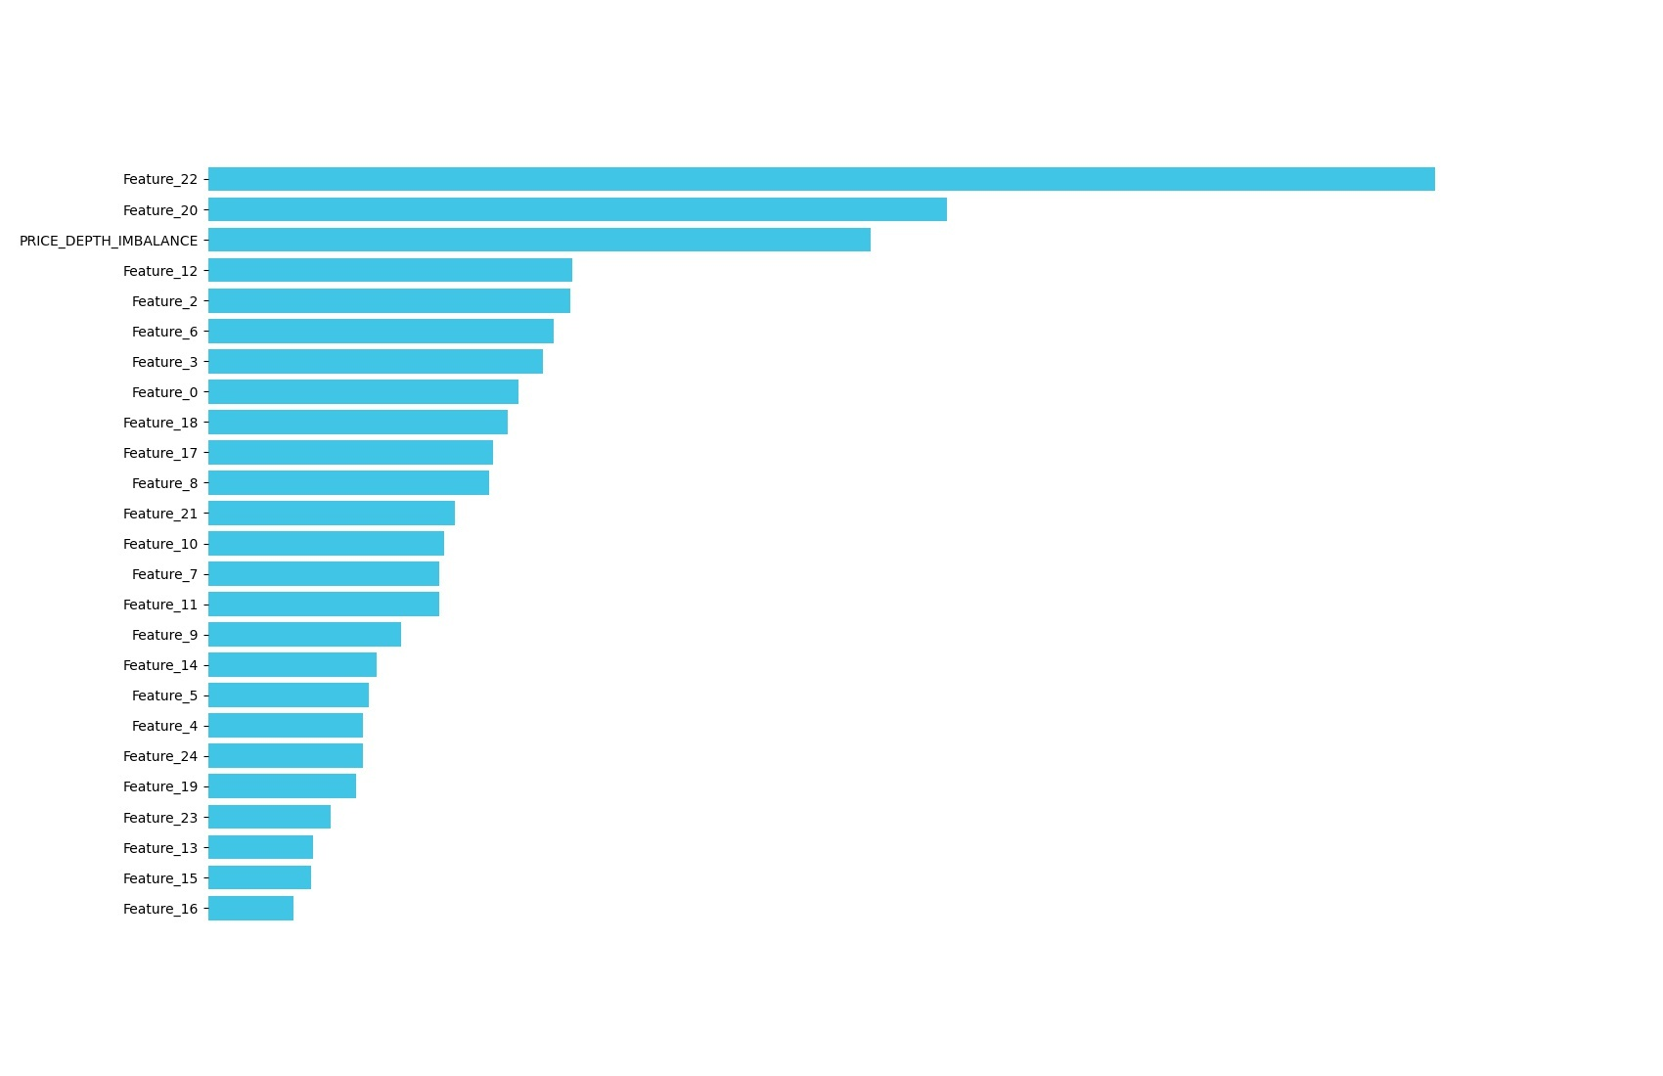
PERMUTATION FEATURE IMPORTANCE - EXAMPLE
The bigger the PFI value, the more important the feature
Conclusions related to the whole model - not particular prediction

Slide 20
Shapley Values
Method proposed by Lloyd Shapley
Analogy to the Game Theory:
Cooperation game -> model
payoff -> prediction
players -> explanatory variables
Real Life analogy

Slide 21
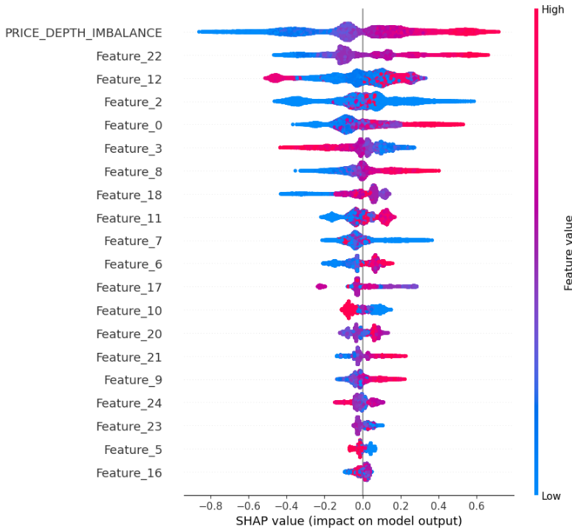
SHAPLEY VALUES - EXAMPLE
A lot of information related to:
the Influence of a particular feature on the prediction of the model
the influence of particular values of explanatory variables on prediction

Slide 22
SHAPLEY VALUES - EXAMPLE 2

Slide 23
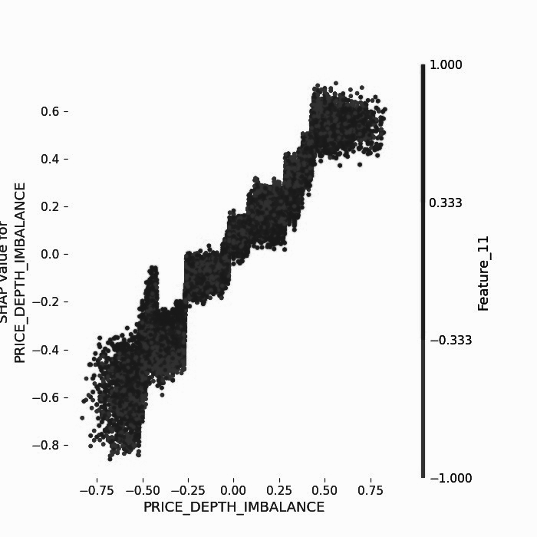
SHAPLEY VALUES - EXAMPLE 2

Slide 24
SHAPLEY VALUES - EXAMPLE 2
Visualization of variables’ dependence

Slide 25
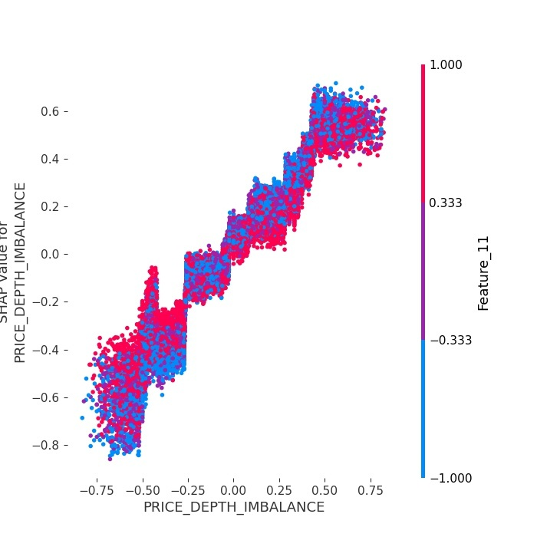
SHAPLEY VALUES - EXAMPLE OF FEATURE INTERACTION

Slide 26
Other applications of Explainable Machine Learning in High-Frequency Trading:
Stockpicking
System/Instrument PnL Estimation
Capital Allocation
Good practice to all models: What does the model pay attention to?

Slide 27
Thank you
for your attention!

