Slide 1
Accelerate AI performance with DirectML on Intel Hardware
Ghost Day: Applied Machine Learning Conference
Szymon Marcinkowski

Slide 2
Agenda
Windows AI ecosystem overview
  DirectML
  Supported frameworks
  Tools
DirectML optimizations overview
  General optimizations
  Performance considerations on Intel platform
Guide on how to bring your AI model at scale with DirectML
  3-step guide
  Example of Generative AI workflow: Stable Diffusion 1.5
Summary

Slide 3
Windows AI ecosystem overview.
What DirectML is and how it fits Windows AI ecosystem?

Slide 4
DirectML: Low-level API for high performance machine learning, supported by all DirectX 12 compatible hardware.
Breakdown of DirectML definition:
“Low-level” and “High performance”:
  Native C++ API
  Developed on top of DirectX 12
“Supported by all DirectX 12 compatible hardware”:
  Industry standard with cross-vendor support: Intel, Nvidia, AMD, Qualcomm etc.
  Deployed with Windows OS
  GPU and NPU acceleration

Slide 5
Frameworks: DirectML is industry standard for deploying AI on Windows OS with GPU/NPU accelerators.
Windows ML:
  Ease of development – built into Windows OS
  Broad hardware support – GPU, NPU and CPU
  Flexibility – evaluate your models locally on PC
ONNX Runtime:
  Cross-platform, cross-hardware
  Integrated into many frameworks
TensorFlow:
  Public Preview available for version: 1.15
  Inference and training
PyTorch:
  Public Preview available for version: 1.13
  Inference and training

Slide 6
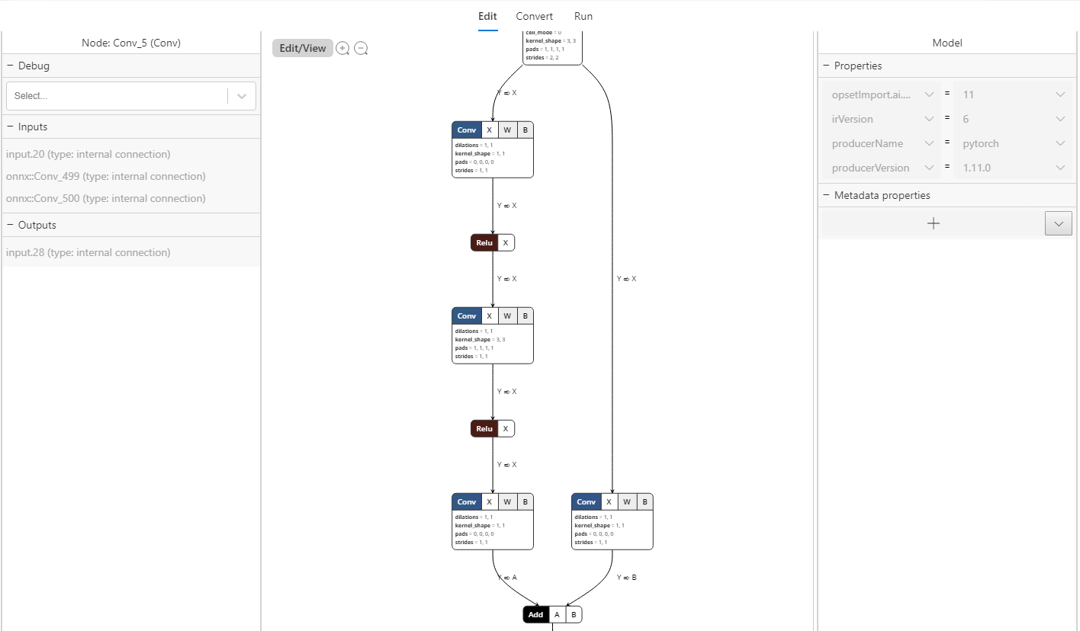
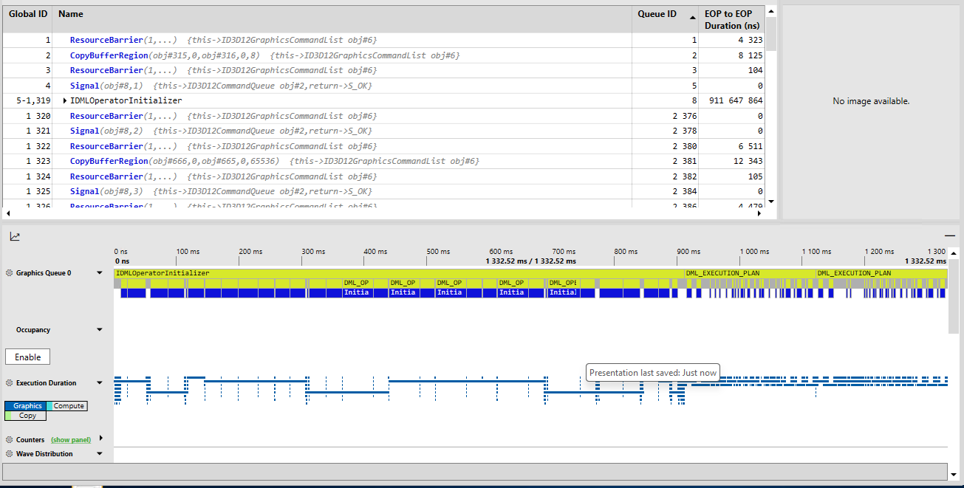
Tooling: Windows AI and DirectML ecosystem delivers broad set of tools, which helps improve and evaluate your AI workloads.
Olive​
    Hardware aware model optimization ​
WinML Dashboard​
    Graphic view of model’s architecture​
    Conversion from popular frameworks into ONNX format​
ONNXMLTools​
    Converts models from popular frameworks into ONNX format​
WinMLRunner​
    WinML framework consuming ONNX format to evaluate performance and model completeness​
  PIX
    Application DirectX calls instrumentation and work visualization
    Useful for performance analysis

Slide 7
DirectML optimizations overview.
Methods used by DirectML to provide great performance.

Slide 8
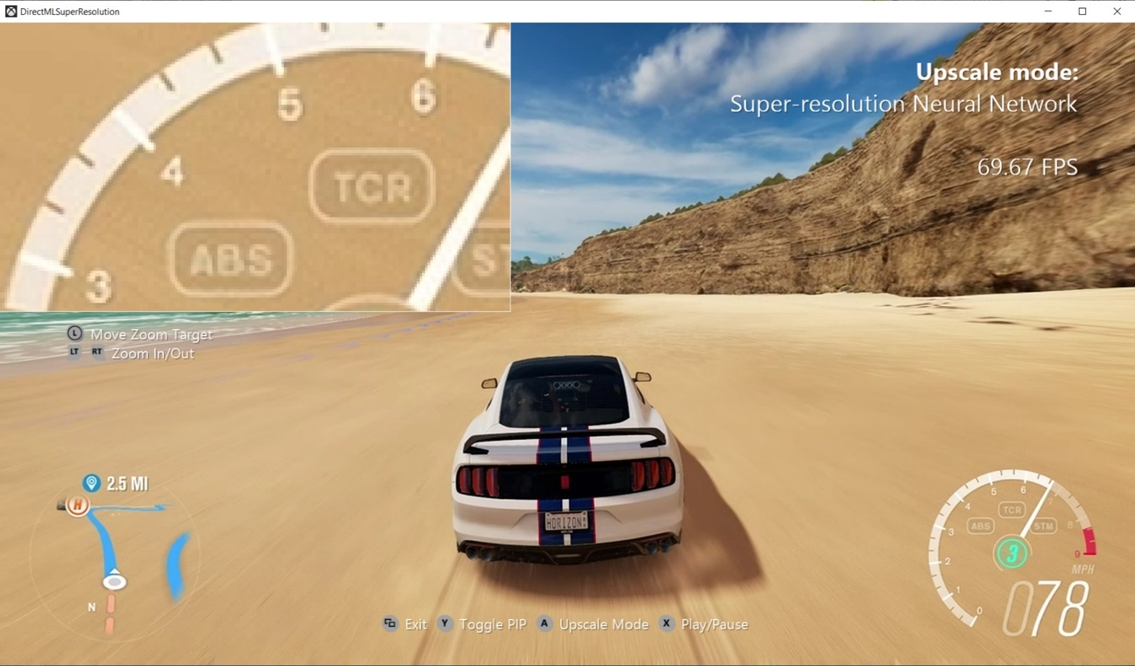
DirectML: Performance is key
Performance is key to adopt AI models into day-to-day use cases:
DirectML allows for seamless integration into DirectX 12 apps (including games)
Low latency inference thanks to broad set of optimizations described in next slides
Super Resolution public demo: link

Slide 9
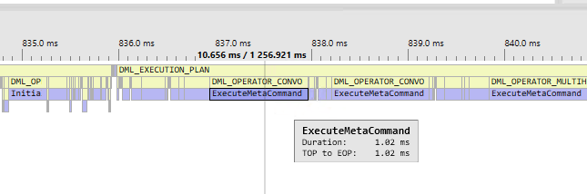
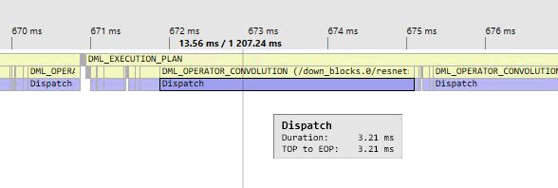
General optimizations pt. 1: DirectML provides broad set of performance optimization opportunities for your AI model.
With Metacommand
Metacommands
  Mechanism by which vendors can implement own versions of operations making best use of underlaying hardware
Without Metacommand

Slide 10
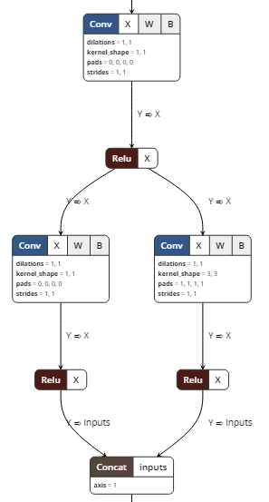
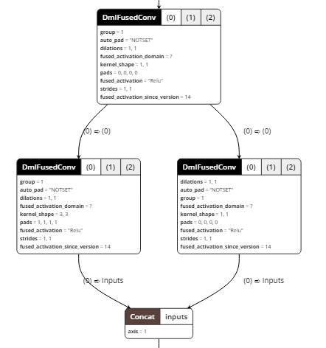
General optimizations pt. 2: DirectML provides broad set of performance optimization opportunities for your AI model.
Graph optimizer
  Execution improvements via removal of not needed nodes
  Operator fusion

Slide 11
Performance considerations: Get best performance out of your DirectML AI model on Intel GPU hardware.
Managed tensors
  Set Convolution weights tensors to be managed by DirectML. During model loading driver will have option to reshuffle its data into format optimized for efficient data loads.
Optimal data layout
  Use NHWC (interleaved) data layout for your tensors, so kernels can make effective use of block/coalesced loads.
Optimal input dimensions
  Design your AI model architecture to use input dimensions in multiple of 16 (FP16) to get best XMX (Xe Matrix Extension) utilization.
Analysis
  Use PIX – performance capture and analysis tool to investigate if your tensors are leveraging MetaCommands.

Slide 12
Guide on how to bring your AI model at scale with DirectML.
Follow this rules to get best out of your AI workload.

Slide 13
3-step guide: These three steps are a powerful combo to deploy your AI model.
Convert
  Convert your model into ONNX format.
Optimize
  Leverage Olive tool powered by DirectML to optimize your model. You should see dramatic performance improvements.
Integrate
  Your model is ready to bring hardware-accelerate inferencing in your application, whether it is low level C++ application, or high-level Python framework.

Slide 14
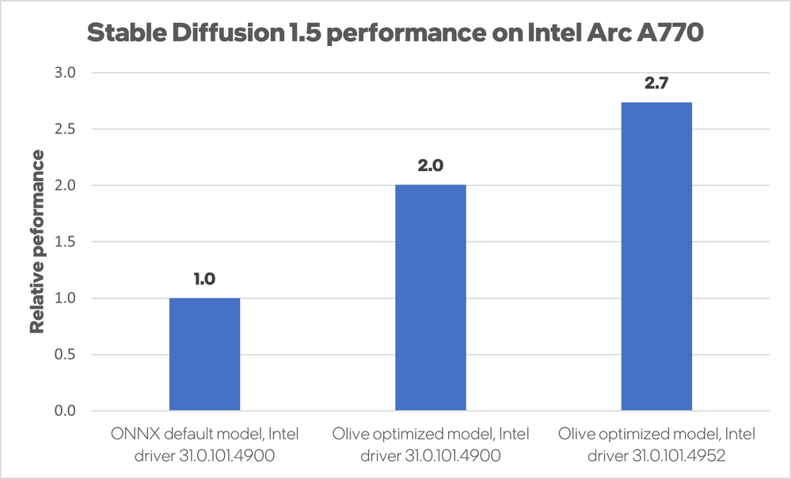
Stable Diffusion 1.5: Presents on how easy it is to get optimized AI model working at scale with DirectML.
Install latest drivers of your vendor.
Convert and optimize
  Clone Olive repo
  Run SD1.5 example, it script will:
    download PyTorch models
    convert them to ONNX format
    run through predefined list of optimizations steps
Test
  Run script again to validate correctness of your optimized model.
Integrate and deploy
  Integrate optimized models into your application.

Slide 15
Summary
AI PC era accelerated with DirectML

Slide 16
Why use DirectML in AI PC era?
Cross vendor – works at scale
Performance – hardware accelerated (GPU/NPU)
Reliable – conformance tests with hardware certification
Works out of the box - deployed together with Windows OS

