Slide 1
Federated Learning via Lens of Data
by Adam Narożniak

Slide 2
Assumptions?
What are we missing about the data?

Slide 3
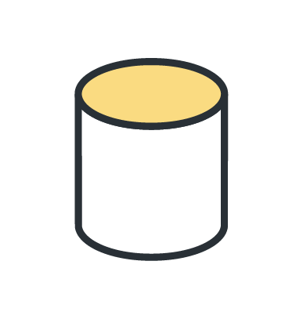
Centralized Machine Learning
Point of view
Data

Slide 4
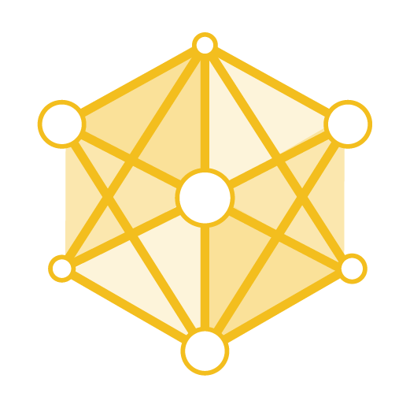
Centralized Machine Learning
Point of view
Data
Model

Slide 5
Stork Delivers Babies

Slide 6
Stork Delivers Babies Data

Slide 7
Data in “Nature”

Slide 8
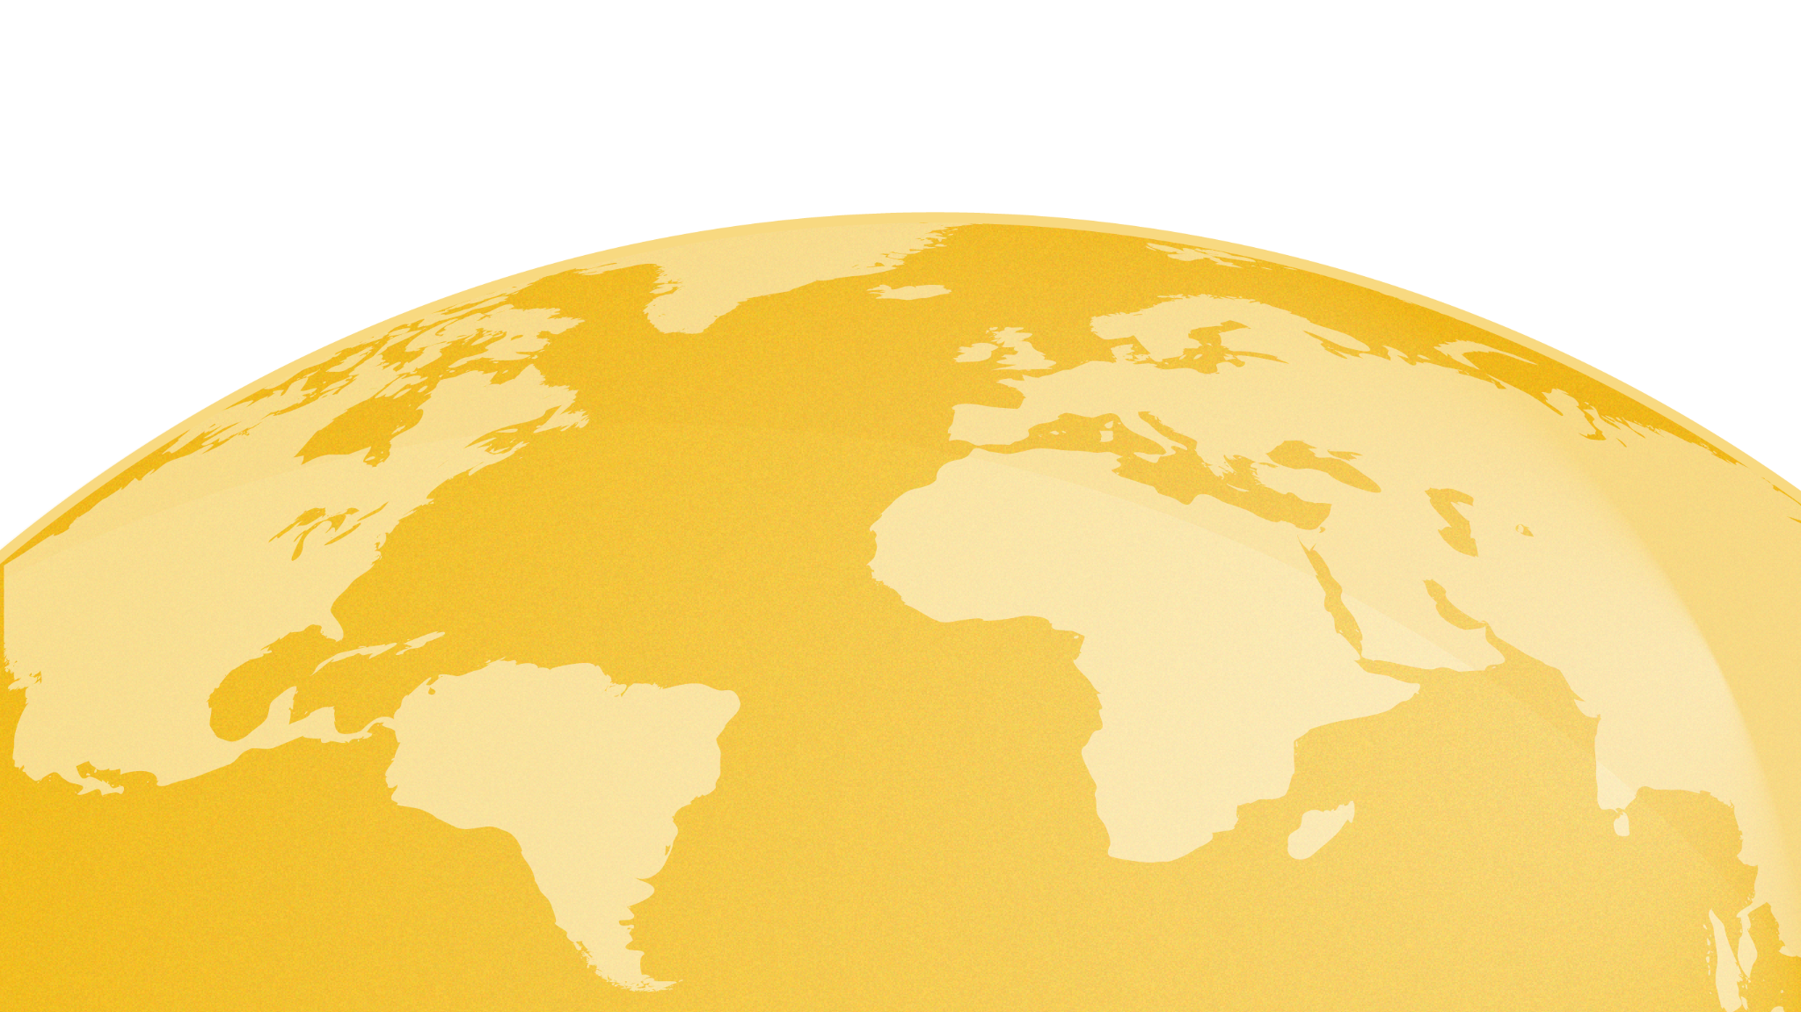
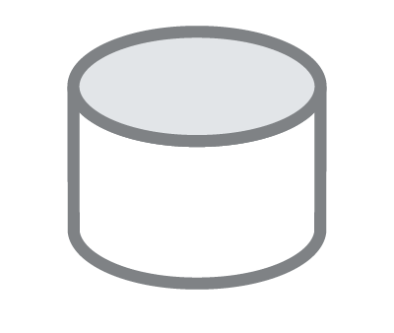
Naturally Distributed

Slide 9
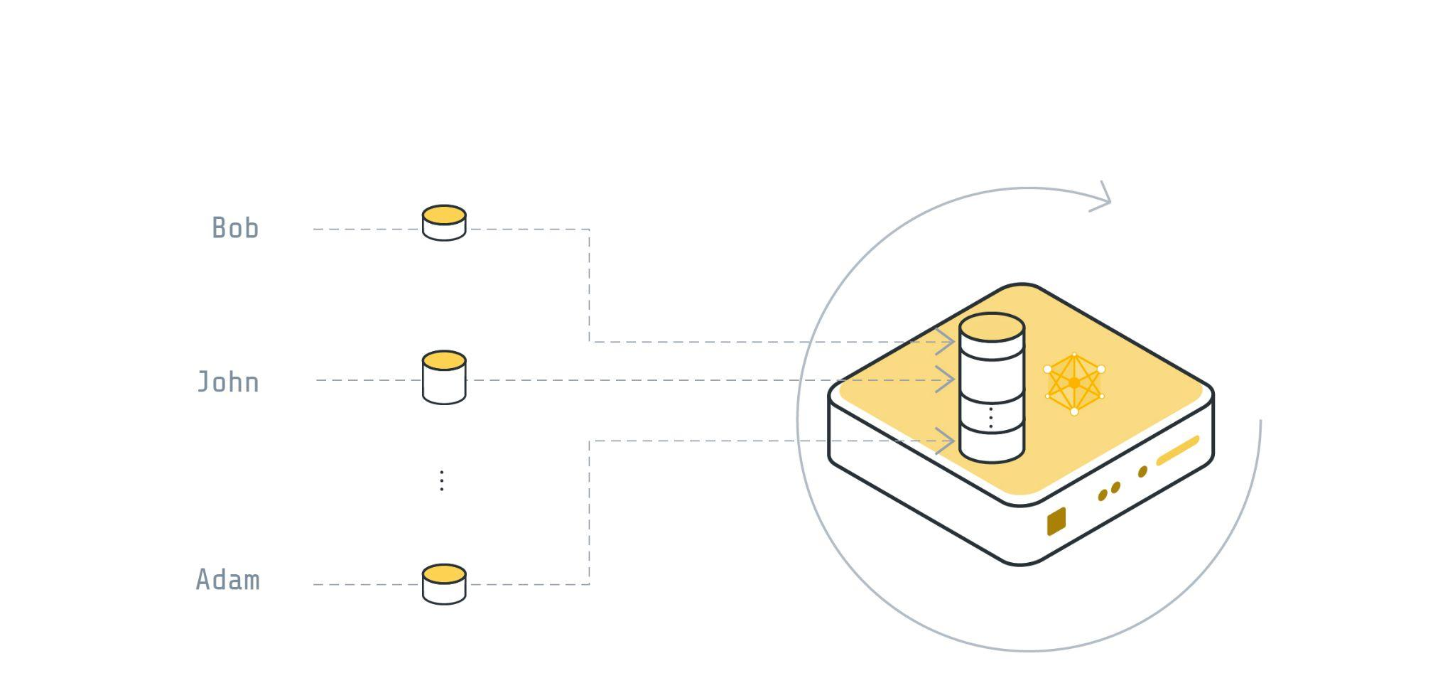
Centralized Machine Learning
Thinking about the data collection

Slide 10
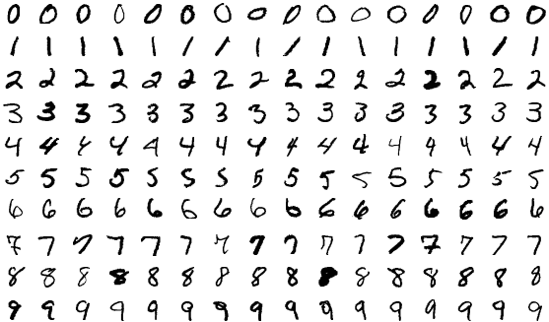
Example: MNIST

Slide 11
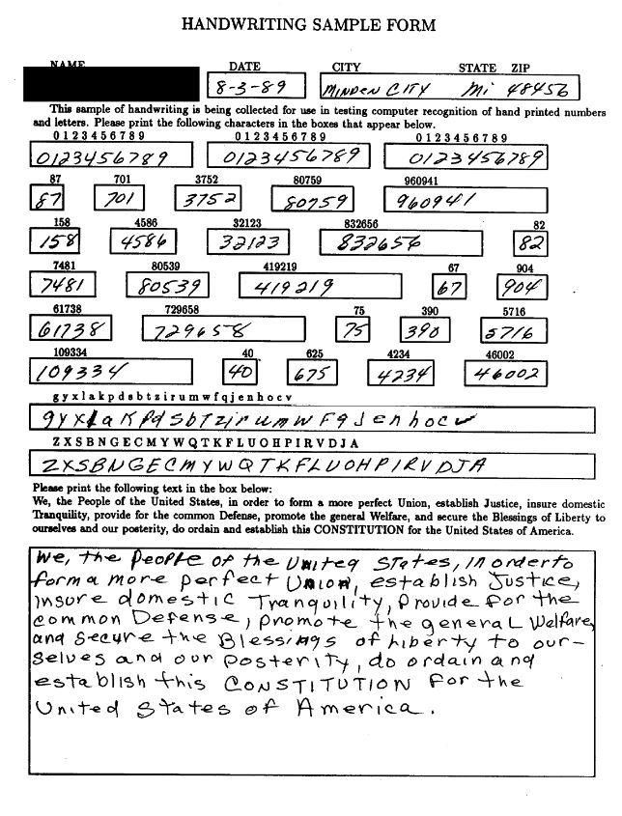
Example: MNIST
NIST Special Database19
3600 writers
unique handwriting

Slide 12
Data Collection Problems

Slide 13
Sources of the Problems:
Regulations
User Preference
Data Volume

Slide 14
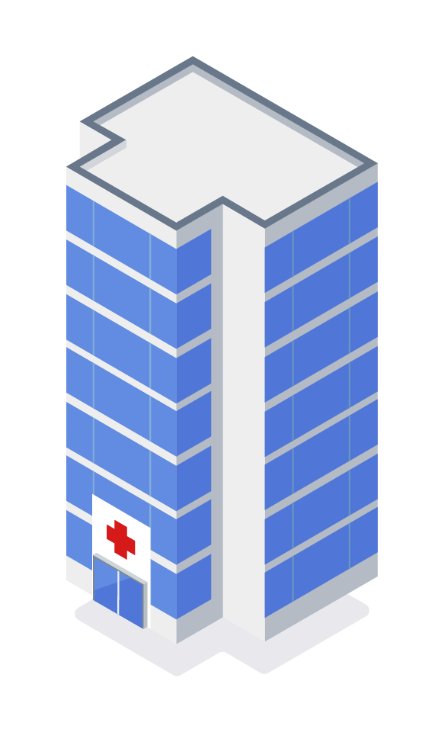
Regulations
GDPR (Europe), CCPA (California), PIPEDA (Canada), LGPD (Brazil), PDPL (Argentina), KVKK (Turkey), POPI (South Africa), FSS (Russia), CDPR (China), PDPB (India),
PIPA (Korea), APPI (Japan), PDP (Indonesia), PDPA (Singapore), APP (Australia) …

Slide 15
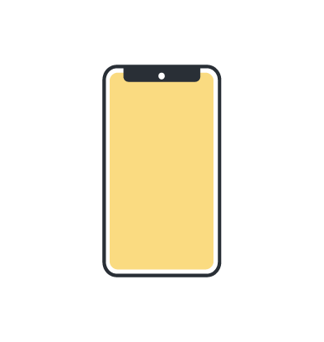
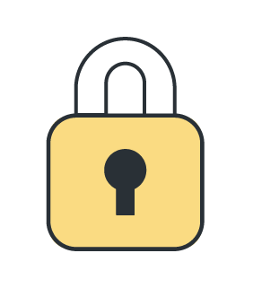
User Preference

Slide 16
Data Volume

Slide 17
Is there a solution?

Slide 18
Federated Learning

Slide 19
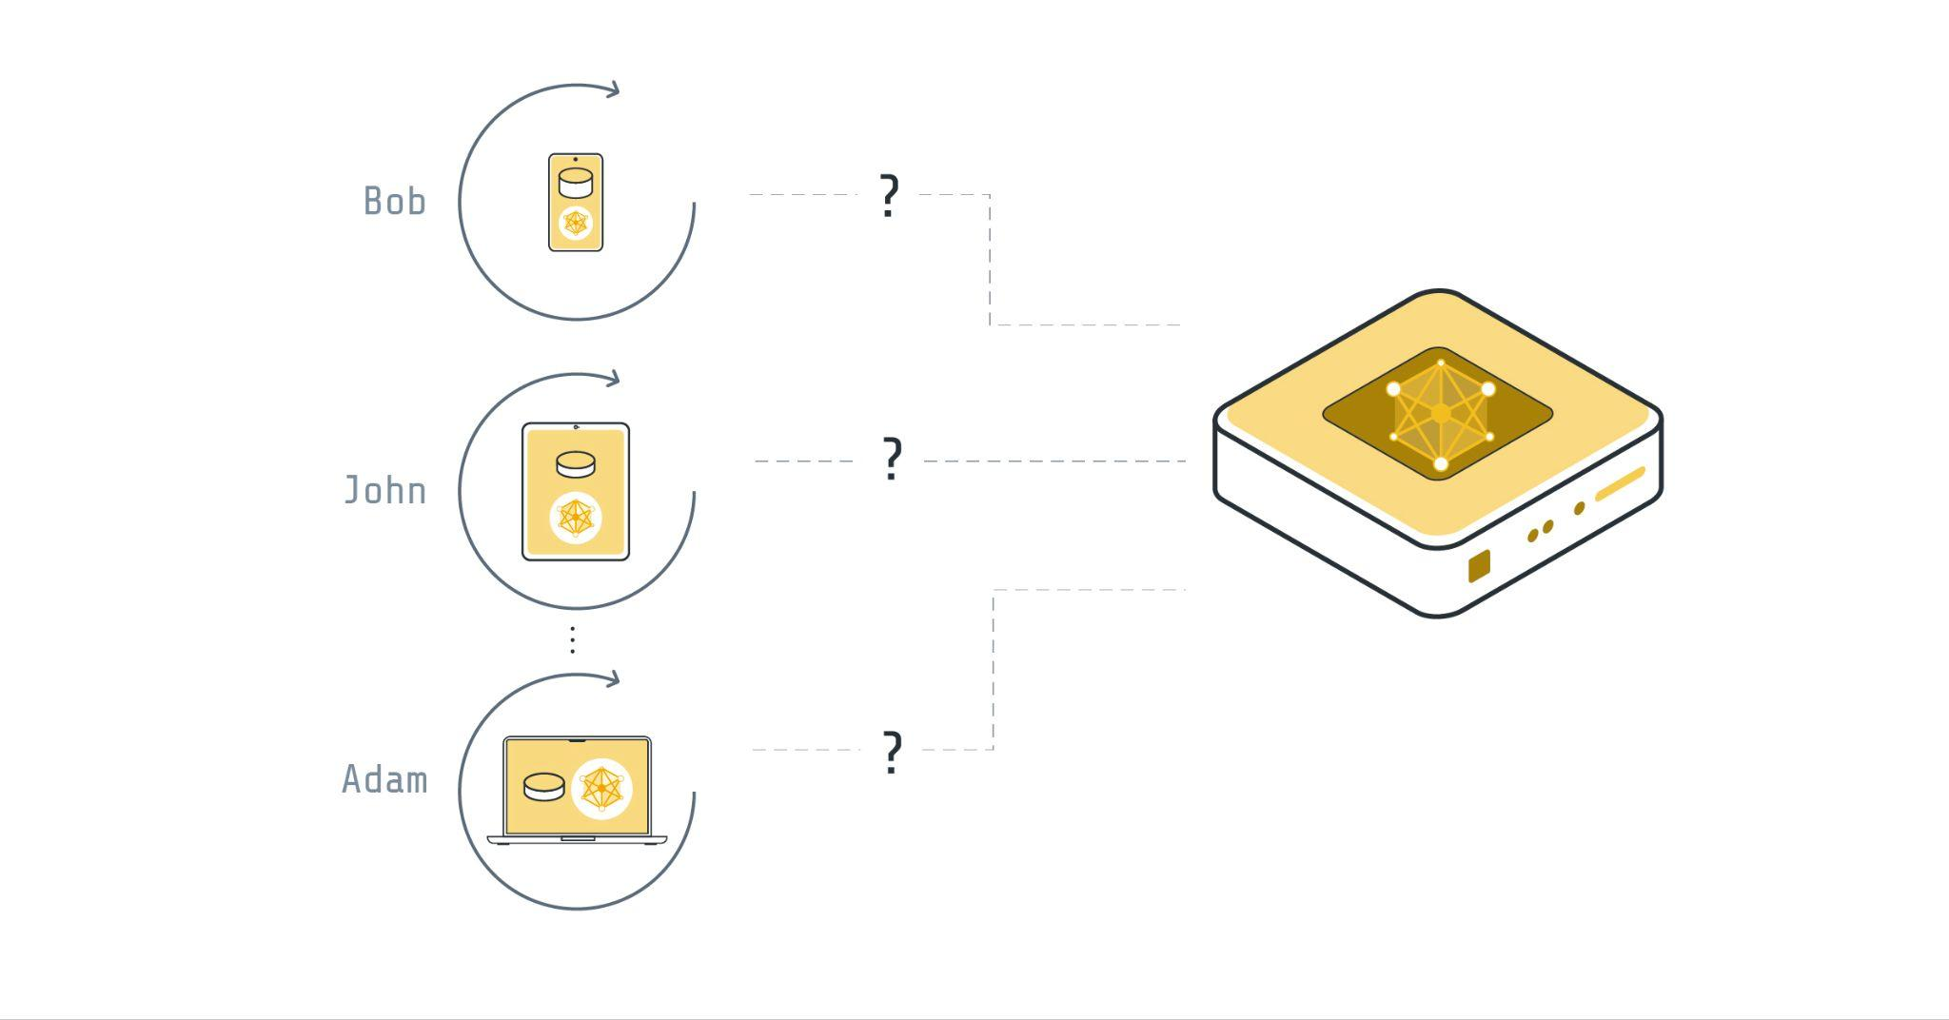
Some connection must exist

Slide 20
How does FL work?

Slide 21
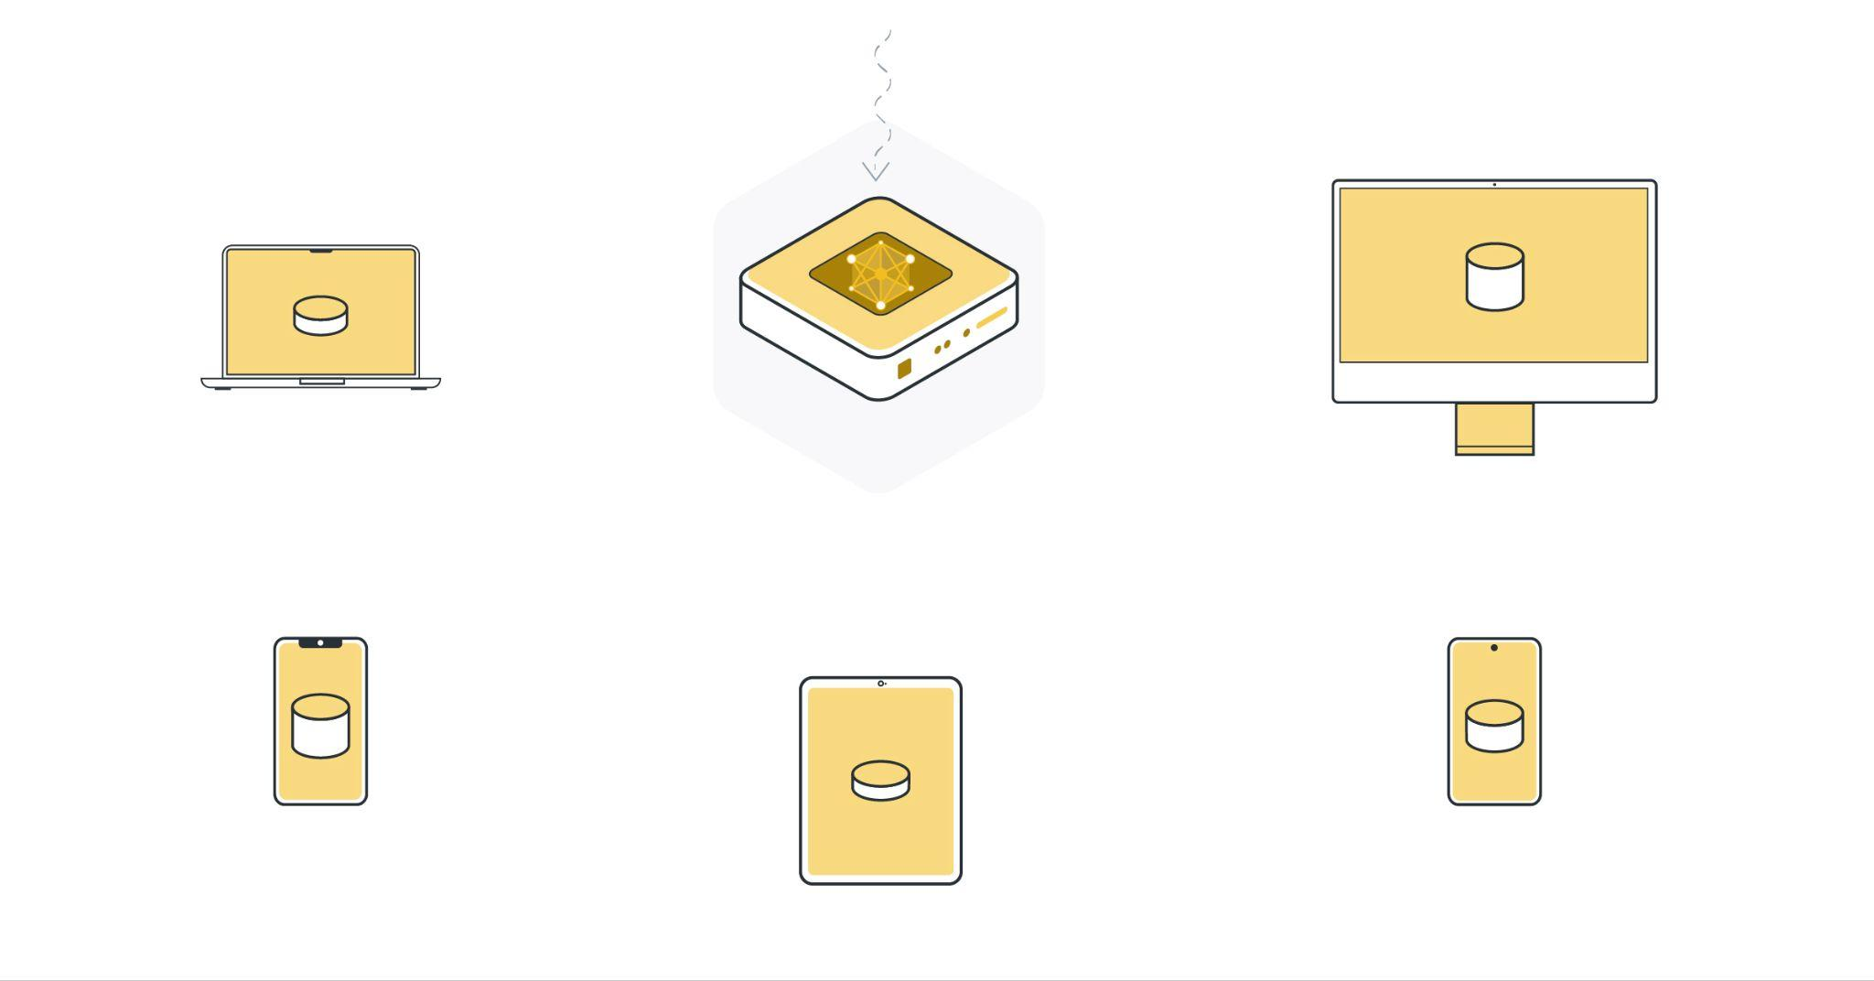
Step 0: Random weights initialization

Slide 22
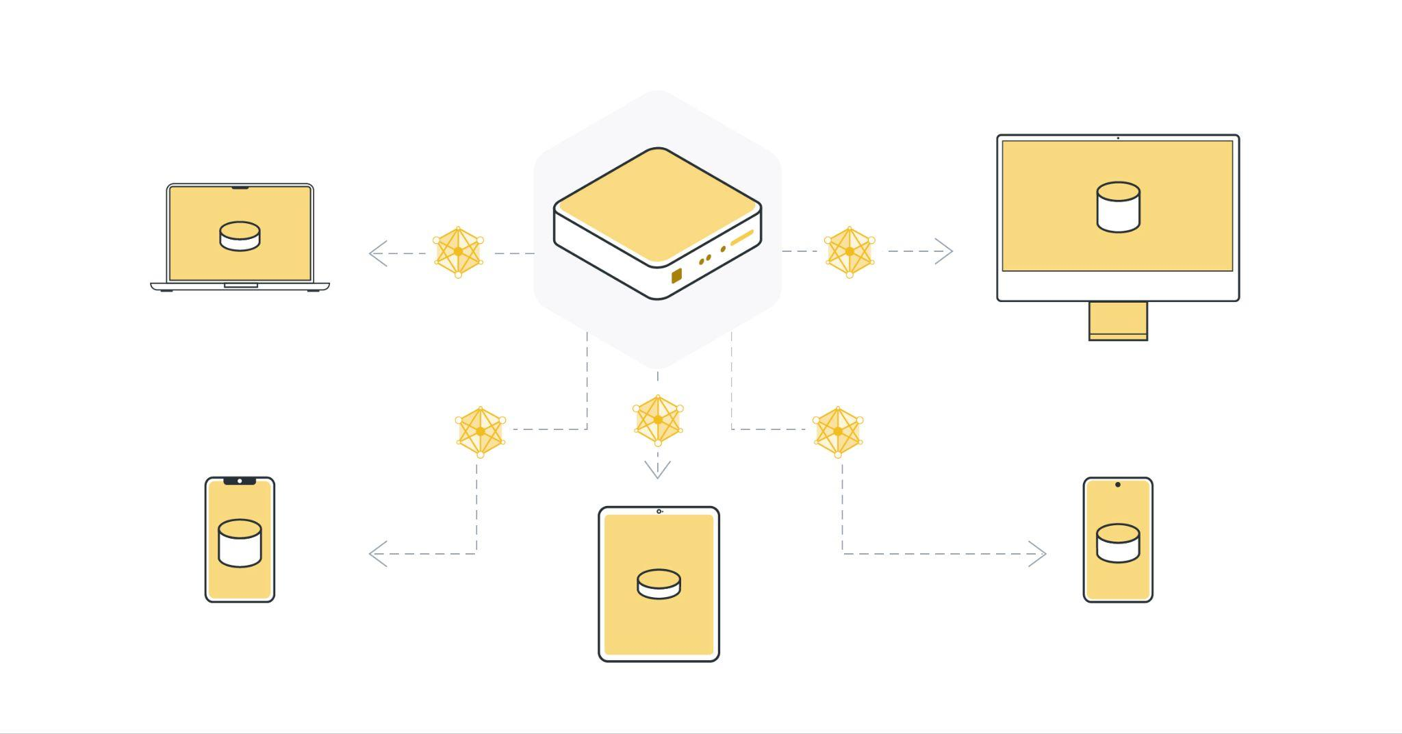
Step 1: Send weights

Slide 23
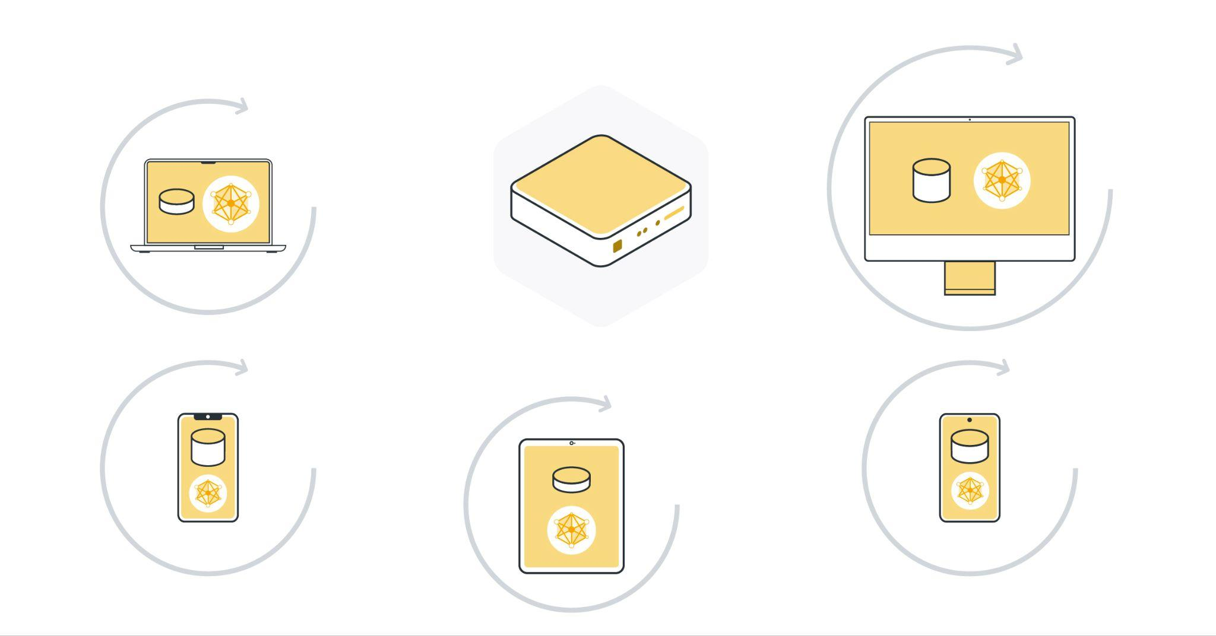
Step 2: Train local models
on edge devices

Slide 24
Step 3: Send weights back to the server

Slide 25
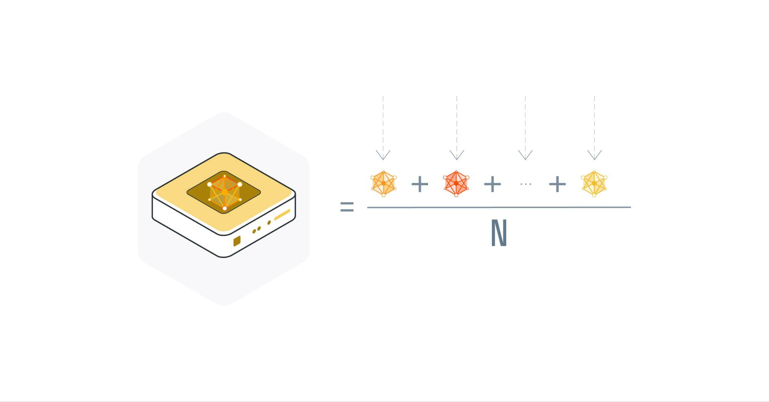
Step 4: Aggregate the weights
(and metrics)

Slide 26
Step 5: Send the weights for evaluation

Slide 27
Step 6: Send back the evaluation results
Acc
Loss
Acc
Loss
Acc
Loss
Acc
Loss
Acc
Loss

Slide 28
Step 7: Aggregate the metrics
L_{avg}
L₁
L₂
L_{N}

Slide 29
Single communication round

Slide 30
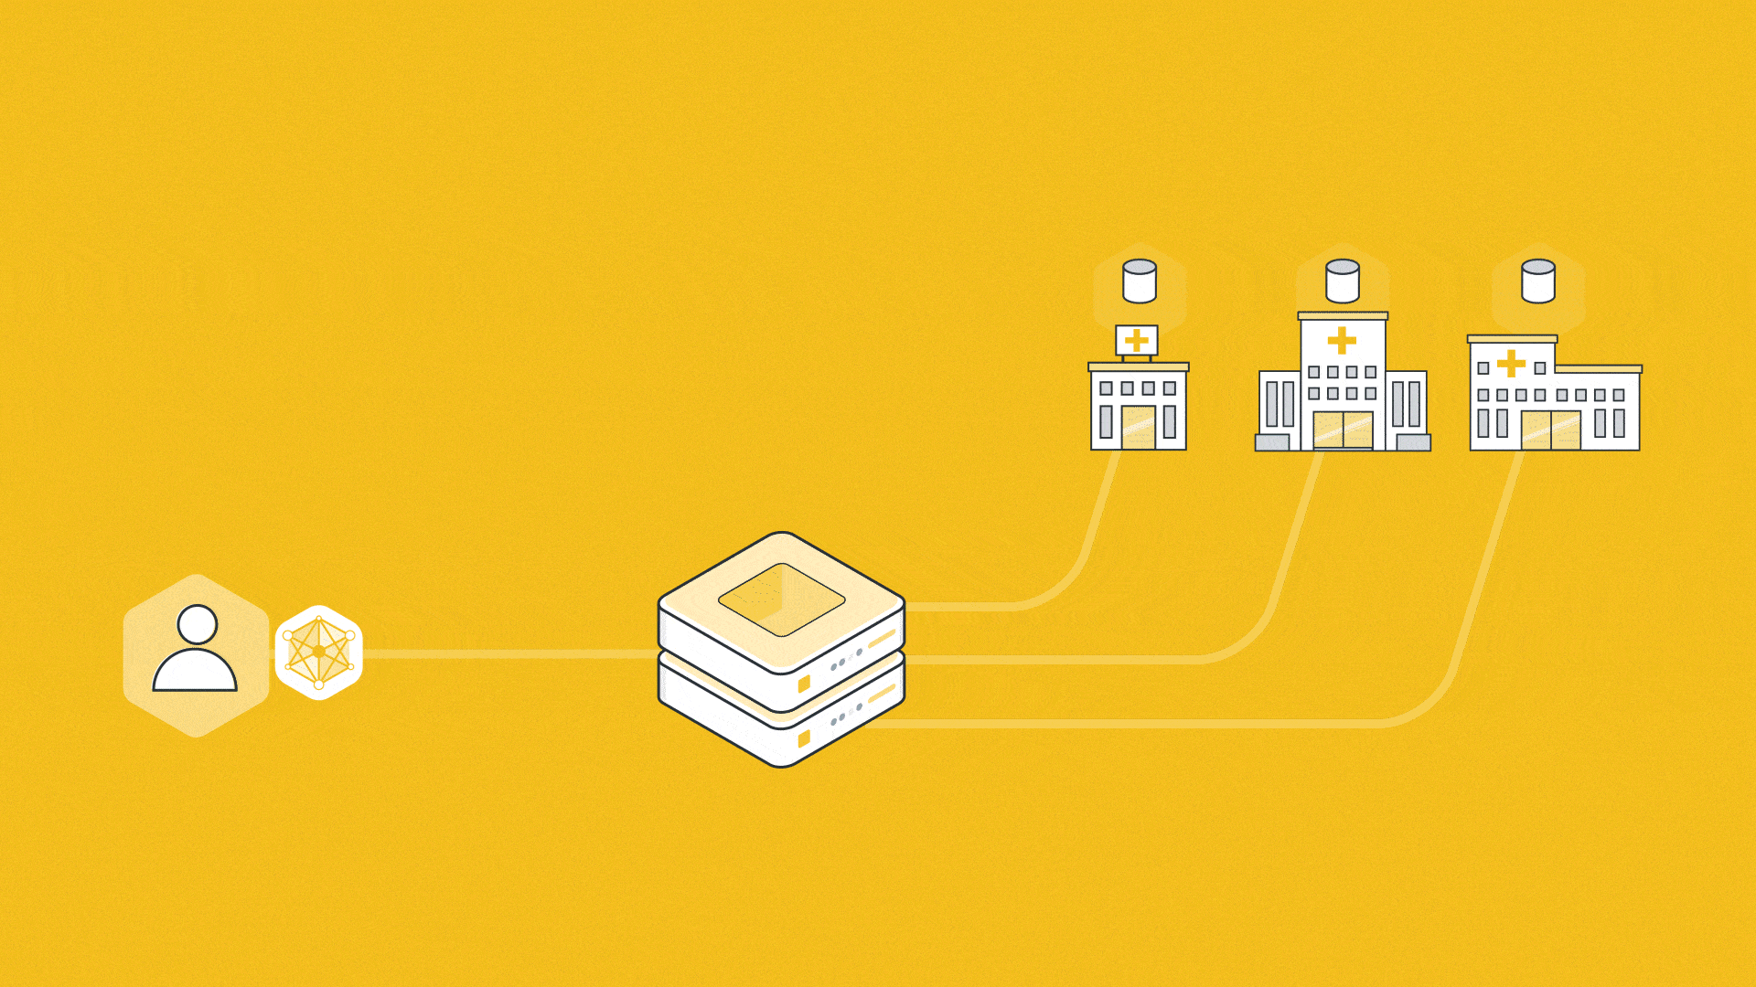
FL: Repeat steps 1-7

Slide 31
Benefits of FL

Slide 32
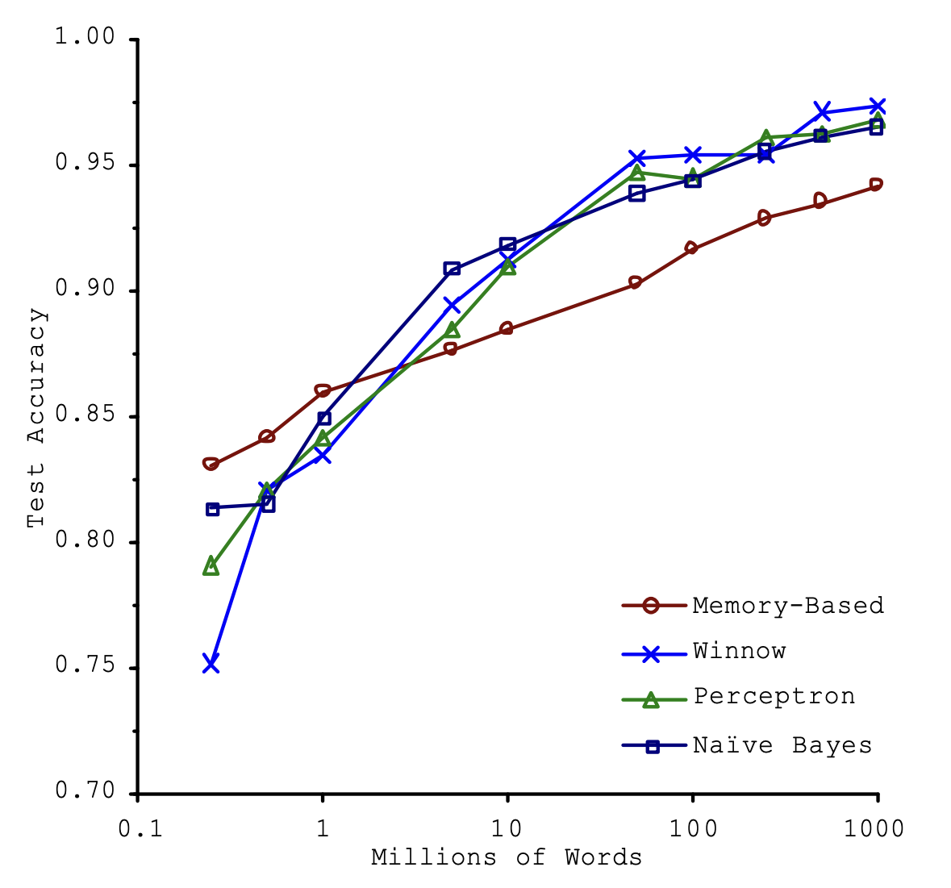
[Centralized ML] Back to Data
Source: Michele Banko and Eric Brill. 2001. Scaling to very very large corpora for natural language disambiguation.

Slide 33
Where is more data?
?
>
<
=

Slide 34
Where is more data?
<

Slide 35
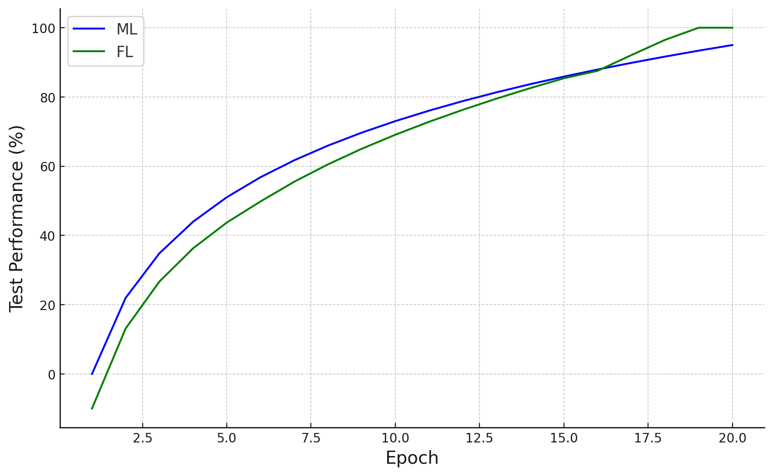
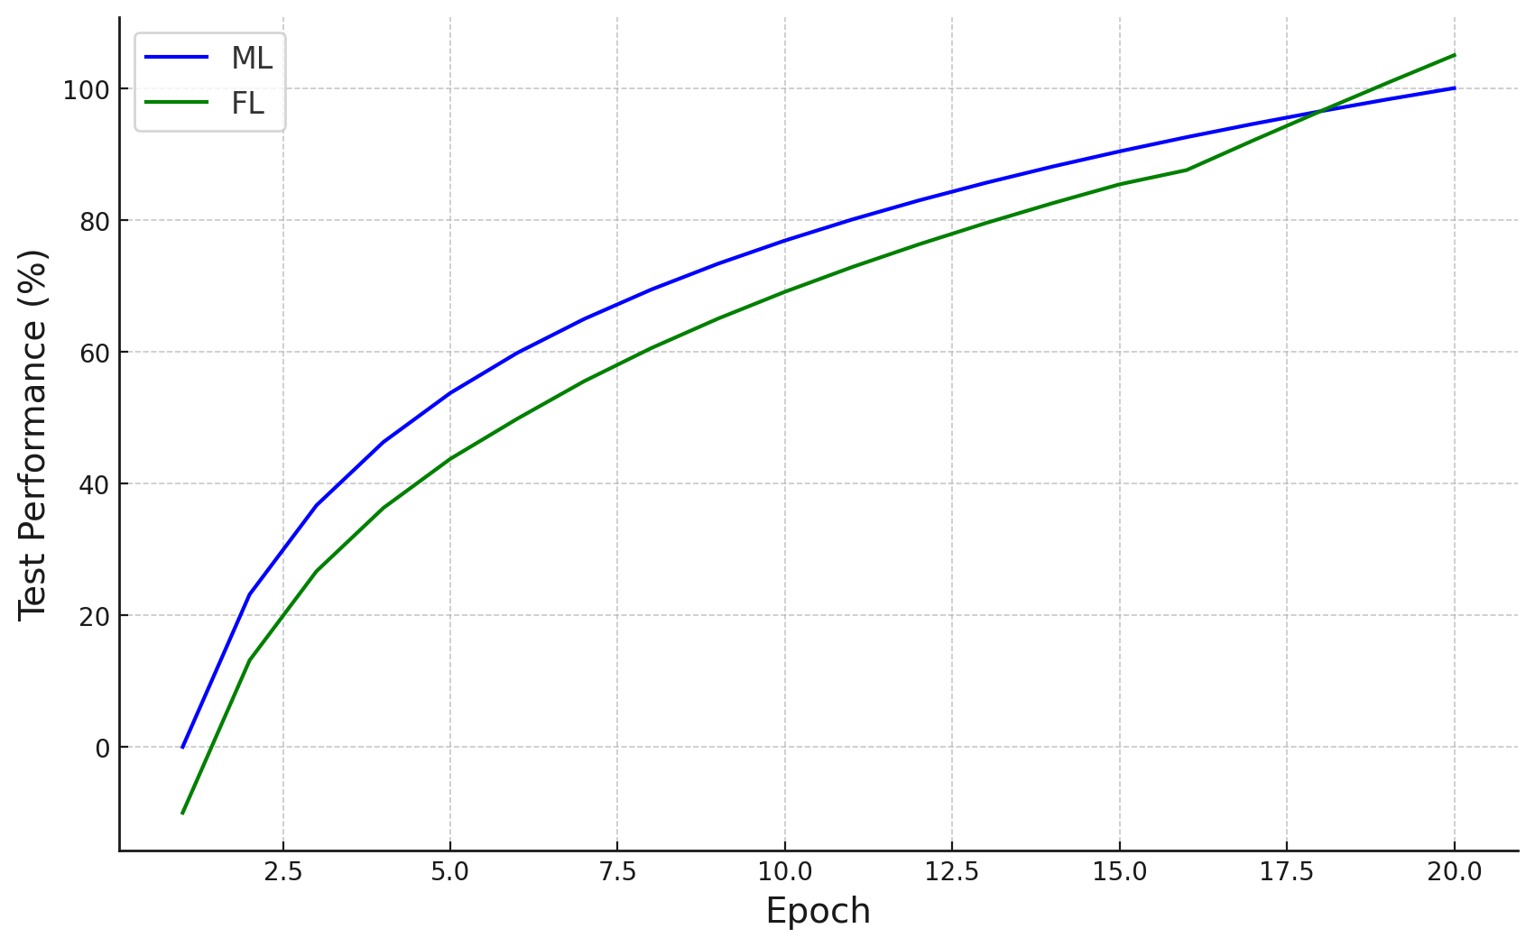
ML vs FL Performance

Slide 36
What is wrong with that plot?

Slide 37
It should not exist!

Slide 38
Unfair comparison due to the data
<

Slide 39
Benefits of FL
Ability to Access More Data

Slide 40
Benefits of FL
Ability to Access More Data
Privacy and Data Security

Slide 41
[Centralized ML] Are you GPU rich?
Single server with GPU

Slide 42
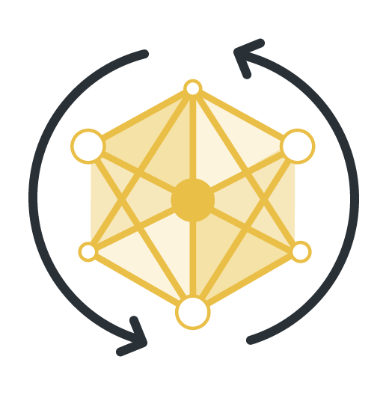
Spread computation

Slide 43
Benefits of FL
Ability to Access More Data
Privacy and Data Security
Reduced Dependence on Server-Side GPU Resources

Slide 44
[Centralized ML] Are you alone?

Slide 45
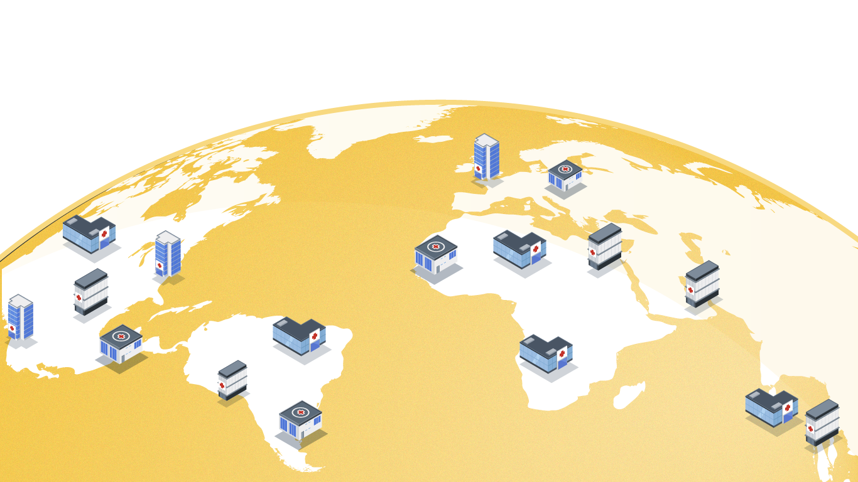
Collaboration

Slide 46
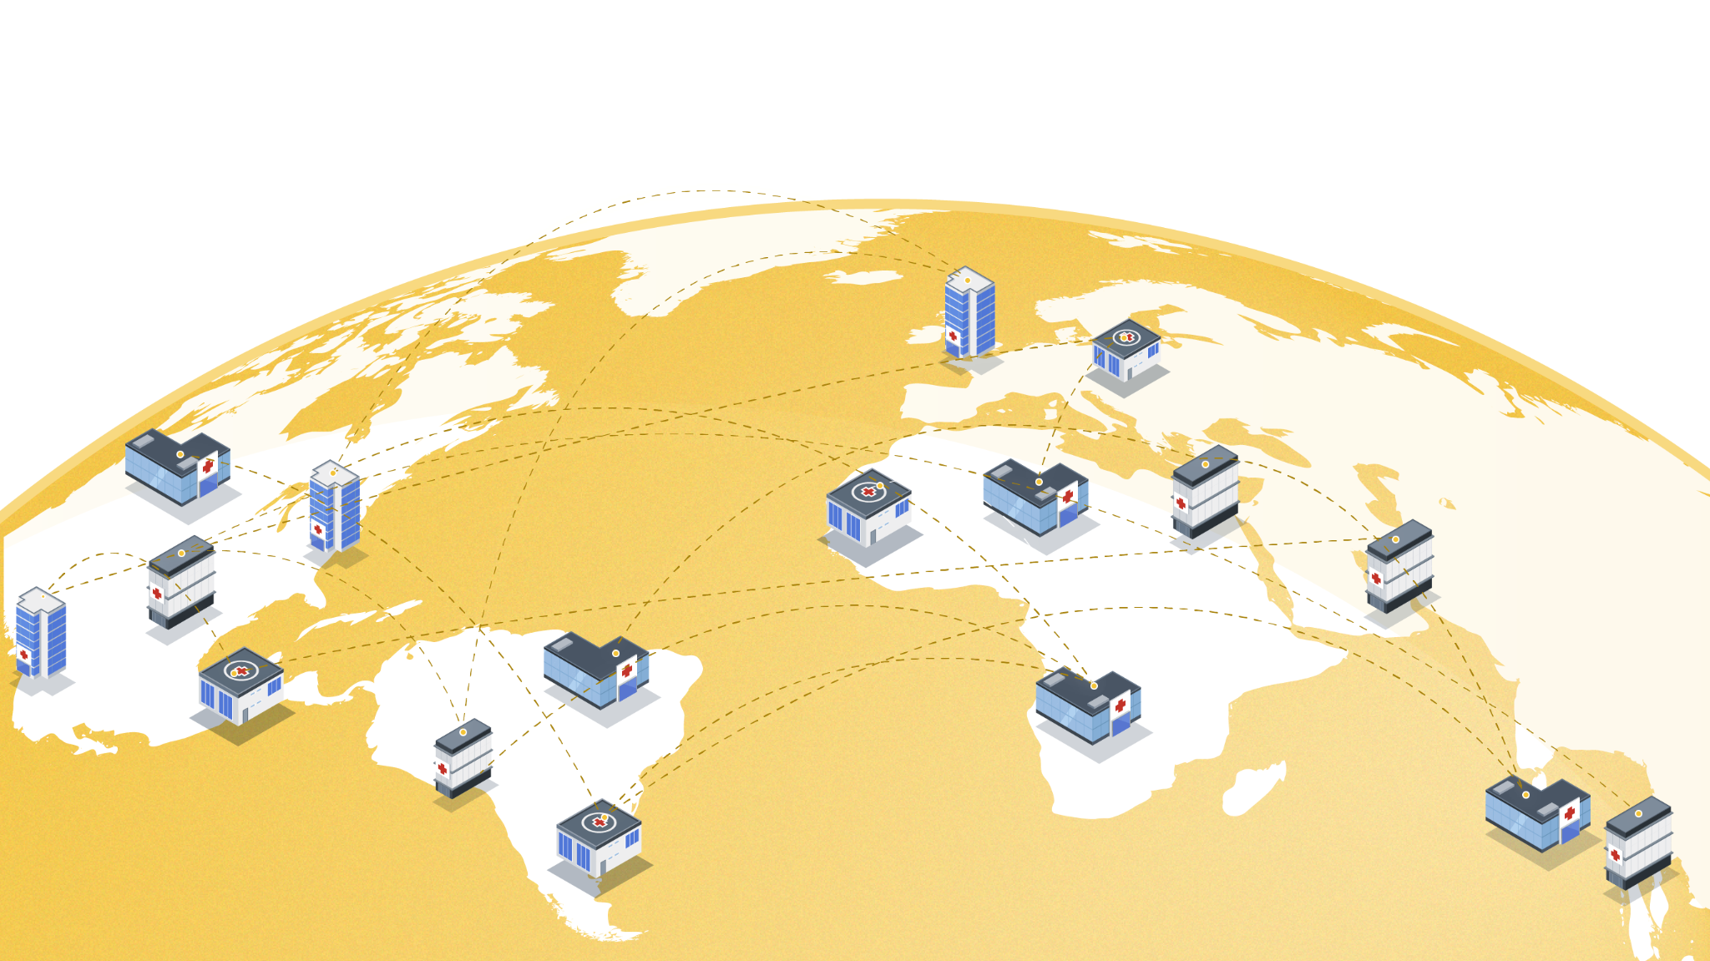
Collaboration

Slide 47
Benefits of FL
Ability to Access More Data
Privacy and Data Security
Reduced Dependence on Server-Side GPU Resources
Collaboration

Slide 48
Use Case
FL vs real world

Slide 49
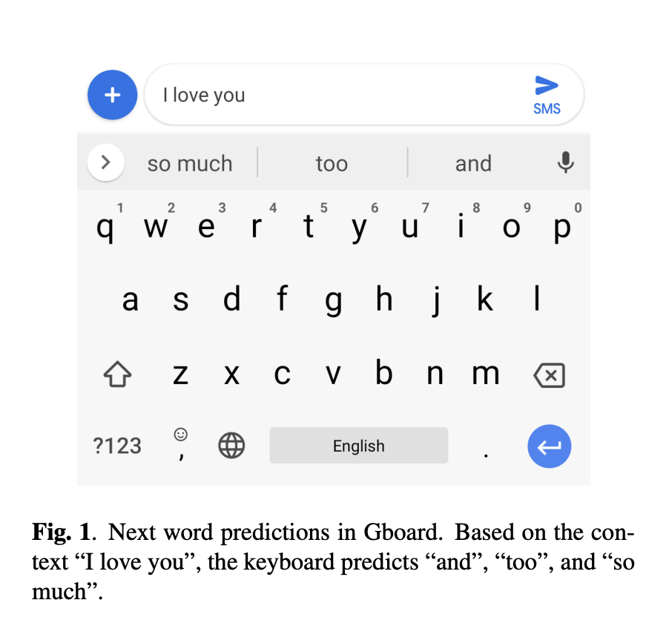
Federated Learning for Mobile Keyboard Prediction, Hard et al. 2018
1 billion installs of Google keyboard in 2019

Slide 50
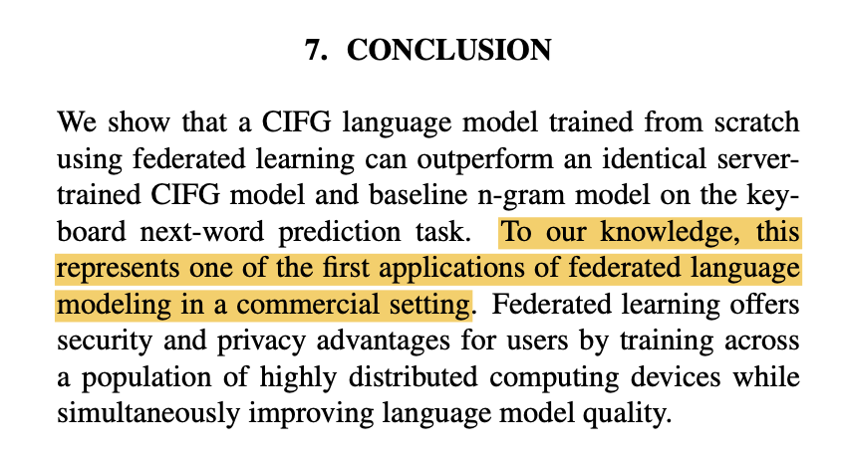
Federated Learning for Mobile Keyboard Prediction, Hard et al. 2018

Slide 51
Conclusions

Slide 52
Thank you
Q&A

Slide 53
References
Communication-Efficient Learning of Deep Networks from Decentralized Data by McMahan et al., 2016 (Google)
Federated Learning for Mobile Keyboard Prediction, Hard et al., 2018 (Google)
Kairouz, Peter, et al. "Advances and open problems in federated learning." Foundations and Trends® in Machine Learning 14.1–2 (2021): 1-210.
Visuals/graphics Flower https://flower.ai/
General FL information https://flower.ai/docs/framework
Affiliation:
Flower Labs

Slide 54
Federated Learning Formally

Slide 55
Federated Averaging (FedAvg)
Where:
- loss function
- the set of indices of data points on client k,

Slide 56
Data in Research

Slide 57
Partition the data
Partitions
…

Slide 58
Partitions
Partitions
Statistical Heterogeneity
…

Slide 59
Key difference between FL and Distributed ML
Considering heterogeneity in FL

Slide 60
How did FL start?
Communication-Efficient Learning of Deep Networks from Decentralized Data by McMahan et al., 2016 (Google)

Slide 61
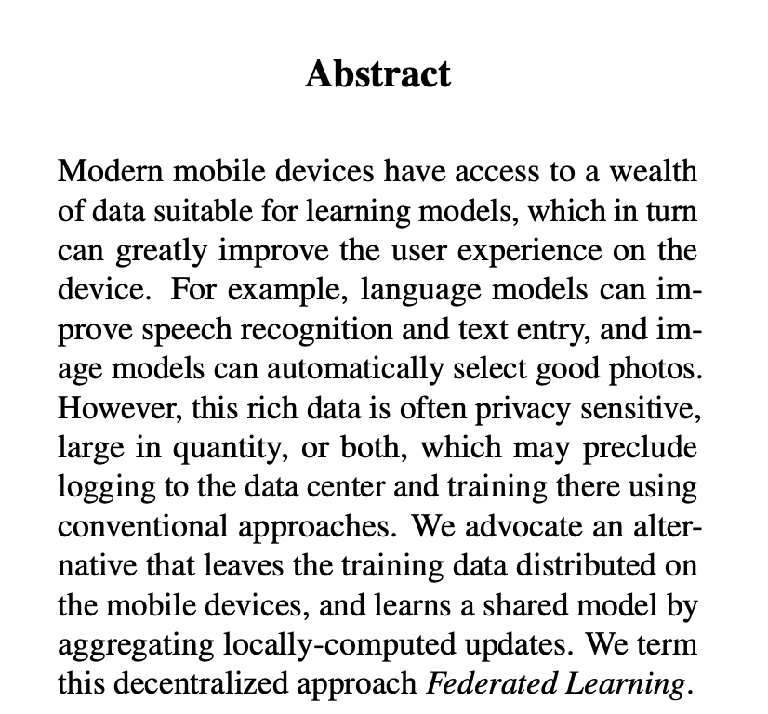
FedAvg

Slide 62
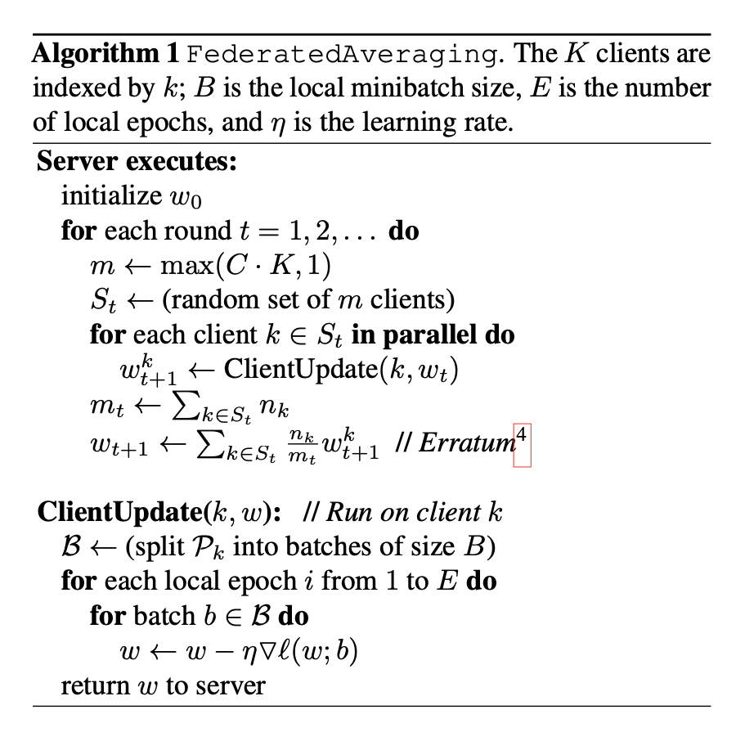
FedAvg
Algorithm

Slide 63
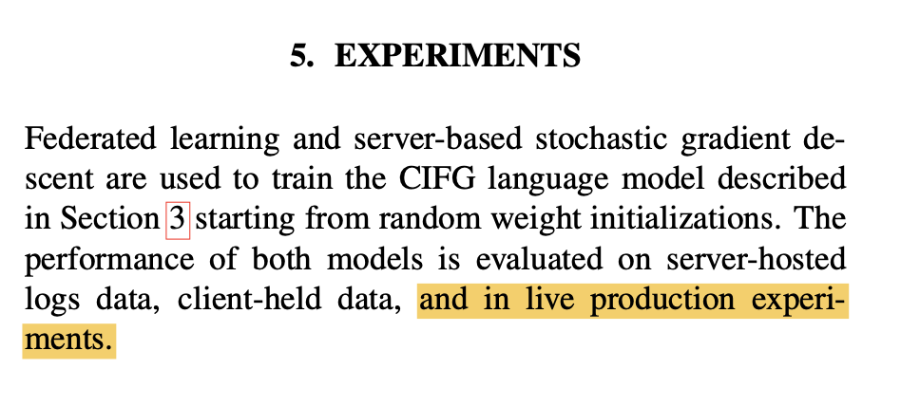
Federated Learning for Mobile Keyboard Prediction, Hard et al. 2018

Slide 64
More use cases
Finance - Fraud Detection
Health and Fitness Apps
HealthCare
Hospital Data Collaboration
Wearable Medical Devices
generally IoT

