Slide 1
I’ve tried various AI-based code writing tools so you don’t have to
Maks Operlejn | ML Engineer @ deepsense.ai
April 5th, 2024

Slide 2
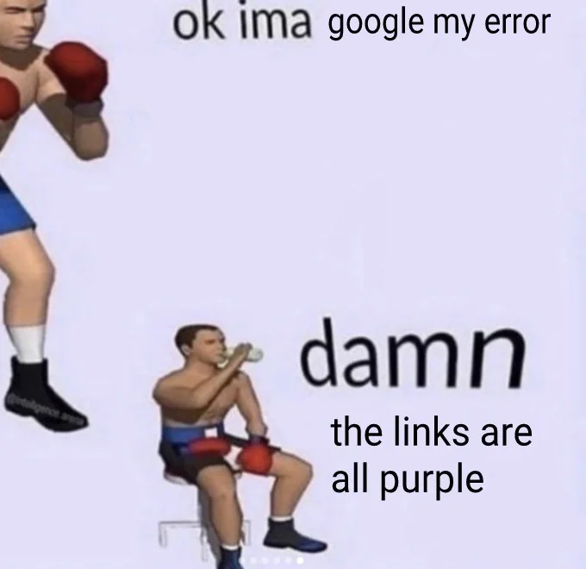
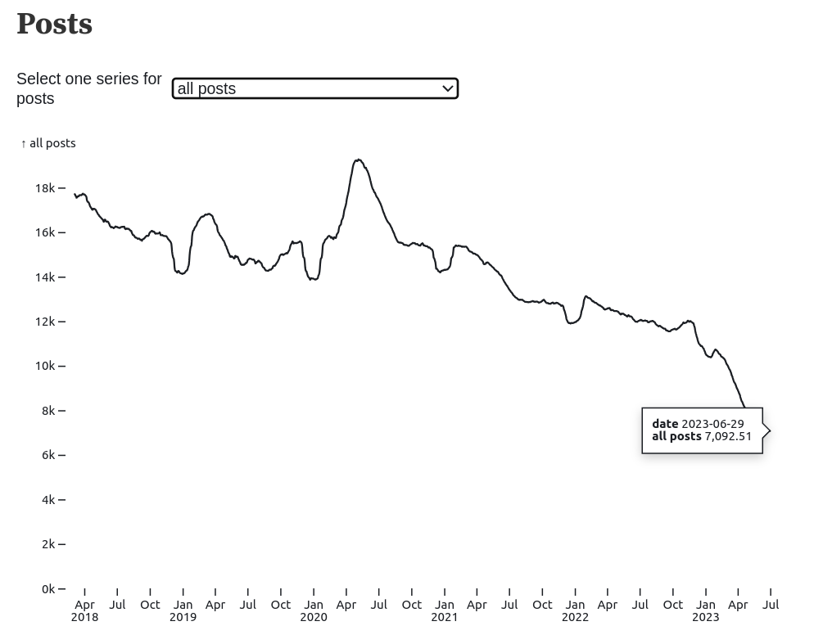
StackOverflow hegemony is over…
Source: https://www.reddit.com/r/ProgrammerHumor
https://observablehq.com/@ayhanfuat/the-fall-of-stack-overflow

Slide 3
GPT-4? It kinda sucks.
“I think it kinda sucks.”
Sam Altman, CEO of OpenAI on what are the most impressive capabilities of GPT-4.
Source: Lex Fridman Podcast

Slide 4
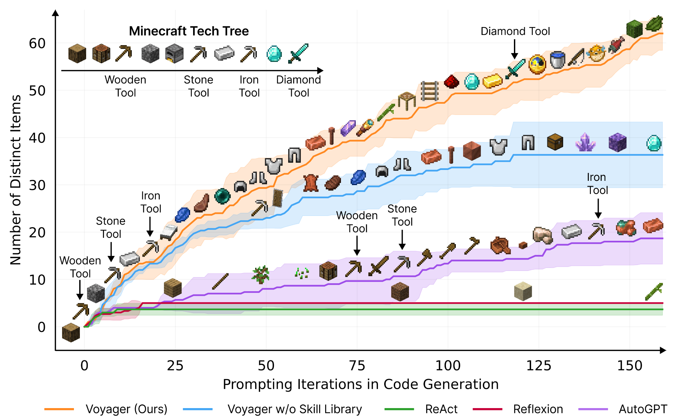
Voyager - great example of LLM Agent
Source: Wang et al., “VOYAGER: An Open-Ended Embodied Agent with Large Language Models”, 2024

Slide 5
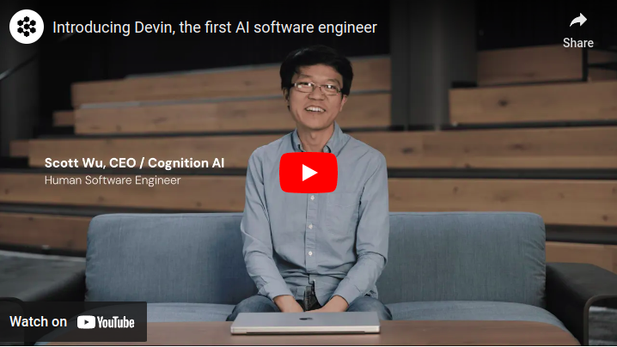
Devin will steal our job?
Source: https://www.cognition-labs.com/introducing-devin
Twitter/X

Slide 6
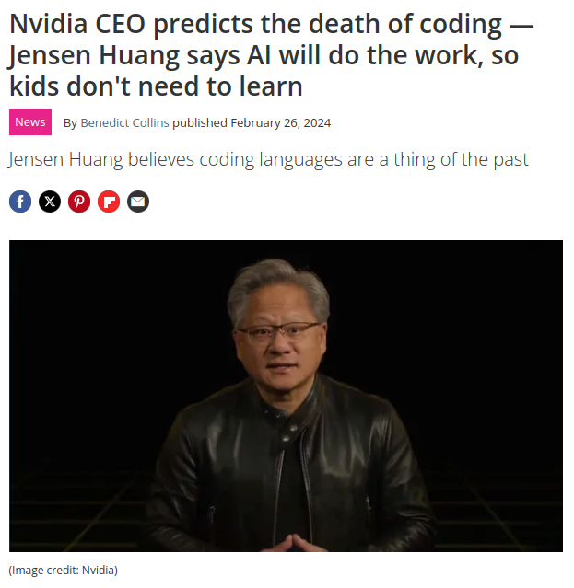
The death of coding!
Source: https://www.techradar.com

Slide 7
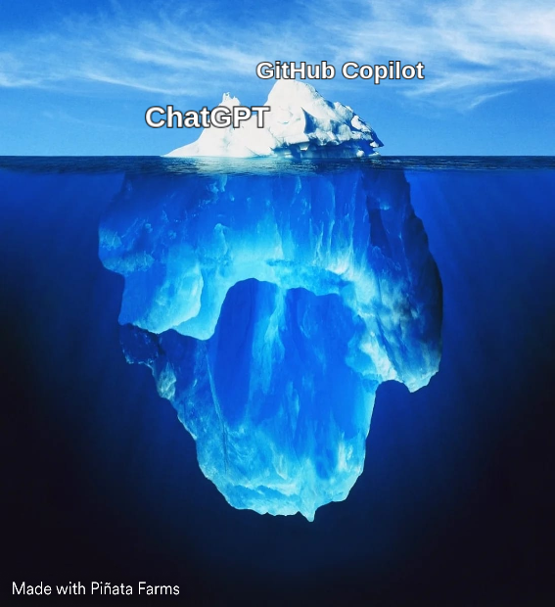
Code Writing Tools Iceberg
Source: https://www.pinatafarm.com/memegenerator

Slide 8
Introduction
Code completion tools
Coding support tools
Coding agents
Fundamentals and our approach
Literature (and industry) review
Conclusions and recommendations
Agenda

Slide 9
Code completion tools

Slide 10
GitHub Copilot
GitHub Copilot strengths and features:

Slide 11
GitHub Copilot
GitHub Copilot strengths and features:
Code completion (duh)

Slide 12
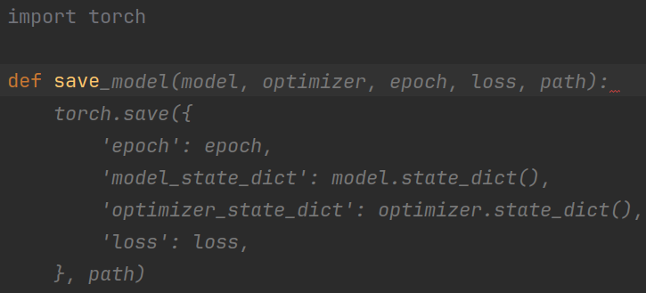
GitHub Copilot
GitHub Copilot strengths and features:
Code completion (duh)
Context-aware completion

Slide 13
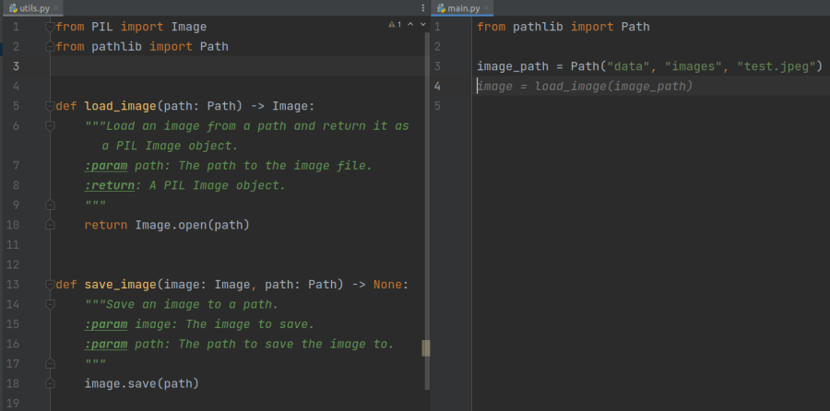
GitHub Copilot
GitHub Copilot strengths and features:
Code completion (duh)
Context-aware completion
Context from neighboring tabs

Slide 14
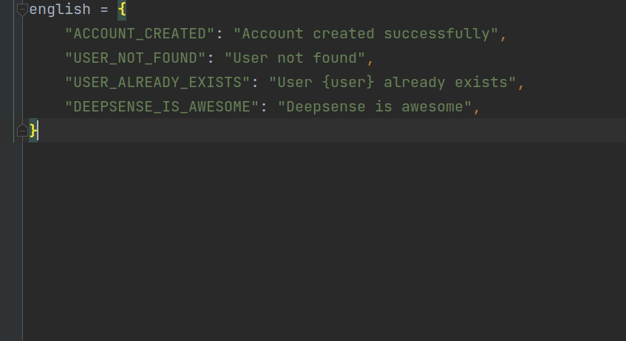
GitHub Copilot
GitHub Copilot strengths and features:
Code completion (duh)
Context-aware completion
Context from neighboring tabs
Great for docstrings, tests, repetitive and dull tasks (but not only)

Slide 15
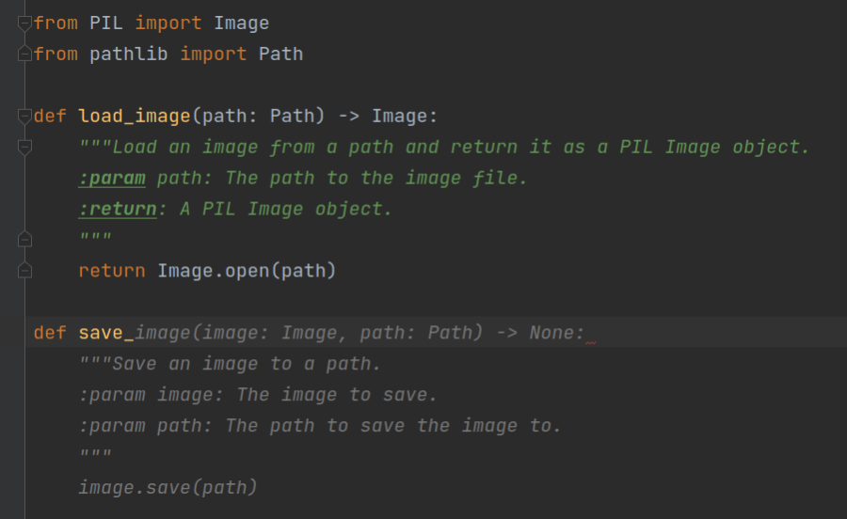
GitHub Copilot
GitHub Copilot strengths and features:
Code completion (duh)
Context-aware completion
Context from neighboring tabs
Great for docstrings, tests, repetitive and dull tasks (but not only)
Better coding practices = better completion

Slide 16
GitHub Copilot
GitHub Copilot strengths and features:
Code completion (duh)
Context-aware completion
Context from neighboring tabs
Great for docstrings, tests, repetitive and dull tasks (but not only)
Better coding practices = better completion
Better prompting = better completion
❌
✅

Slide 17
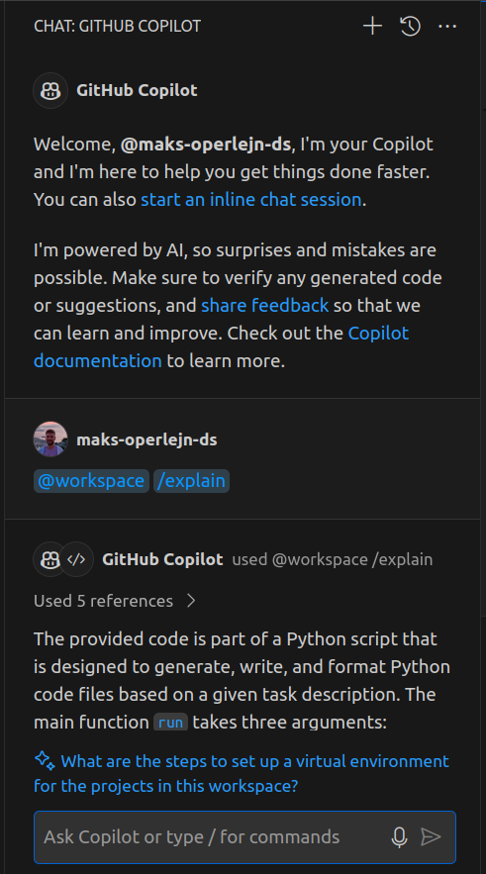
GitHub Copilot Chat
GitHub Copilot Chat is available for all users of Copilot!
Powered by GPT-4

Slide 18
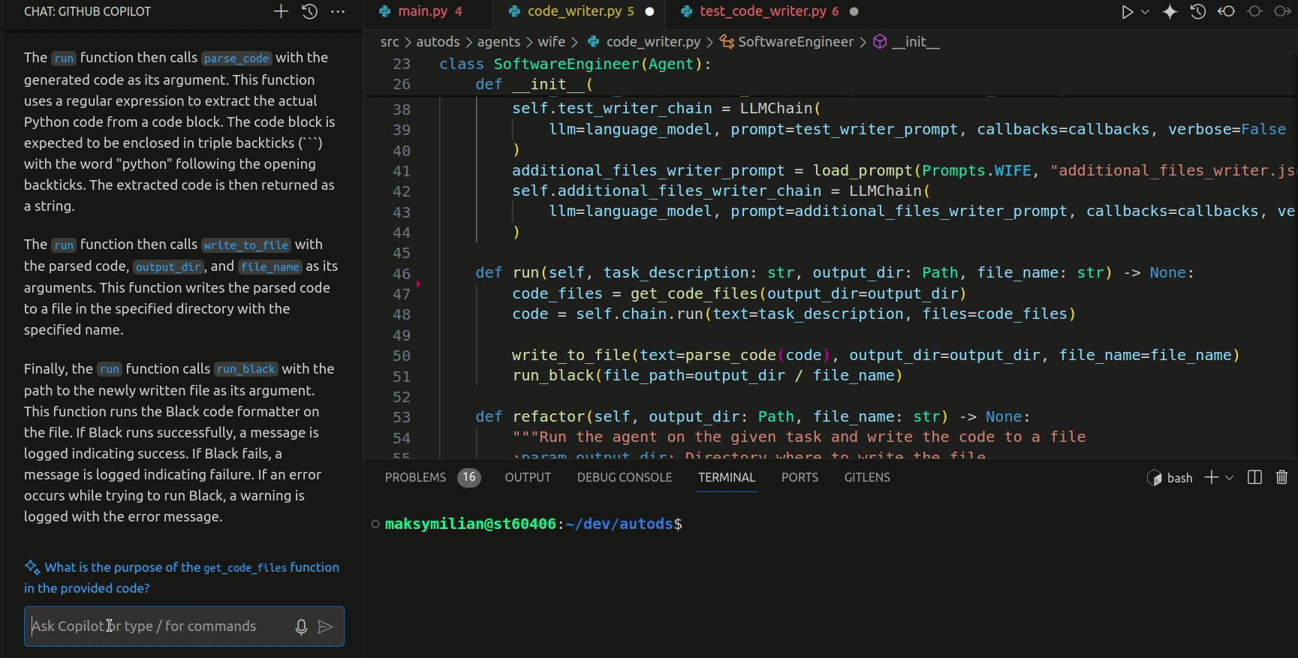
GitHub Copilot Chat
GitHub Copilot Chat is available for all users of Copilot!
Powered by GPT-4
Chat about your code

Slide 19
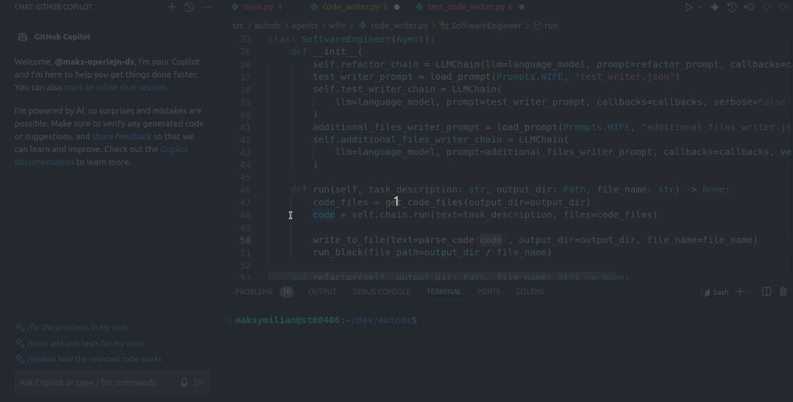
GitHub Copilot Chat
GitHub Copilot Chat is available for all users of Copilot!
Powered by GPT-4
Chat about your code
Many built-in commands - fix, explain, tests, simplify etc.

Slide 20
GitHub Copilot Chat
GitHub Copilot Chat is available for all users of Copilot!
Powered by GPT-4
Chat about your code
Many built-in commands - fix, explain, tests, simplify etc.
Inline Chat
built-in commands

Slide 21
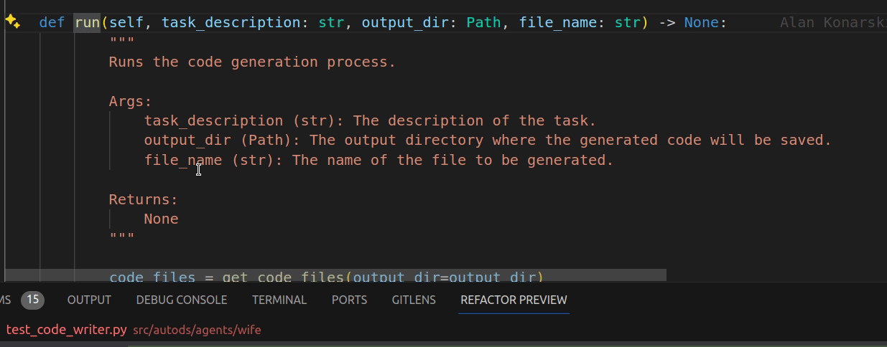
GitHub Copilot Chat
GitHub Copilot Chat is available for all users of Copilot!
Powered by GPT-4
Chat about your code
Many built-in commands - fix, explain, tests, simplify etc.
Inline Chat
built-in commands
own requests

Slide 22
Code completion tools
Code completion tools ecosystem:
GitHub Copilot
Codeium (free alternative)
Cursor (IDE based on VSCode)
Tabnine
AlphaCode 2 (not published but apparently really good)
Amazon CodeWhisperer
And probably maaaany more.
Source: Iconduck

Slide 23
Code completion tools
My opinion?
Code completion tools are getting better and better It will become a standard, so learn it.

Slide 24
Coding support tools

Slide 25
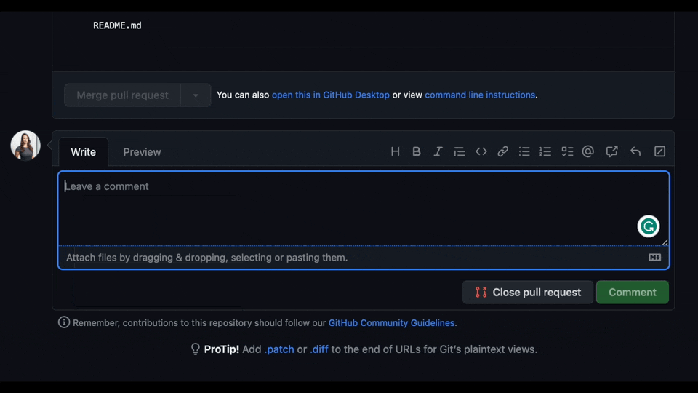
PR Agent
Tool for analysing your pull requests
Source: https://github.com/Codium-ai/pr-agent

Slide 26
PR Agent
Tool for analysing your pull requests
GitHub
GitLab
BitBucket
Azure DevOps
Even locally 😊
Source: https://github.com/Codium-ai/pr-agent

Slide 27
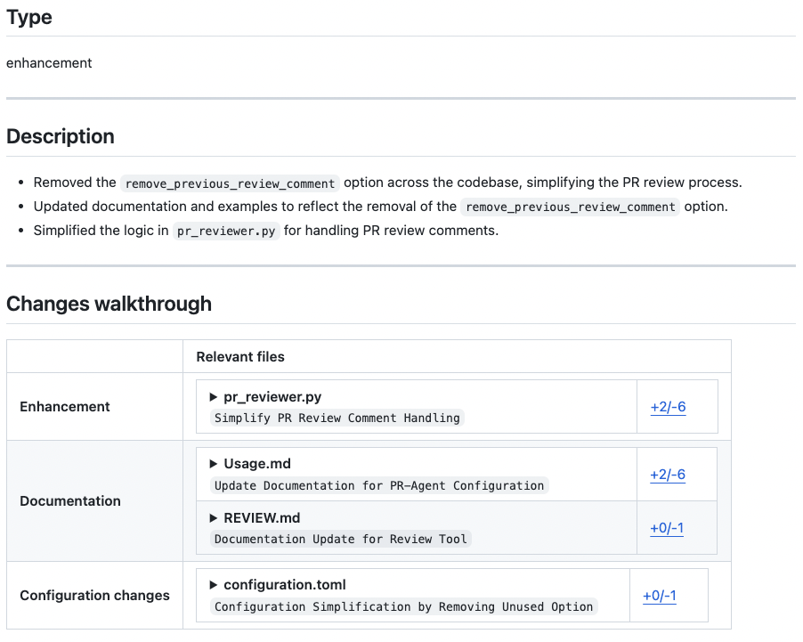
PR Agent
Tool for analysing your pull requests
/describe
Source: https://github.com/Codium-ai/pr-agent

Slide 28
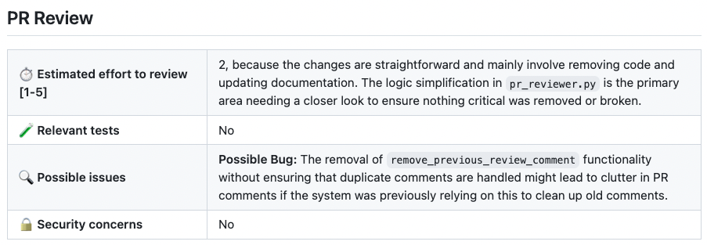
PR Agent
Tool for analysing your pull requests
/describe
/review
Source: https://github.com/Codium-ai/pr-agent

Slide 29
PR Agent
Tool for analysing your pull requests
/describe
/review
/improve
Source: https://github.com/Codium-ai/pr-agent

Slide 30
PR Agent
Tool for analysing your pull requests
/describe
/review
/improve
/generate_labels
Source: https://github.com/Codium-ai/pr-agent

Slide 31
PR Agent
Tool for analysing your pull requests
/describe
/review
/improve
/generate_labels
/add_docs
/update_changelog
/similar_issue
/check_ci_job
…
Source: https://github.com/Codium-ai/pr-agent

Slide 32
PR Agent
My opinion?
It is significantly worse than a good human code review... for now 😉
Source: https://github.com/Codium-ai/pr-agent

Slide 33
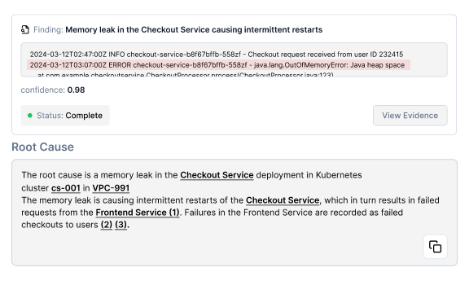
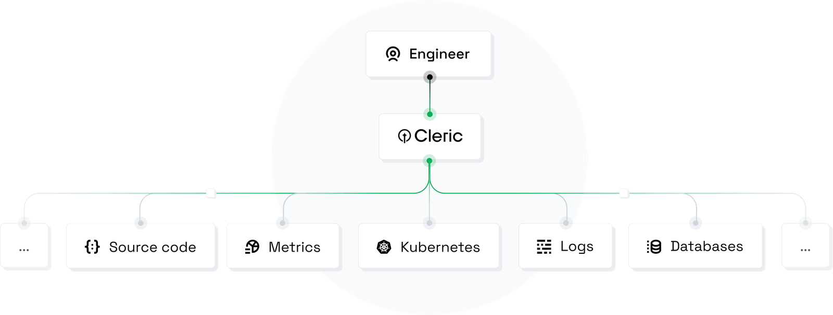
Cleric
AI site reliability engineer
Root cause alerts from production applications
Source: https://cleric.io/

Slide 34
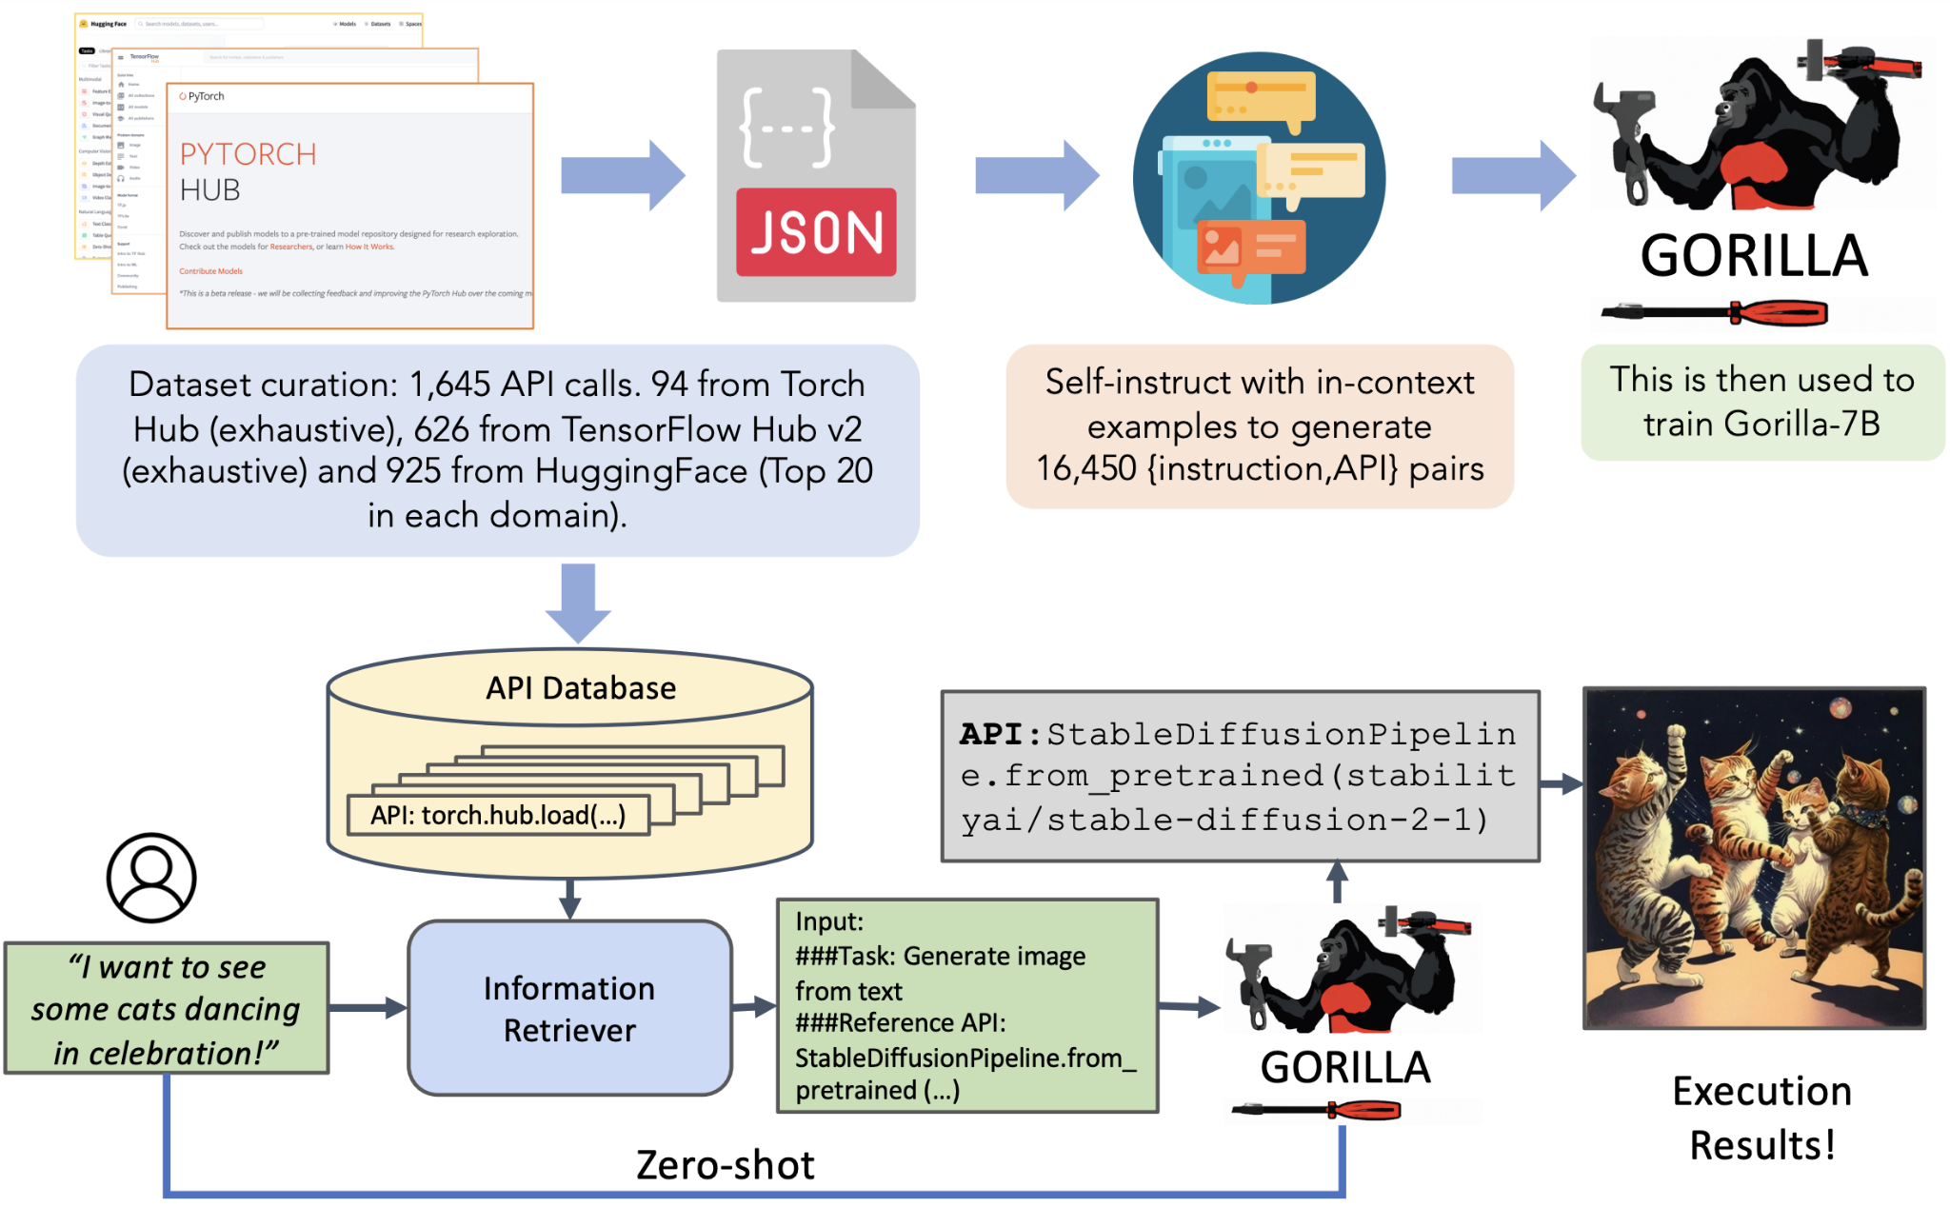
Gorilla - LLM for finding appropriate API calls
Source: https://github.com/ShishirPatil/gorilla

Slide 35
Coding agents
Fundamentals and our approach

Slide 36
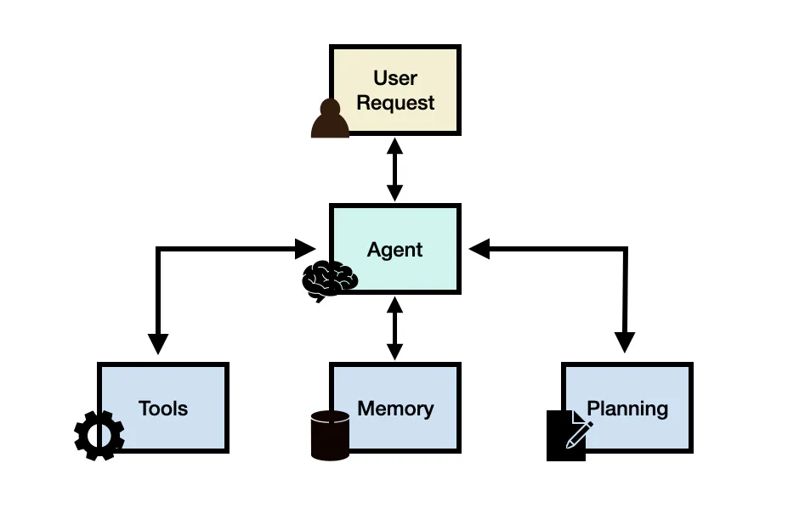
LLM Agents - fundamentals
LLM Agents usually contain these components:
User Request - A question or demand made by a user.
Agent Core - The central unit of the agent, serving as the coordinator.
Planning - Supports the agent in strategizing its upcoming actions.
Memory - Handles the agent's past actions.
Tools - enables interaction with external environments (Wikipedia, Google or other external APIs)
Often LLM Agent is just LLM in the loop
Source: https://www.promptingguide.ai/research/llm-agents

Slide 37
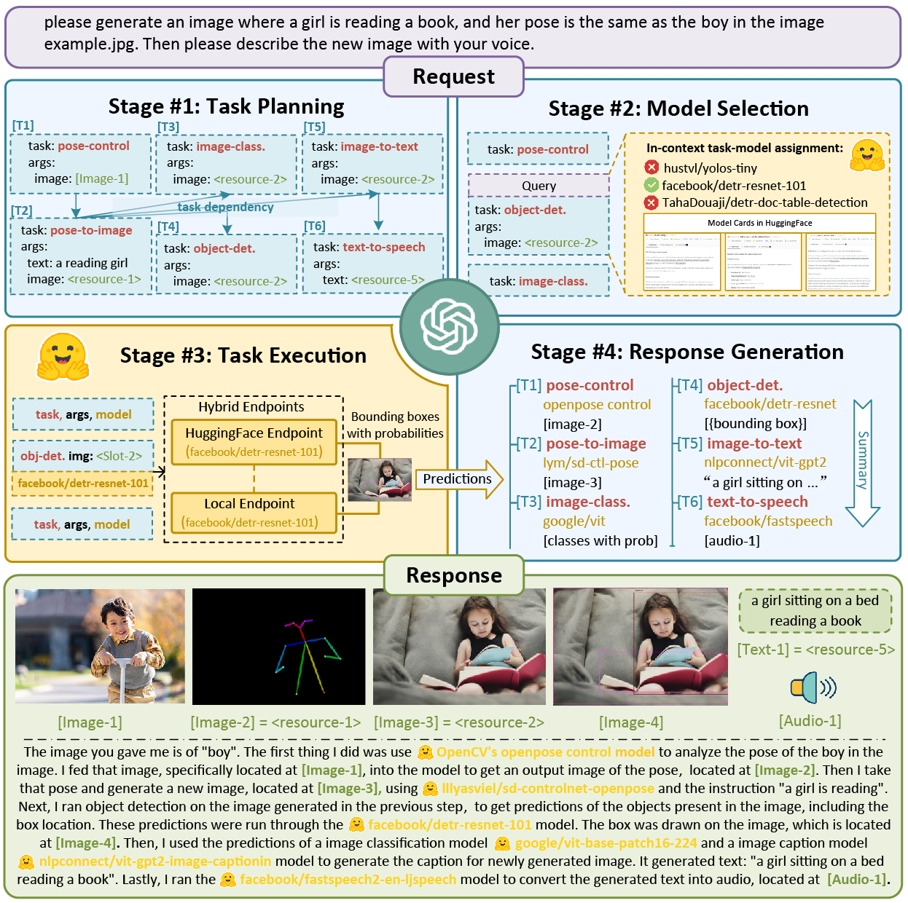
Jarvis / HuggingGPT - automate AI task for you
Source: https://github.com/microsoft/JARVIS

Slide 38
Our agent - Artificial Data Scientist
How far are we to automate professional Data Scientist?
We tested that on 7 projects such as:
detection of license plates in the image (CV)
text summarizer (NLP)
spotify genre classification (tabular)
Inputs:
a prompt with task description
a script to download a dataset
We created this agent during the last vacation season, almost a year ago - a lot has changed since then 😉

Slide 39
Our agent - Artificial Data Scientist
User specifies the main objective “Create an image classifier…”

Slide 40
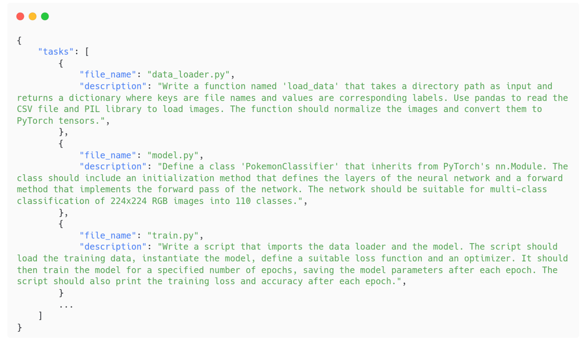
Our agent - Artificial Data Scientist
Planner Agent Create a plan in JSON format

Slide 41
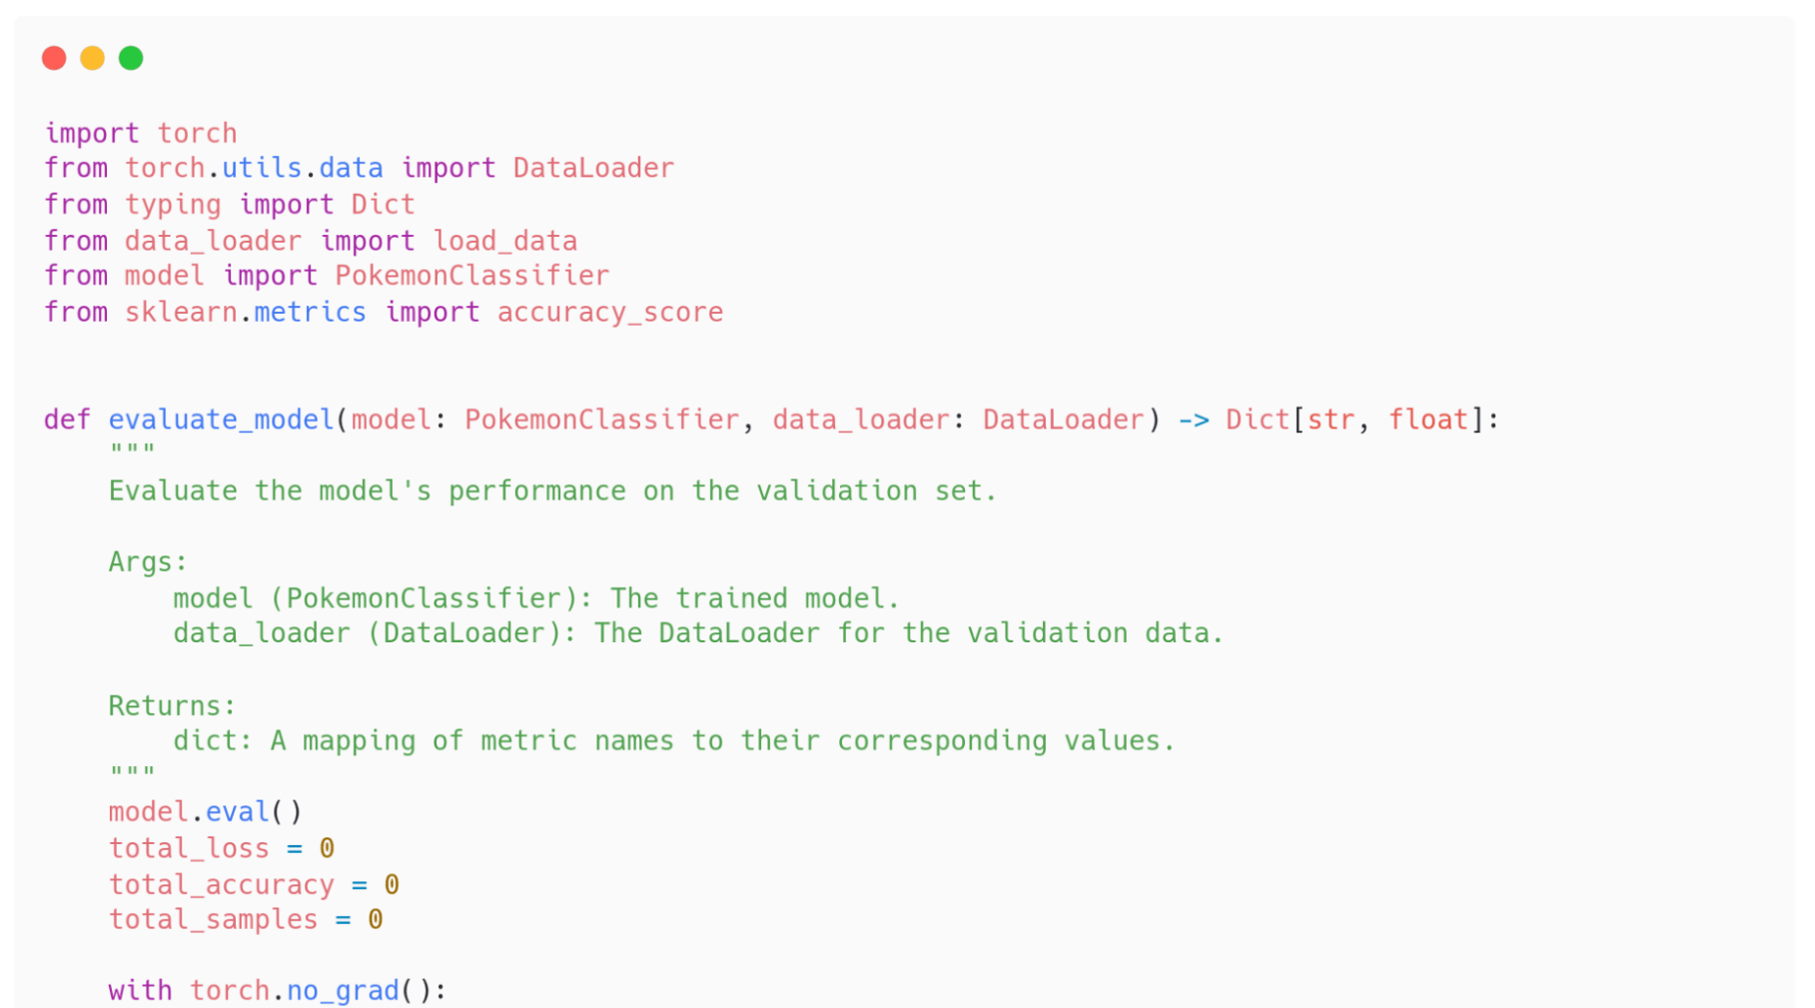
Our agent - Artificial Data Scientist
Code Writer Agent Enhanced code writing (based on context)

Slide 42
Our agent - Artificial Data Scientist
Code Refactorer Agent
Maybe some part of the code is repeated?
Maybe some imports are unused?
Maybe bad practices are seen?

Slide 43
Our agent - Artificial Data Scientist
Test Writer Agent Code coverage

Slide 44
Our agent - Artificial Data Scientist
Additional Files Writer Agent
requirements.txt
README.md
…

Slide 45
Our agent - Artificial Data Scientist
Results and insights:
Not bad, not really good
The code looks tutorial-based rather than production-ready
Non-deterministic results - sometimes it worked, sometimes it didn't
GPT-4 is sooo much better than GPT-3.5
Your agent is as good as your prompts

Slide 46
Our agent - Artificial Data Scientist
What would we add with more time?
Human-feedback loop
Code execution
Test Driven Development
Self-reflection loop (based on agent’s own mistakes)
Test out different models (we tested out GPT-3.5, GPT-4 and Claude 2)
Integrate more tools (web searching, API integration)

Slide 47
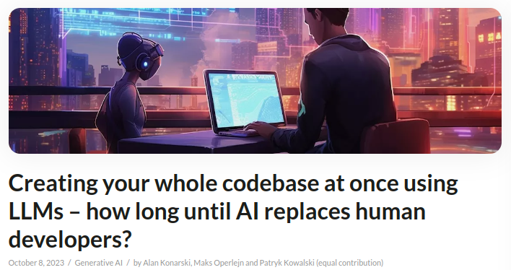
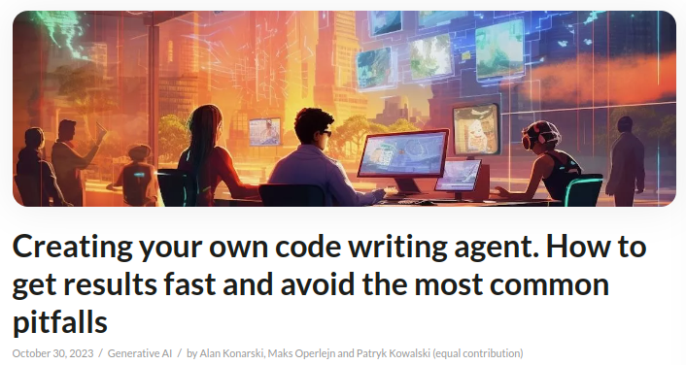
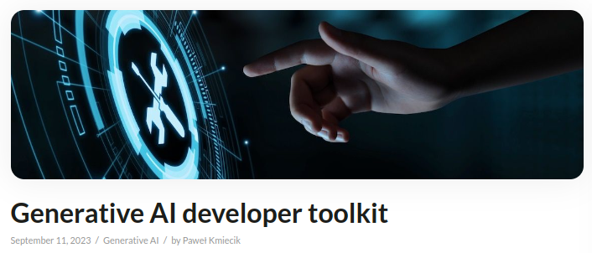
If you want to know more
Source: https://deepsense.ai/blog/

Slide 48
Coding agents
Literature (and industry) review

Slide 49
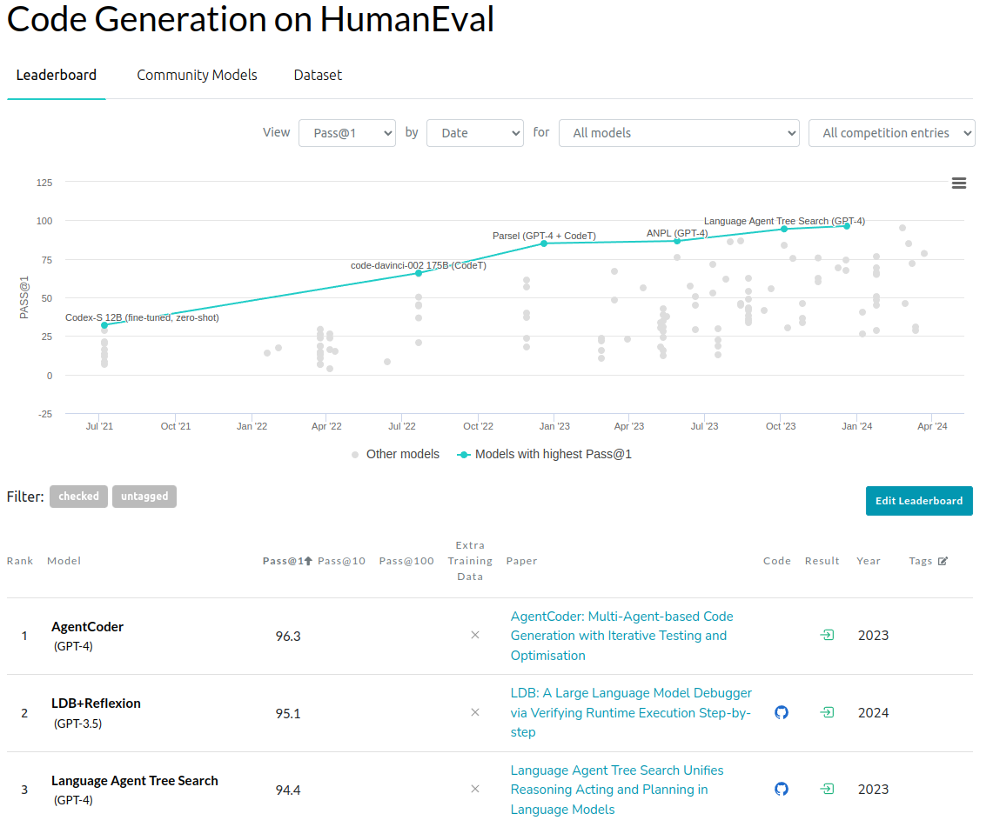
HumanEval Code Generation benchmark
Source: https://paperswithcode.com/sota/code-generation-on-humaneval

Slide 50
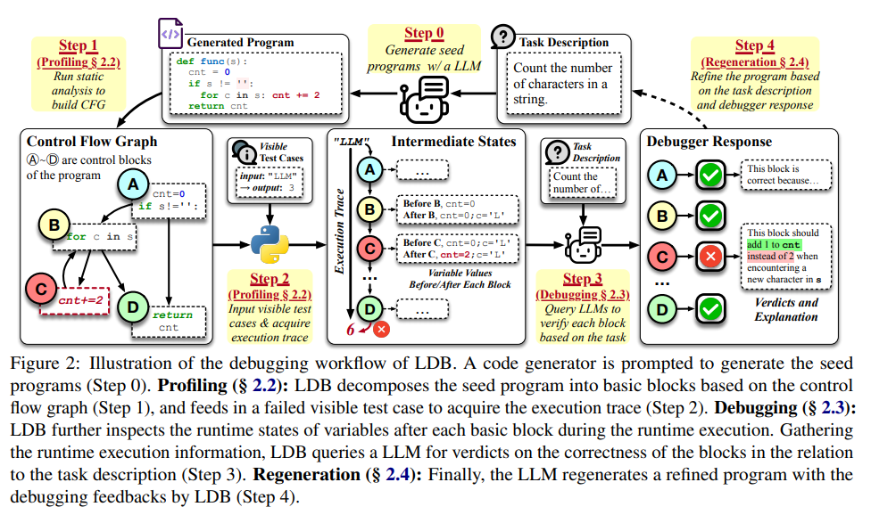
LDB: A Large Language Model Debugger via Verifying Runtime Execution Step by Step
Source: Zhong et al., “LDB: A Large Language Model Debugger via Verifying Runtime Execution Step by Step”, 2024

Slide 51
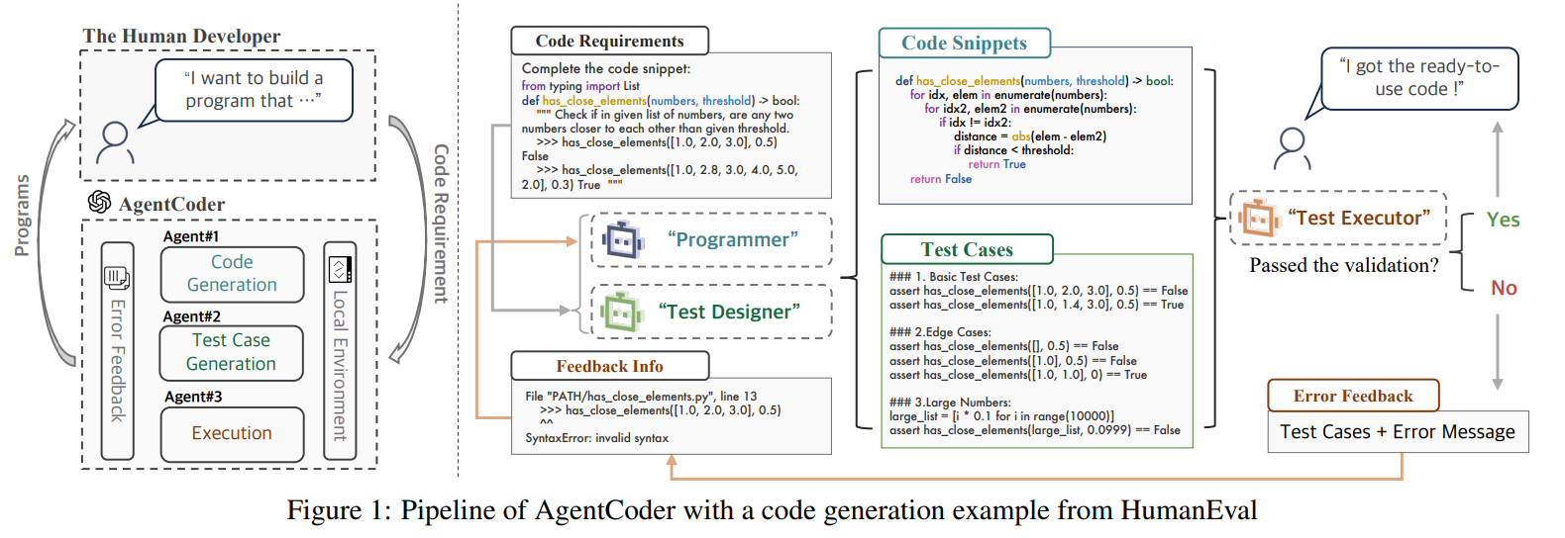
AgentCoder: Multiagent-Code Generation with Iterative Testing and Optimisation
Source: Huang et al., “AgentCoder: Multiagent-Code Generation with Iterative Testing and Optimisation”, 2024

Slide 52
GPT-Engineer
Similar to our solution: consists of planning, writing code and testing it in the loop
Asks questions for clarification
Generates documentation
Tries to execute the code
Source: https://github.com/gpt-engineer-org/gpt-engineer

Slide 53
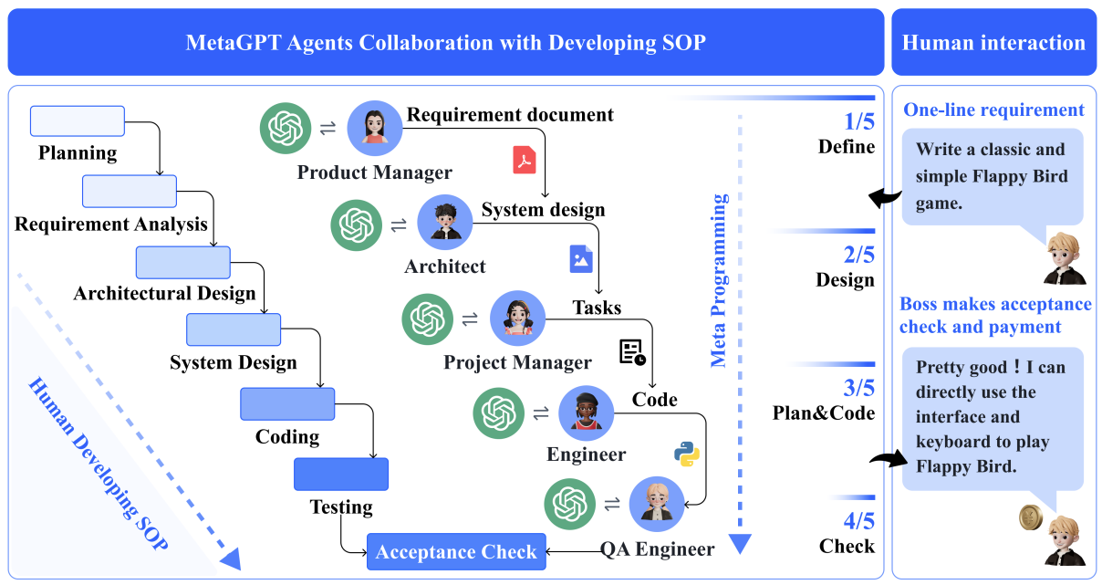
MetaGPT
Source: Hong et al., “MetaGPT: Meta Programming for Multi-Agent Collaborative Framework”, 2023

Slide 54
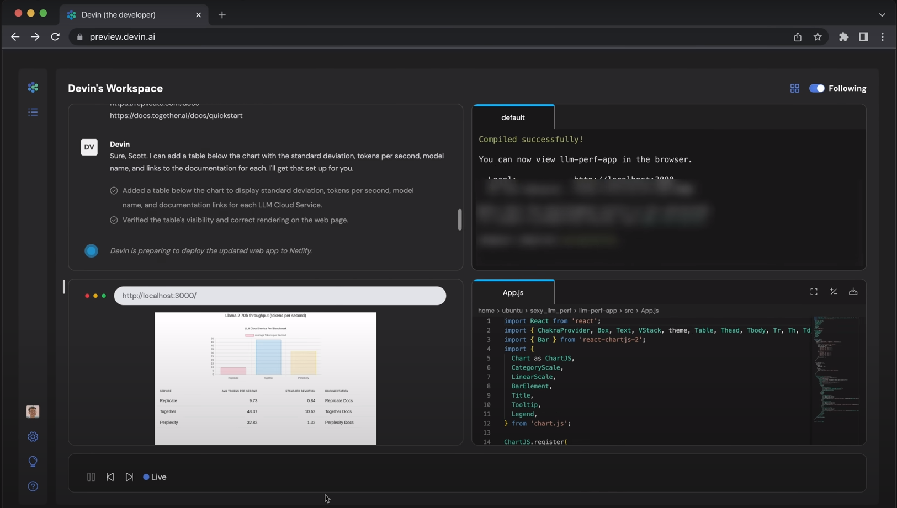
Devin
Source: https://www.cognition-labs.com/introducing-devin

Slide 55
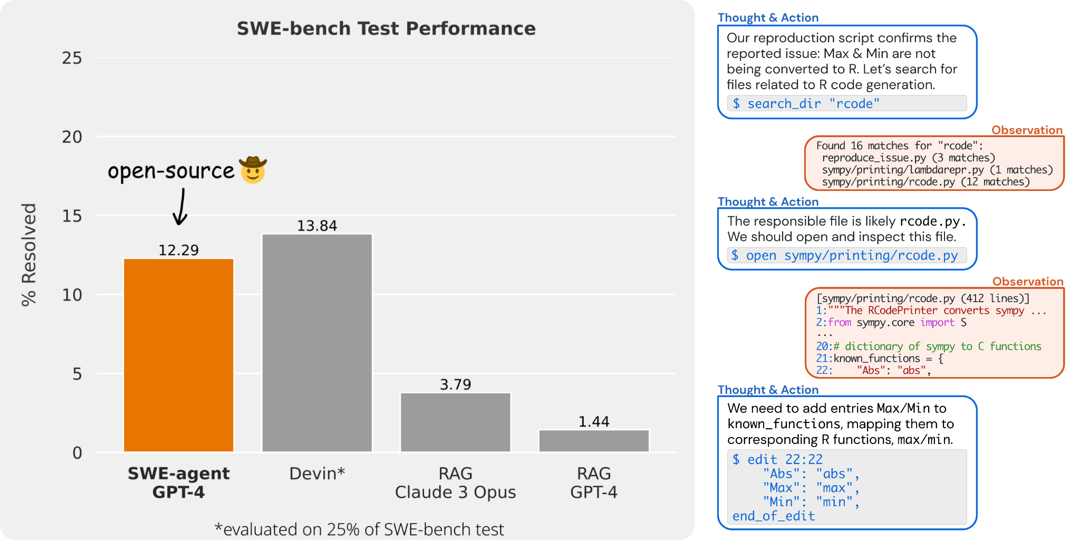
SWE-agent
Source: https://github.com/princeton-nlp/swe-agent

Slide 56
Coding Agents
My opinion?
For now, it only looks good on demos It’s good if you want to create a copy of Flappy Bird 🐦
But it will change sooner or later…
Source: https://github.com/Codium-ai/pr-agent

Slide 57
Conclusions
My personal insights:
In-editor code completion tools will become a standard. Learn to use them now.
It's hard to find gems in this mess of AI-based coding tools, but it is certainly possible! Example: PR Agent
Coding agents are great for solving small, complex cases, but struggle with simpler tasks in huge repositories.
It's worth keeping up to date so you don't get left behind 😉

Slide 58
Conclusions

Slide 59
Thanks for listening!
I am more than happy to connect!
Maksymilian Operlejn
maksymilian.operlejn@deepsense.ai
maks.operlejn@gmail.com

