Slide 1


Adversarial Machine Learning Model Vulnerabilities and Robustness
Alessandro Ortis, PhD

Slide 2









IPlab@UNICT
Core Competences: Computer Vision and Multimedia
Overall Team (~20 – Lead by Prof. Sebastiano Battiato)
Results: >30 patents, >400 papers
Applications to:
  Multimedia Forensics and Security
  EgoCentric Vision
  Cultural Heritage
  Social Media Mining
R&D projects:
  STM (Catania, Grenoble): Joint R&D lab (since 2007), Ph.D. (>10), grants (>10)
  Funded projects: ENIAC (1), PO/FESR (4), MISE HZ2020(1), other (4)
International Events: ICVSS (since 2007), MISS (since 2014) ICIAP 2017, ACIVS 2015, VISAPP
4 Full Professors
4 assistant PROFESSORS
4 RESEARCH FELLOWS
4 POST Docs
>15 PhD students
http://iplab.dmi.unict.it
Notes:
IPLAB’s research focuses in the areas of Image Processing, Computer Vision, Machine Learning and Computer Graphics. We’re involved in different research projects with national and international funding. We have several collaborations with companies and IT industries as well as joint research laboratories, a few of them are shown on this slide.

Slide 3



Sicily – July 2024
Third Edition!
https://www.ifoss.it/
Notes:
This year we’re also organizing the third edition of the international forensics summer school which will take place in sicily in late july. The International Forensics Summer School aims to provide a clear overview of the state-of-the-art research as well as the professional best practices in Forensics and related fields. The courses are delivered by world renowned experts, from either academia, law enforces and industry covering both theoretical and practical aspects of real Forensics problems. The school started in 2022 and its third edition will take place on July 2024 in Sicily.

Slide 4
Outline
Artificial Neural Networks Learning Aspects
Adversarial Machine Learning
Notes:
In this first part I will talk about Deep Learning and in particular about GAN. The second part focuses on deep fakes and adversarial ML which are currently hot topics in the field.

Slide 5
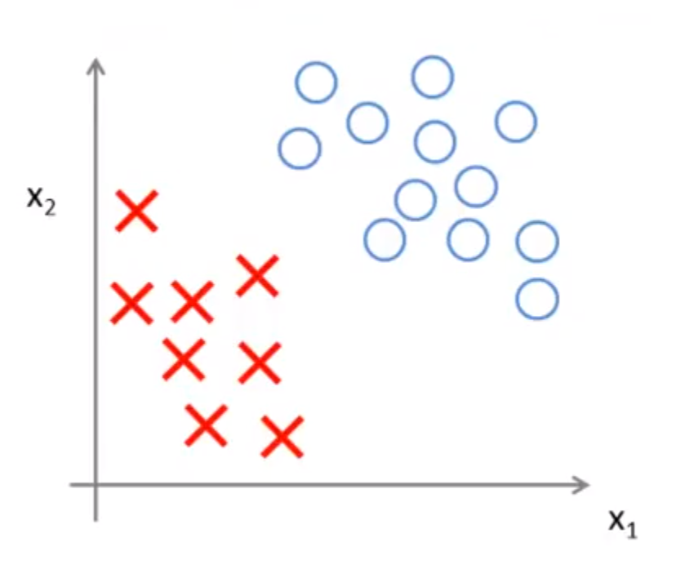
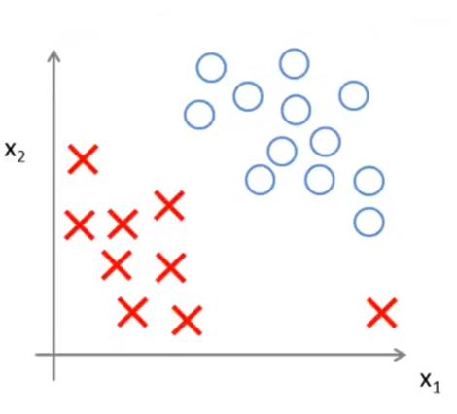
Classification
Notes:
Classification is the main task in machine learning. Basically we have 2 or more classes and want to find a function which is able to distinguish, in some space, elements of one class from the others.
On the left we have what we call ‘’separable data’’, and there are multiple solutions to the problem. When data are not separable, we start to find out some tricks: complex functions, non linear functions, feature transformation, feature learning. In general we can either transform the data to make them separable or use a more complex discrimination function to better fit the data. In any way, we can also accommodate some errors on training data.
In general any model we train for this task only defines an approximation of the real decision boundary based just on the information provided by the training data. Indeed in the second case the number of possible solution is limited by only one example that has been shifted, dec. boundary is driven by training data.

Slide 6
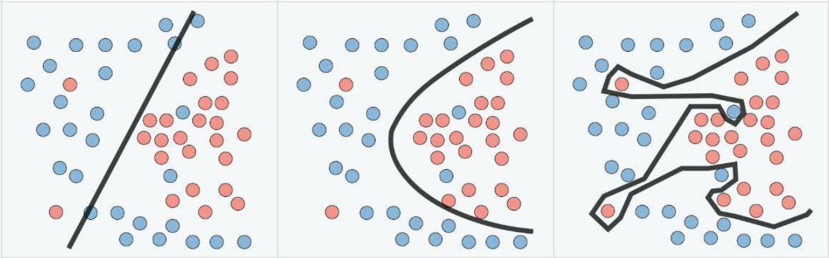
Overfitting
Underfitting
Overfitting
generalization
accuracy
Notes:
Another problem to deal with is the trade-off between generalization and accuracy. The model should be enough accurate on training data but also able to generalize to new examples.
Left: simple but makes several errors
Right: doesn’t make errors but is unable to generalize

Slide 7
2D Convolution
CNNs learn the convolution parameters (i.e., kernel values) which extract meaning features from the (training) data.
Deep Learning is representation learning.
Notes:
Convolutional layers are the major building blocks used in convolutional neural networks. A convolution is the simple application of a filter to an input that results in an activation.
The innovation of convolutional neural networks is the ability to automatically learn a large number of filters (specific to a training dataset) under the constraints of a given predictive modeling problem, such as image classification. The result is the definition of highly specific features that can be detected anywhere on input images.

Slide 8
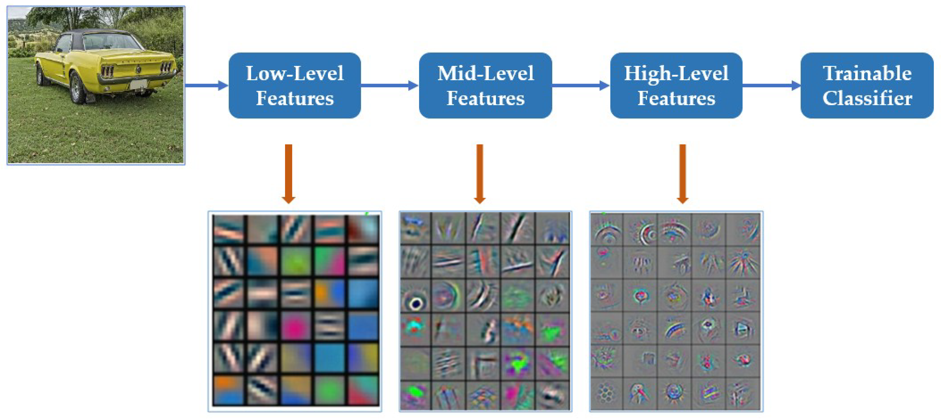
Convolutional Neural Networks
CNNs perform lots of complex feature space mappings in order to make data “more separable”.
Notes:
The features learned in the first layers are very basic, such as blobs and edges. As well as we go deeper in the architecture the features represent more semantic information.
A DNN performs several feature transformation applying convolutions and not linear transformations in order to learn a final meaningful representation of the input.

Slide 9
Generative Adversarial Networks (GANs)
GANs are Neural Networks able to generate outputs (e.g. a picture of a human face) that appear to be a sample from the distribution of the training set (e.g. set of other human faces).
Applications:
Data augmentation
Create photorealistic images.
Generate images from descriptions (text to image synthesis).
Improve the resolution (low-resolution to high-resolution).
Voice translation.
Notes:
One of the most important model in deep learning is represented by generative adversarial networks or GAN
GANs are neural networks able to generate data from a training distribution. Application examples are data augmentation, photorealistic image generation and image translations, among others.

Slide 10
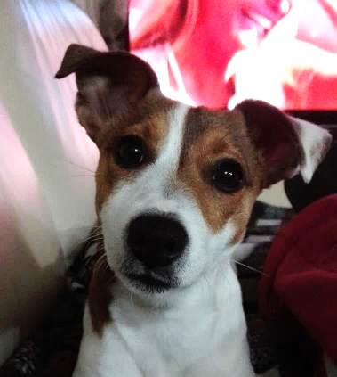
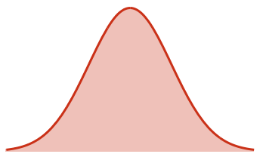
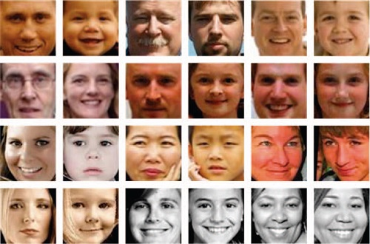
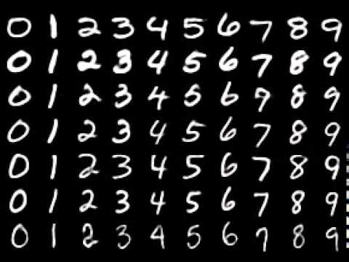
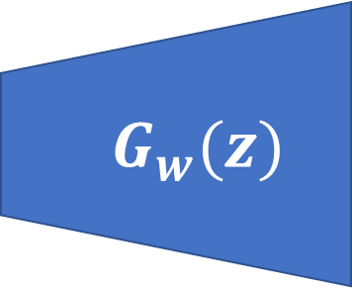
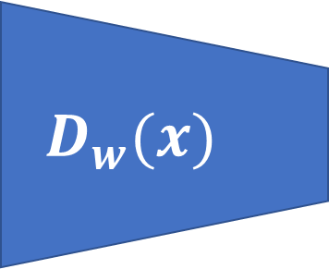
Generative vs. Discriminative models
Discriminative models
‘’dogs’’
$$D_{w}(x)$$
x
‘’dog’’
‘cats’’
Target distribution
Generative models
$$G_{w}(z)$$
z
G(z)
Uniform/Gaussian
distribution
Notes:
A GAN is the combination of a discriminative and a generative model.
A discriminative model project the input to a feature space in which a decision bundary function separates examples of the different classes.
A generative model generates samples of a given target distribution by passing a random noise as input.

Slide 11
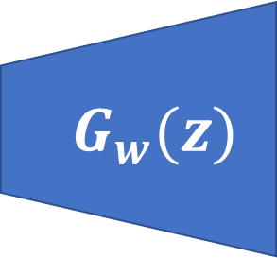
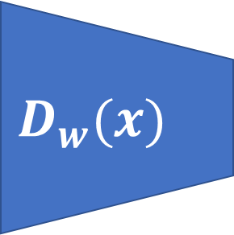
Generative Adversarial Networks
Target distribution
x
p_{data}(x)
$$D_{w}(x)$$
sample
Real or Fake
(1 or 0)
$$G_{w}(z)$$
z
p(z)
x = G(z)
Notes:
In GAN, generative ad discriminative models are combined and trained simultaneously.
G tries to generate data of the target distribution.
D tries to distinguish genuine examples than generated ones.

Slide 12
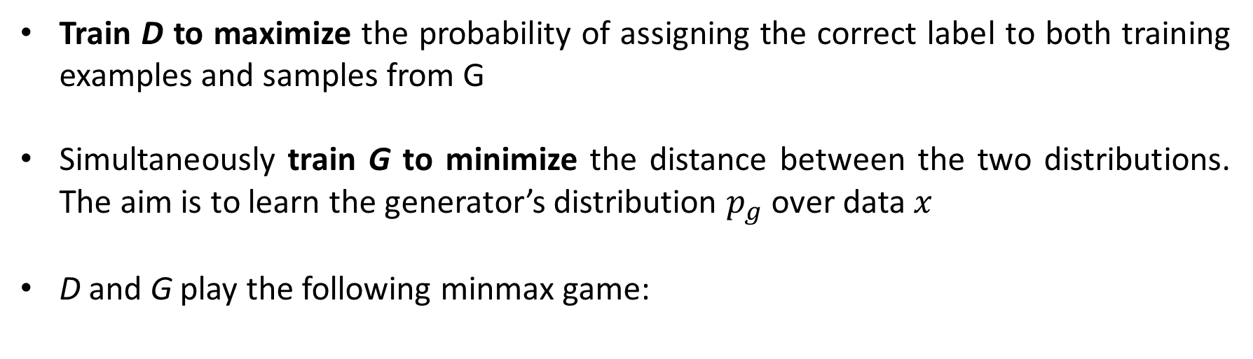
Generative Adversarial Networks
Train D to maximize the probability of assigning the correct label to both training examples and samples from G
Simultaneously train G to minimize the distance between the two distributions. The aim is to learn the generator’s distribution $p_{g}$ over data $x$
D and G play the following minmax game:
Recognize real images better
Recognize generated images better
Optimize G that can fool the discriminator the most
Notes:
In terms of probability..
D tries to maximize the prob. To correctly classify the examples
G tries to maximize the prob. Of D making a mistake.
This is the objective function of a GAN.

Slide 13
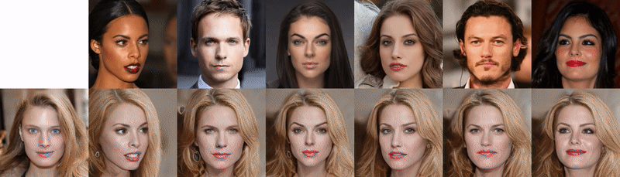
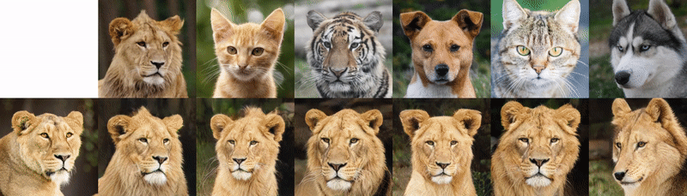
StarGANv2 – Multiple domains translation
Source (identity)
Reference
(gender & style)
Source (pose)
Reference
(breed & style)
Y. Choi et al., StarGAN v2: Diverse Image Synthesis for Multiple Domains – CVPR 2020
Notes:
StarGAN v2 provides a fine-grained selection of the feats. To be transferred/preserved (identity gender pose breed..)
Instead of the label (class), G is conditioned by a domain specific style code that can represent diverse styles of a specific domain.
Example: source is preserved, reference is what is transferred

Slide 14
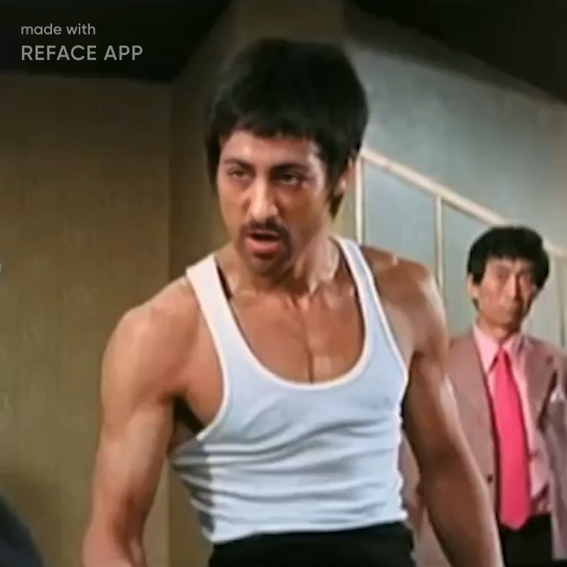
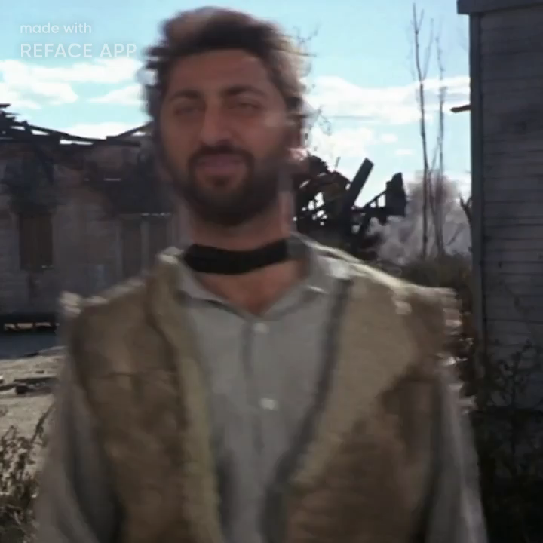


Why deepfakes are a problem
Easy to access
Easy to master
Inexpensive
Scalable
Often the quality is very high...

Slide 15
Adversarial Machine Learning

Slide 16
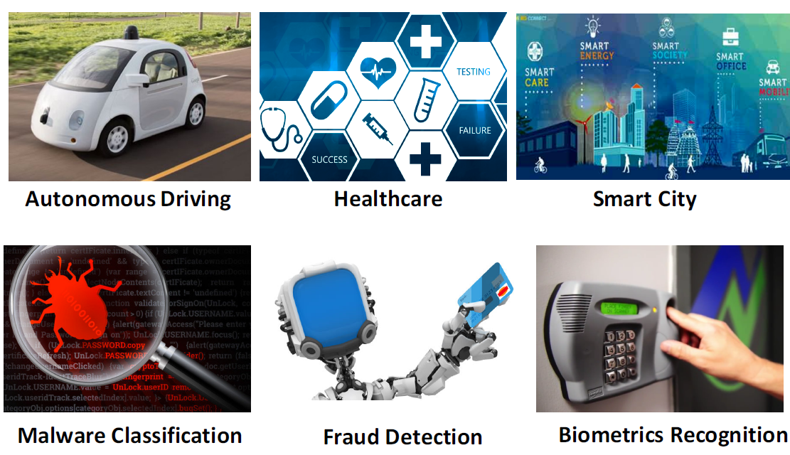
The Success of Machine Learning!
Credits: Bo Li, Secure Learning in Adversarial Deep Neural Networks
Notes:
advances in AI have shown impressive performances in several application domains …

Slide 17
The Success of Machine Learning!
Can we trust ML for
real-world deployment?
Notes:
… but are we ready to trust such methods for real world deployment ?

Slide 18
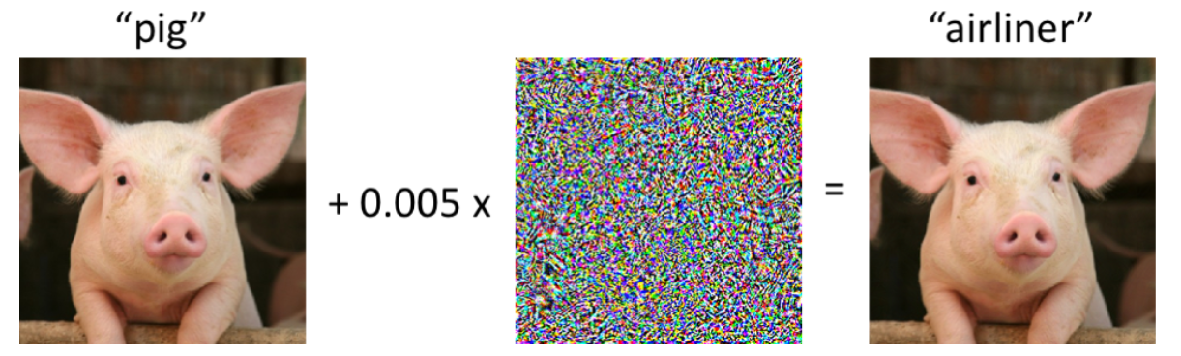
The Success of Machine Learning!
Can we trust ML for
real-world deployment?
“pig”
“dog”
Credits: Z. Kolter, A. Mądry- Adversarial Robustness: Theory and Practice
Notes:
Consider this example: by adding an iperceptible noise is possible to drive the classification of a DNN to a wrong class.

Slide 19
Adversarial Machine Learning
Adversarial machine learning is a series of techniques that aim to undermine machine learning performances, through the definition of special inputs (adversarial examples) that an attacker has intentionally designed to cause the model to make a mistake.
“pig”
“dog”
Credits: Z. Kolter, A. Mądry- Adversarial Robustness: Theory and Practice
Notes:
Adversarial examples are modified inputs crafted to force a model to classify them in a wrong class. Over the past few years, adversarial examples have received a significant amount of attention in the deep learning community. As we seek to deploy machine learning systems not only on virtual domains, but also in real systems, it becomes critical that we examine not only whether the systems don’t simply work “most of the time”, but which are truly robust and reliable. One particular topic in this area that has raised a great deal of interest in recent years is that of adversarial robustness: can we develop classifiers that are robust to (test time) perturbations of their inputs, by an adversary intent on fooling the classifier?

Slide 20
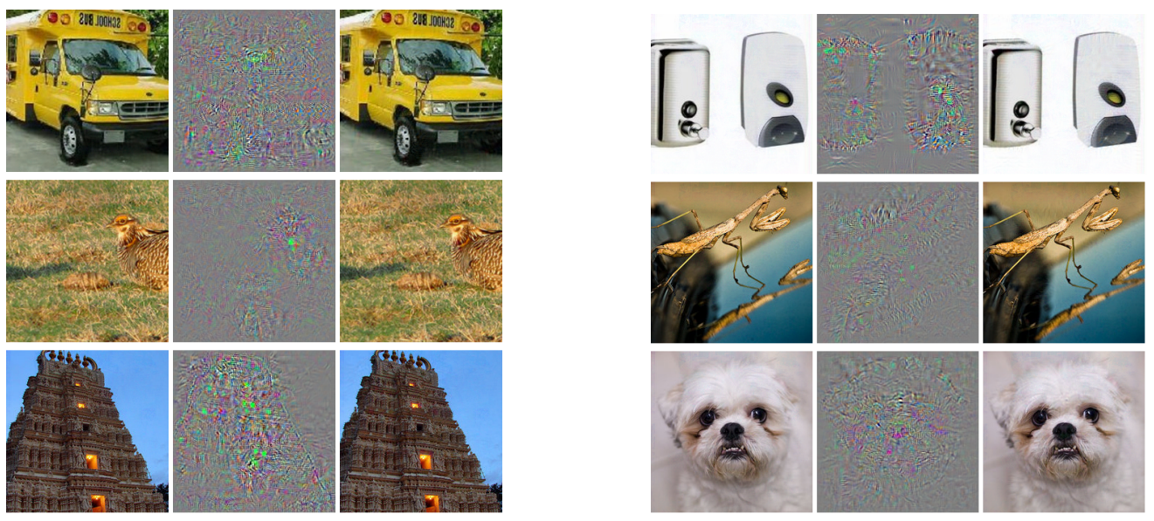
Adversarial Machine Learning
Szegedy et al. first discovered that well-performing deep neural networks are susceptible to adversarial attacks.
All images in the right column are predicted to be an “ostrich”.
original
difference
adverarial example
original
difference
adverarial example
Szegedy, Christian, et al. "Intriguing properties of neural networks." arXiv preprint arXiv:1312.6199 (2013).

Slide 21
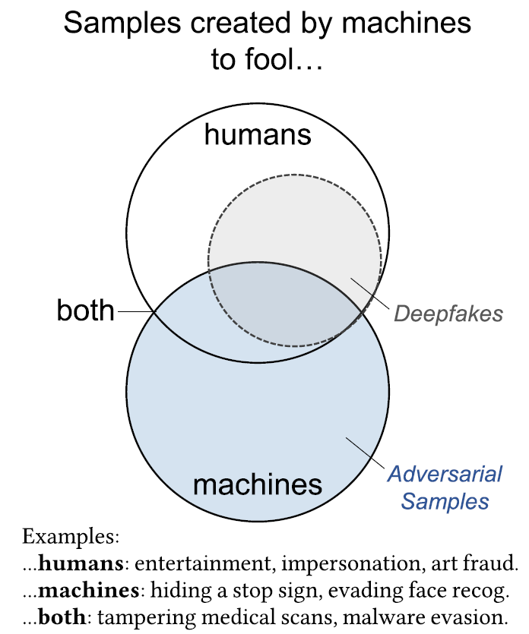
Adversarial Machine Learning
Deepfakes vs. Adversarial Machine Learning
In Adversarial Machine Learning the objective of the generated content is to fool a machine (i.e., an algorithm) and not a human.
Notes:
The difference between DF and AML: in AML the objective is to fool a machine, in DF the objective is to fool a human.

Slide 22
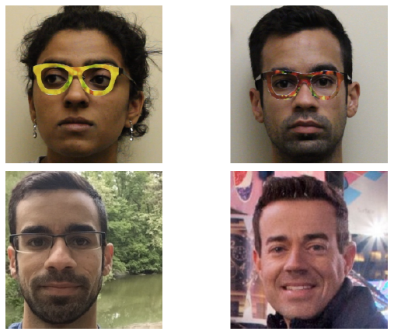
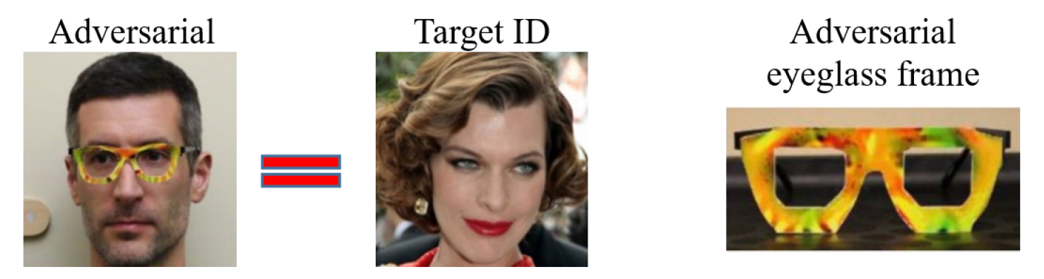
Adversarial Machine Learning
Glasses that fool face recognition
Sharif, Mahmood, et al. "Accessorize to a crime: Real and stealthy attacks on state-of-the-art face recognition." 2016.
Notes:
In this case, the authors found specific patterns to fool a face recognition system by just wearing eyeglasses reproducing that pattern. This shows how can be very easy to fool a neural network.

Slide 23
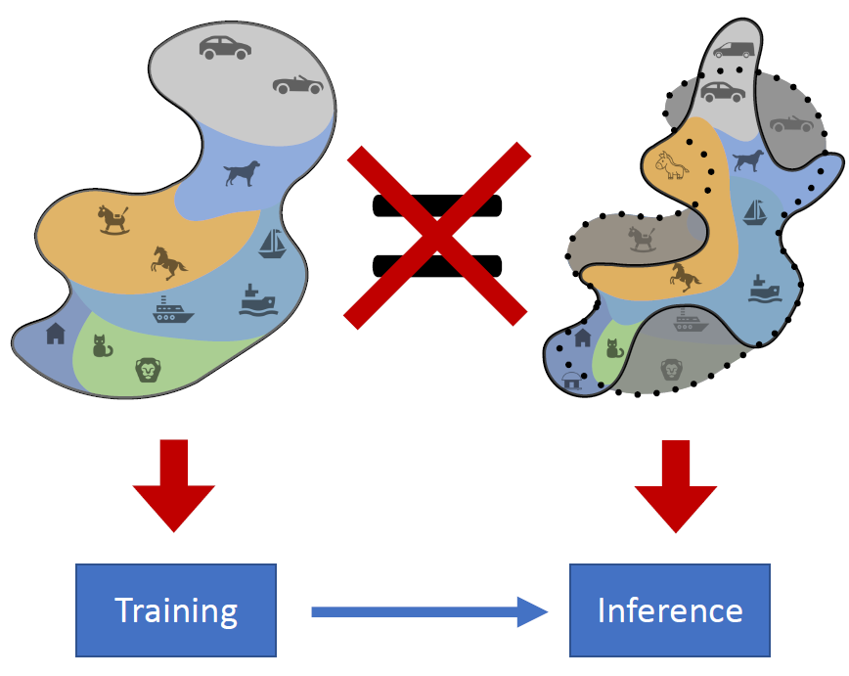
Adversarial Machine Learning
Real
Train
Test
Distributions we use ML on are NOT the ones we train it on!
Any model defines an approximation of the real distribution, based only on the knowledge provided by training data.
Credits: Z. Kolter, A. Mądry- Adversarial Robustness: Theory and Practice
Notes:
But how can this happen ? And why ? Traditional machine learning approaches assume that training data and inference data belongs to the same distribution, but this is not true.. Moreover, both train and test data often times can’t represent the real distribution which is unknown.

Slide 24
Adversarial Machine Learning
DNNs are powerful because their many layers mean they can pick up on patterns in many different features of an input when attempting to classify it.
But this also means that a very small change in the input can tip it over into what the model considers an apparently different state.
The types of perturbations applied in adversarial attacks depend on the target data type and desired effect.

Slide 25
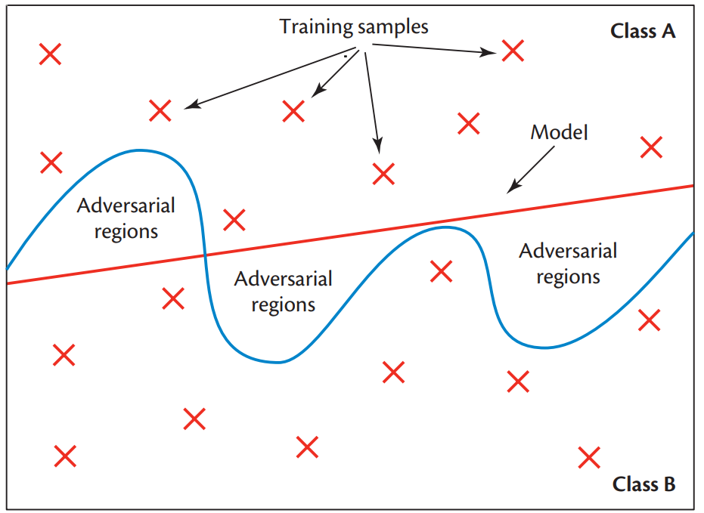
Adversarial Machine Learning
The training defines a model decision boundary (red line) which only approximates the real decision boundary (blue line).
  This model has high train accuracy (100%).
  Real decision boundary becomes more complex as the feature dimension space becomes larger (such as in ANN).
  Adversarial attackers exploit this complexity to find perturbation that moves samples into the adversarial regions.
McDaniel, Patrick, Nicolas Papernot, and Z. Berkay Celik. "Machine learning in adversarial settings." IEEE Security & Privacy 14.3 (2016): 68-72.
Notes:
We train models using the training data. On the basis of these samples the model approximates the class separation as the red line. The difference between the real and model decision boundary is called model error or space of adversarial samples (adversarial regions). The accuracy of this model is high, all samples are correctly classified. However the training data can’t cover the entire feature space. Making matters worse, the real decision bound. becomes more complex as the feat. dimension becomes larger. Adversarial exploits this complexity to find perturbations that move samples into the adv regions.

Slide 26
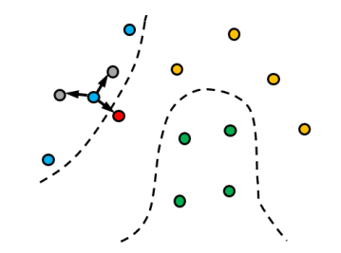
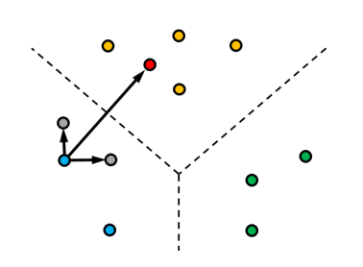
Adversarial Machine Learning
Despite gray/red points are at the same distance from x in the input space, the adversarial example (red) is much farther in the deep feature space.
Input space
Deep feature space
Random perturbations in the input space only result in a very small shift in the deep space, while even light alterations of an image along the adversarial direction cause a large shift in deep space.
Vulnerability of the deep feature space mapping.
Melis, Marco, et al. "Is deep learning safe for robot vision? adversarial examples against the icub humanoid." Proceedings of the IEEE International Conference on Computer Vision Workshops. 2017.

Slide 27
Adversarial Machine Learning
‘’dog’’
Input space
Deep feature space
‘’pig’’

Slide 28
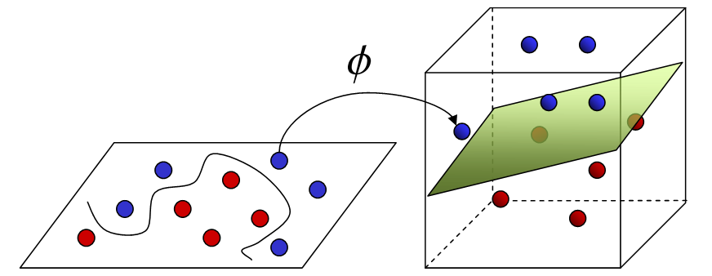
Input Space vs Feature Space
Often the original input data are transformed into a higher dimensional space using a nonlinear mapping to make data separable in the new feature space.
In general, the real decision boundary becomes more complex as the feature dimension space becomes “larger”.
Notes:
Often times we transform data into a higher dimensional space to make them more easily to be classified or analyzed in general. The goal is that after transformation the data are separable in the higher space…. The decision boundary of the model will be simple after transformation, however the real decision boundary becomes more complex as the feature dimension space becomes larger.

Slide 29
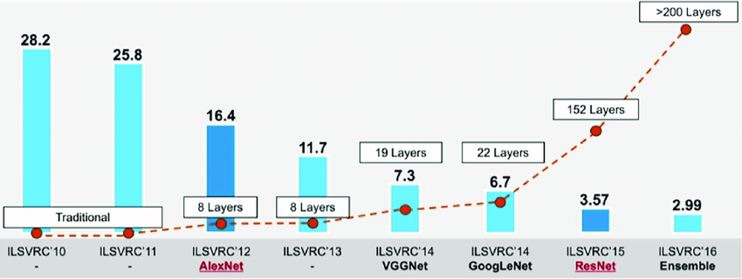
ImageNet Classification Challenge (ILSVRC)
Deep neural networks implement very complex mapping of the input space.
Notes:
All successfull deep neural networks proposed in the last years have increasing number of layers. As consequence, the real decision boundary of the data became more and more complex in the feature space. The underlying issue here is that because neural networks have much more modeling power than linear models, they have the ability to have much bumpier function surface.

Slide 30
Adversarial Machine Learning
Random perturbations in the input space only result in a very small shift in the deep space, while even light alterations of an image along the adversarial direction cause a large shift in deep space.
Input space
Deep space
‘’dog’’
‘’pig’’
Melis, Marco, et al. "Is deep learning safe for robot vision? adversarial examples against the icub humanoid." ICCV Workshops. 2017.
Notes:
Descrivi la slide (perturbare x)… Despite gray/red points are at the same distance from x in the input space, the adversarial example (red) is much farther in the deep feature space. Random perturbations in the input space only result in a very small shift in the deep space, while same alterations along the adversarial direction cause a large shift in deep space. Neural networks, by the nature of their loss surfaces, are especially prone to adversarial examples.

Slide 31
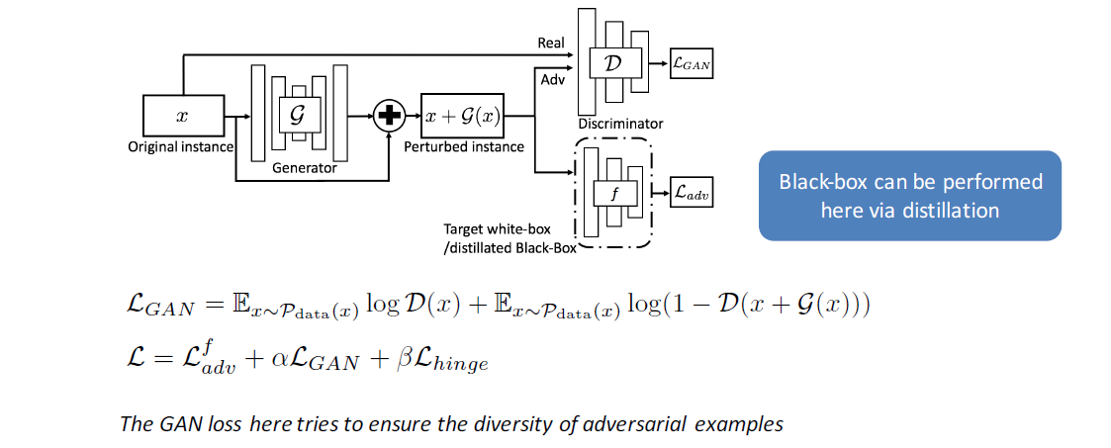
Adversarial Machine Learning
Constructing adversarial examples with adversarial networks
https://arxiv.org/pdf/1801.02610.pdf
Chaowei Xiao et al., Generating Adversarial Examples with Adversarial Networks 2017

Slide 32
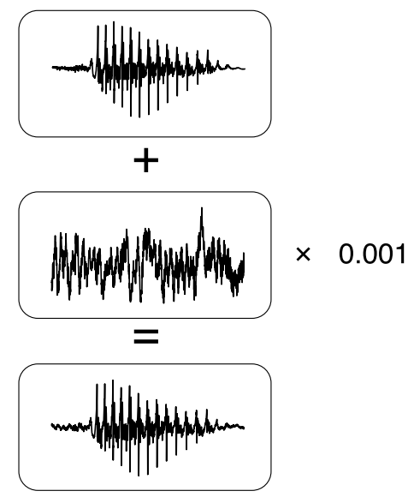

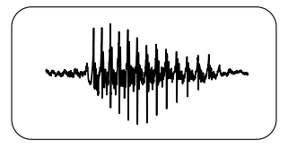
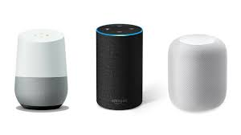
Adversarial Machine Learning
‘’Ok! I’m opening the door...’’
Adversarial attacks against speech recognition systems
Carlini, Nicholas, and David Wagner. "Audio adversarial examples: Targeted attacks on speech-to-text." 2018 IEEE SPW.

Slide 33
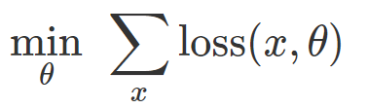



Constructing Adversarial Examples
Training a classifier is often formulated as finding model parameters θ that minimize an empirical loss function for a given set of samples.
How much a change of parameters affects the loss
$$∇_{θ}loss(h_{θ}\left(x\right),y)$$
to cause a misclassification for a fixed model θ and “benign” input x, a natural approach is to find a bounded perturbation δ such that the loss on x+δ is as large as possible:
How much a change of the input affects the loss
$$∇_{(x+δ)}loss(h_{θ}\left(x+δ\right),y)$$
Notes:
Training a classifiers means adjusting the parameters wrt how much their change affects the loss function, this is given by the derivative. However we can also fix parameters and change the input, based on the gradient wrt the input… In AML we compute how a change in the input affect the loss, and an attacker want to maximize this loss.
https://gradientscience.org/intro_adversarial/

Slide 34

Constructing Adversarial Examples
Obvious solution: change x as much as we need to fool the classifier…
if we change the image entirely, then it’s not particularly impressive that we can “fool” the classifier into thinking it’s not a pig.
$$∇_{(x+δ)}loss(h_{θ}\left(x+δ\right),y)$$
Notes:
The obvious solution is to change the input as much as we can fool the classifier, but it’s not that impressive…
https://gradientscience.org/intro_adversarial/

Slide 35
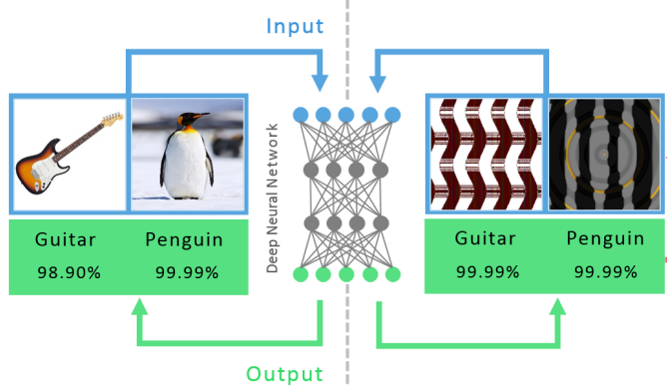
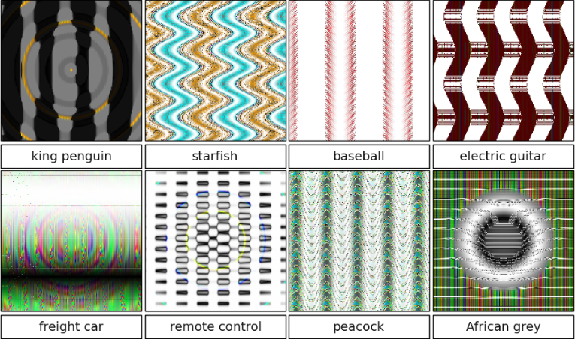
Constructing Adversarial Examples
It is easy to produce images that are completely unrecognizable to humans.
99.99% confidence
Nguyen, Anh, Jason Yosinski, and Jeff Clune. "Deep neural networks are easily fooled: High confidence predictions for unrecognizable images." Proceedings of the IEEE conference on computer vision and pattern recognition. 2015.
Notes:
This has been actually done in this work… In this paper, the authors fixed the output class, and optimized the input image so that they obtained specific patterns that are unrecognizable to humans but get 99% confidence of an image classifier.

Slide 36
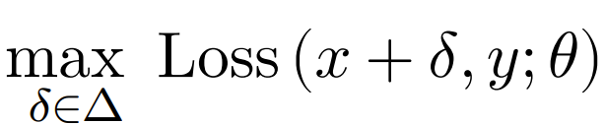

Constructing Adversarial Examples
Obvious solution: change x as much as we need to fool the classifier…
We need to ensure that (x$+δ$) is close to our original input x.
Δ : an allowable set of perturbations
Notes:
The goal is to fool the classifier with an input that seems x, then we optimize over a perturbation within a set of possible perturbations.
https://gradientscience.org/intro_adversarial/

Slide 37
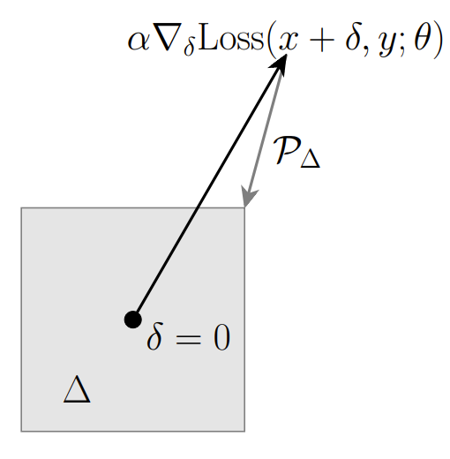


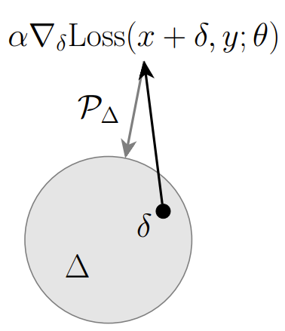

Constructing Adversarial Examples
Fast Gradient Sign Method (FGSM)
we will simply take δ to be either +ϵ or −ϵ depending upon the sign of the gradient
Projected Gradient Descent (PGD)
re-iterate the basic approach and apply the gradient descent optimization.
Credits: Z. Kolter, A. Mądry- Adversarial Robustness: Theory and Practice
Notes:
https://gradientscience.org/intro_adversarial/

Slide 38
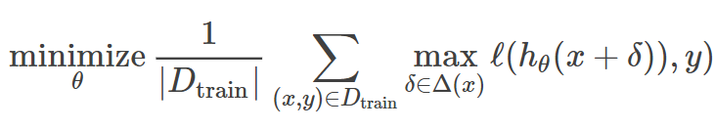

Training Adversarially Robust Classifiers
Minimizing the adversarial empirical risk…
Risk: expected loss under the true distribution… but
$D_{train}≠D$
We must use a biased estimation of the risk, then we use the $D_{test}$ as a proxy to estimate the true risk.
Credits: Z. Kolter, A. Mądry- Adversarial Robustness: Theory and Practice
Notes:
To train an ADV robust classifier we have to minimize the adversarial empirical risk.. Which is empirical because we lean on train data (not the true distribution)… Moreover we can’t derivate the max function, so we can only find a local optimal and approximate the solution.
https://gradientscience.org/intro_adversarial/

Slide 39
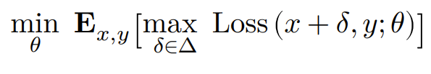
Training Adversarially Robust Classifiers
Notes:
To train an ADV robust classifier we have to minimize the adversarial empirical risk
https://gradientscience.org/intro_adversarial/

Slide 40
Training Adversarially Robust Classifiers
Train a robust classifier
Create aversarial example
Credits: Z. Kolter, A. Mądry- Adversarial Robustness: Theory and Practice
Notes:
All AML attacks/defense methods are based on this min-max objective.. Outer minimization (robust classifier) inner maximization (adversarial perturbation)
https://gradientscience.org/intro_adversarial/

Slide 41
Training Adversarially Robust Classifiers
Every adversarial attack/defense are method for approximately solving the inner-max/outer-min problem.
Different strategies are variants of min-max optimization considering:
Different bounds Δ
Different optimization procedures
Some empirically effective strategies
Notes:
… is not possible to find a perfect solution because we can’t compute the deriv. of max function. Only approximate solutions are available…
https://gradientscience.org/intro_adversarial/

Slide 42
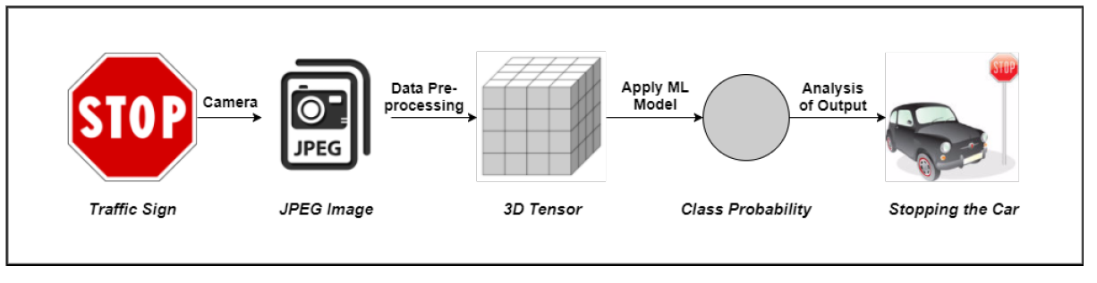
Adversarial Machine Learning Attacks
Evasion Attack - the adversary tries to evade the system by adjusting malicious samples during testing phase. This setting does not assume any influence over the training data.
Poisoning Attack - an adversary tries to poison the training data by injecting carefully designed samples to compromise the whole learning process.
Exploratory Attack - try to gain as much knowledge as possible about the learning algorithm of the underlying system and pattern in training data.
Notes:
Evasion -> Test Poisoning -> Training Exploratory-> tries to distill the model (a sort of evasion attack)

Slide 43
Adversarial Machine Learning
Evasion Attack (test time)
Evasion attacks consist of manipulating input data to evade a trained classifier at test time (e.g., manipulation of malware code to have the corresponding sample misclassified as legitimate, or manipulation of images to mislead object recognition).
Error generic: the attacker is interested in misleading classification, regardless of the output class predicted by the classifier.
Error specific: the attacker requires the adversarial examples to be misclassified as a specific class.

Slide 44
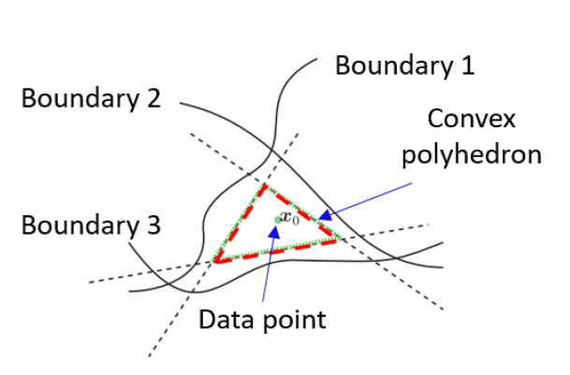
AML – Evasion Attack
DeepFool
In each iteration, DeepFool linearizes the classifier at the current adversarial example and adds the minimum noise required to move the adversarial example to the linearized classification boundary
https://arxiv.org/pdf/1709.05583.pdf
https://www.crcv.ucf.edu/wp-content/uploads/2018/11/Lecture-3-DeepFool.pdf
https://openaccess.thecvf.com/content_cvpr_2016/papers/Moosavi-Dezfooli_DeepFool_A_Simple_CVPR_2016_paper.pdf
Moosavi-Dezfooli, et al. "Deepfool: a simple and accurate method to fool deep neural networks." CVPR 2016.

Slide 45
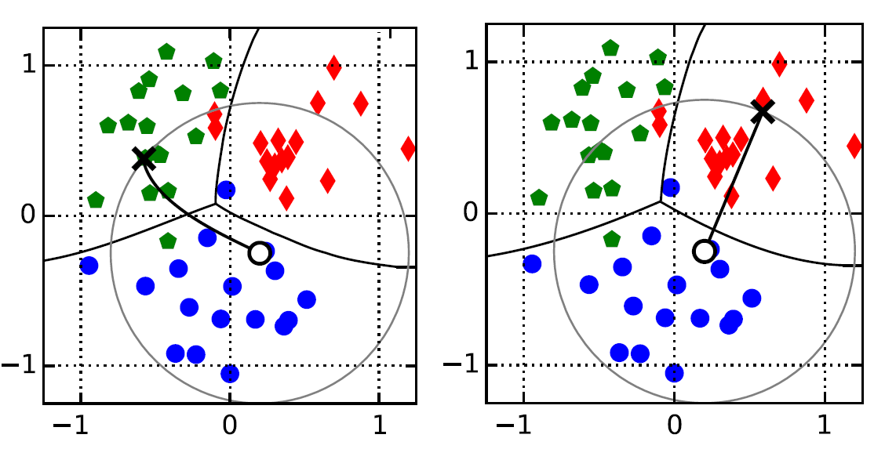
AML – Evasion Attack
Evasion Attack: error-generic vs. error-specific
error-specific
error-generic
Biggio, Battista, and Fabio Roli. "Wild patterns: Ten years after the rise of adversarial machine learning." Pattern Recognition 84 (2018): 317-331.

Slide 46
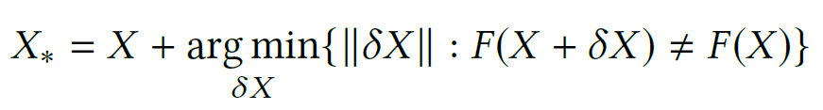
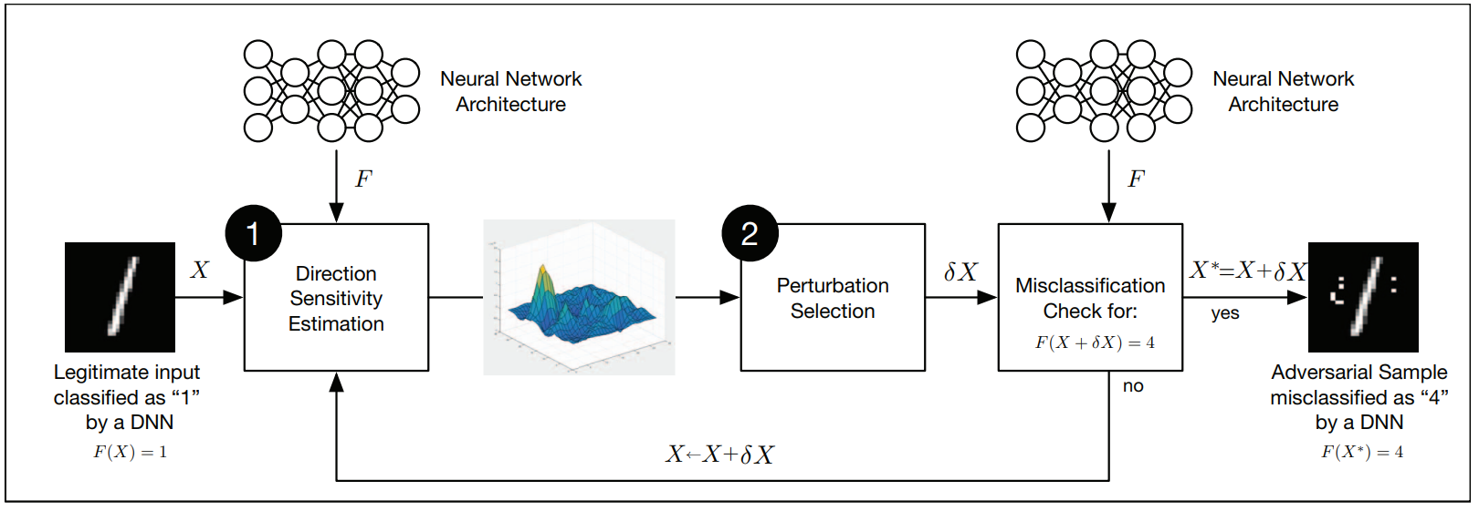
AML – Evasion Attack
Crafting malicious examples by adding a norm-bounded perturbation.
Nicolas Papernot, et al. 2016. Distillation as a Defense to Adversarial Perturbations Against Deep Neural Networks
Notes:
In evasion attacks, adversarial examples can be crafted by adding a bounded perturbation to data and observe the ouput of the model.
Different crafting systems can be defined based on the implementation of (1) direction estimation and (2) perturbation selection.

Slide 47
Adversarial Machine Learning
Adversarial Robustness
TODO…
Adversarial risk…

Slide 48
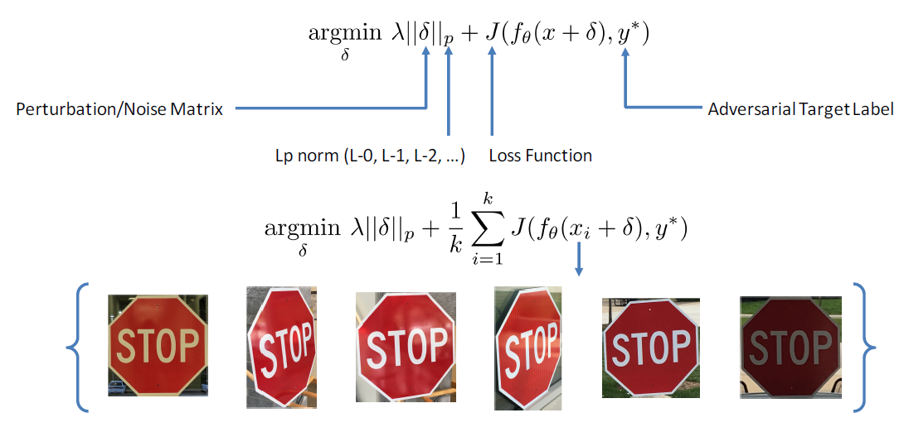
AML – Evasion Attack
Constructing adversarial examples (with a target label)
Credits: Bo Li, Secure Learning in Adversarial Deep Neural Networks
Notes:
In this case the crafted example is generated with a target label

Slide 49
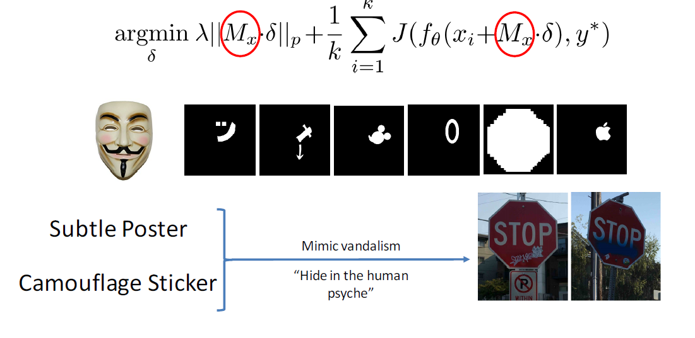
AML – Evasion Attack
Constructing adversarial (visible) examples (with a target label)
Credits: Bo Li, Secure Learning in Adversarial Deep Neural Networks

Slide 50
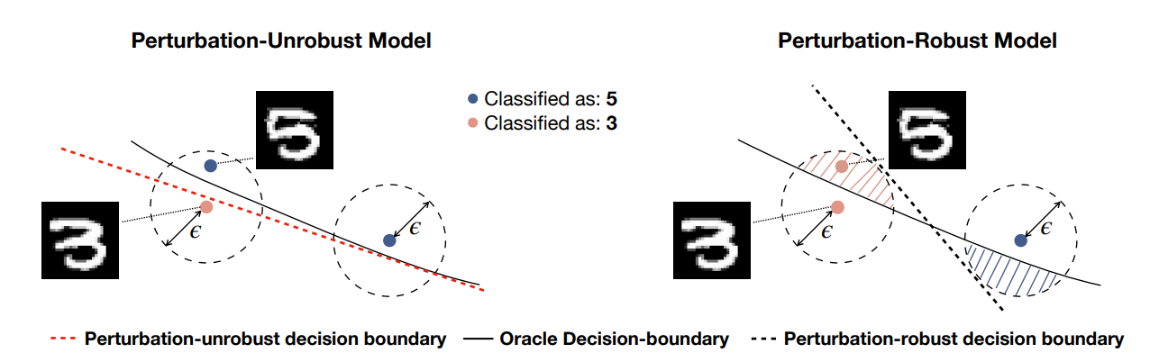
AML – Evasion Attack
Jacobsen, J. H., Behrmannn, J., Carlini, N., Tramer, F., & Papernot, N. (2019). Exploiting excessive invariance caused by norm-bounded adversarial robustness. arXiv preprint arXiv:1903.10484.

Slide 51
AML – Evasion Attack
Craft a malicious example X∗ = X + δX by adding a perturbation δX, so that
F (X∗) = Y∗
where Y∗ is the target output.
Nicolas Papernot, et al. 2016. Distillation as a Defense to Adversarial Perturbations Against Deep Neural Networks
Notes:
I metodi di crafting si differenziano per cosa fanno in (1) direction estimation e (2) perturbation selection

Slide 52
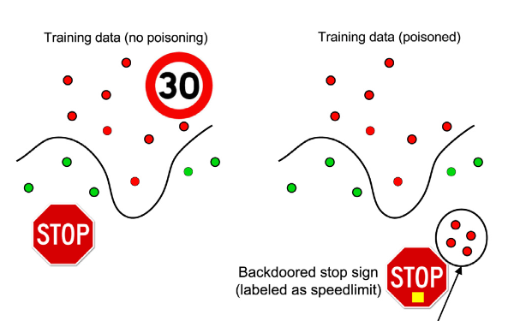

AML – Poisoning Attack
Poisoning Attack (training time)
Poisoning Attacks alter the training dataset by inserting, modifying or deleting points keeping the intention of modifying the decision boundaries of the targeted model.
Biggio, Battista, and Fabio Roli. "Wild patterns: Ten years after the rise of adversarial machine learning." Pattern Recognition 84 (2018): 317-331.
Notes:
A learning process fine-tunes the parameters θ of an hypothesis function h_{θ}(x) by analysing a training set. This makes the training set susceptible to manipulation by adversaries. This concept is exploited in poisoning attacks given the fact that decision boundary is driven by training data…

Slide 53
AML – Poisoning Attack
Biggio, Battista, and Fabio Roli. "Wild patterns: Ten years after the rise of adversarial machine learning." Pattern Recognition 84 (2018): 317-331.

Slide 54

AML – Poisoning Attack
Poisoning Attack (training time)
Alters the trainset by inserting, modifying or deleting points keeping the intention of modifying the decision boundaries of the targeted model.
Biggio, Battista, and Fabio Roli. "Wild patterns: Ten years after the rise of adversarial machine learning." Pattern Recognition 84 (2018): 317-331.
Notes:
Conceptual examples of poisoning attack. Each plot shows the training data and corresponding trained classifier. The fraction of poisoning points injected into the training set is reported on top of each plot along with the test error. The small fraction of poisoned samp. affects the decision boundary that makes errors also on other samples.
…Poisoned points are optimized through a gradient based attack algorithm. Dashed line is the path followed by the attack point (gradient). The gradient trajectories are followed up to some local optimal obtaining the final poisoning points.

Slide 55

Adversarial Machine Learning
Poisoning Attack Examples
Binary search: assumes that the target instance x_{t} can be considered as an outlier with respect to the training data in the opposite class.
StingRay: inserts new copies of existing data instances by perturbing less informative features.
Suciu, O. et al. "When does machine learning FAIL? generalized transferability for evasion and poisoning attacks."
Ma, Yuxin, et al. "Explaining vulnerabilities to adversarial machine learning through visual analytics."

Slide 56



Label-consistent backdoor attack
Face authentication systems are used in several applications
Deep learning models are the de facto standard for their implementation
These models are prone to attacks both during training and inference phases
Poisoning with adversarial examples the training set, it is possible to change the behavior of the authentication system at inference time
Normal system behavior
Poisoned system identity theft

Slide 57

Label-consistent backdoor attack
We are working on a backdoor attack at training time to perform an identity theft at inference time
We poisoned a training set with label-consistent adversarial images (difficult to spot by visual inspection)
After a finetuning with the poisoned dataset, the system recognizes an impostor as a target identity
White-box attack (the attacker knows the model to be attacked), model tested is Inception V1, Projected Gradient Descent (PGD) used to generate the adversarial images

Slide 58




Label-consistent backdoor attack
$$x_{att}$$
$$\hat{x}$$
$$x$$
$min\left\|φ\left(\hat{x}\right)−φ(x_{att})\right\|$ s. t. $\left\|\hat{x}−x\right\|< ε$
Cauli, N., et al. Fooling a face recognition system with a marker-free label-consistent backdoor attack. In International Conference on Image Analysis and Processing (pp. 176-185). Cham: Springer International Publishing.
Notes:
In this work we aim to perform a label consistent poisoning attack on a face recognition system. In the sense that injected adversarial inputs are consistent with their labels.

Slide 59

Label-consistent backdoor attack
$min\left\|φ\left(\hat{x}\right)−φ(x_{att})\right\|$ s. t. $\left\|\hat{x}−x\right\|< ε$
Notes:
Our objective is to create poisoned examples that are similar to real examples in the visual space, but close to fake identity (attacker face) in the feature space.

Slide 60
Label-consistent backdoor attack
Finetuning of the last layer
Notes:
The side effect is that the decision boundary related to the class is also enlarged in all the surrounding directions, this may cause error also with other examples. This means that the model is less confident about patterns associated to that class.

Slide 61

AML – Exploratory Attack
An attacker first queries a victim BERT model, and then uses its predicted answers to fine-tune their own BERT model. This process works even when passages and questions are random sequences of words.
Krishna, Kalpesh, et al. "Thieves on sesame street! model extraction of bert-based apis." arXiv preprint arXiv:1910.12366 (2019).
Notes:
Exploratory attacks do not modify the training set but instead tries to gain information about the state by probing the learner. This approach is also known as model distillation, which attempts to distill knowledge from a larger model to a small model.

Slide 62
AML – Defense Strategies
Adversarial Training
Defensive Distillation
Defensive-GAN
Gradient Hiding
Feature Squeezing
…
Notes:
There are several attempts of developing defense strategies, this slide lists some examples..

Slide 63
AML – Defense Strategies
Adversarial Training
Increase model robustness by injecting adversarial examples into the training set. The augmentation can be done either by feeding the model with both the original data and the crafted data or by learning with a modified objective function.
Original loss function
Modified loss function
Goodfellow, I. J., Shlens, J., & Szegedy, C. (2014). Explaining and harnessing adversarial examples. arXiv preprint arXiv:1412.6572.
Notes:
The objective of the adversarial training is to increase model robustness by injecting adversarial examples into the training set.
The objFunc takes into account also perturbations of the inputs.

Slide 64

AML – Defense Strategies
Defensive Distillation
Distilled model provides a smoother loss function, which is more generalized for an unknown dataset and have high classification accuracy even for adversarial examples.
Notes:
Let us assume that we already have a neural network F which classifies a training dataset X into the target classes Y. The final softmax layer in the produces a probability distribution over Y. Further, assume that we want to train a second neural network F ′ on the same dataset X achieving the same performance. Now, instead of using the target class labels of the training dataset, we use the output of the network F as the label to train another neural network F ′ with the same architecture having the same input dataset X. The new labels, therefore, contain more information about the membership of X to the different target classes, compared to a simple label that just chooses the most likely class.

Slide 65


AML – Defense Strategies
Defensive Distillation
Nicolas Papernot, et al. 2016. Distillation as a Defense to Adversarial Perturbations Against Deep Neural Networks
Notes:
Distillation is a training procedure initially designed to train a DNN using knowledge transferred from a different DNN.
– extract class probability vectors produced by a first DNN or an ensemble of DNNs to train a second DNN
of reduced dimensionality without loss of accuracy.
– label inputs in the training dataset of the second DNN using their classification predictions according to the
first DNN.
• Use defensive distillation to smooth the model learned by a DNN architecture during training by helping the model generalize better to samples outside of its training dataset.
Temperature controls the softmax, increasing the temperature will generally speaking make adversarial sample crafting harder, high T -> smaller sensitivity to perturbations, this is because increasing T will decrease the amplitude of Jacobian’s components of the model.

Slide 66

AML – Defense Strategies
Defensive-GAN
Input images are projected onto the range of the generator G by minimizing the reconstruction error, prior to be fed to the classifier at inference time.
Samangouei, P., et al. (2018). Defense-gan: Protecting classifiers against adversarial attacks using generative models.
Notes:
Here the authors proposed a mechanism to exploit the power of GAN to reduce the efficiency of adversarial perturbations
In a typical GAN, a generative model emulates a data distribution. The central idea is to "project" input images onto the range of the generator G by prior to feeding the image x to the classifier.
…The samples will be close to the range of G than the adversarial samples, resulting in substantial reduction of potential adversarial perturbations. …At inference time, it finds a close output to a given image which does not contain the adversarial changes. This output is then fed to the classifier.

Slide 67


AML – Defense Strategies
Protect medical data from Machine Learning attacks.
Before the attack
After the attack
original protected
original protected

Slide 68
Final Remarks
Towards adversarially robust ML
Algorithms: robust training, verification, smaller models
Theory: better adversarial-robust generalization bounds, new regularization techniques
Data: new datasets and more comprehensive set of perturbations

Slide 69
Final Remarks
Towards adversarially robust ML
Algorithms: robust training, verification, smaller models
Theory: better adversarial-robust generalization bounds, new regularization techniques
Data: new datasets and more comprehensive set of perturbations
Will lead to ML that is not only safe/secure but also “better”?
Notes:
… some published works propose adversarial examples as advanced data augmentation techniques to augment generalization.

Slide 70

Thanks for your attention!
Alessandro Ortis, PhD
Email: alessandro.ortis@unict.it
Personal webpage: http://www.dmi.unict.it/ortis/
Lab webpage: http://iplab.dmi.unict.it

Slide 71
References
"Generative Adversarial Networks." Ian J. Goodfellow, Jean Pouget-Abadie, Mehdi Mirza, Bing Xu, David Warde-Farley, Sherjil Ozair, Aaron Courville, Yoshua Bengio. ArXiv 2014.
Mirza, Mehdi, and Simon Osindero. "Conditional generative adversarial nets." arXiv preprint arXiv:1411.1784 (2014).
Radford, Alec, Luke Metz, and Soumith Chintala. "Unsupervised representation learning with deep convolutional generative adversarial networks." arXiv preprint arXiv:1511.06434 (2015).
Isola, Phillip, et al. "Image-to-image translation with conditional adversarial networks." Proceedings of the IEEE conference on computer vision and pattern recognition. 2017.
Zhu, Jun-Yan, et al. "Unpaired image-to-image translation using cycle-consistent adversarial networks." Proceedings of the IEEE international conference on computer vision. 2017.
Choi, Yunjey, et al. "Stargan: Unified generative adversarial networks for multi-domain image-to-image translation." Proceedings of the IEEE
Y. Choi et al., StarGAN v2: Diverse Image Synthesis for Multiple Domains – CVPR 2020

Slide 72
References
Li, Lingzhi, et al. "Face x-ray for more general face forgery detection." Proceedings of the IEEE/CVF Conference on Computer Vision and Pattern Recognition. 2020.
Nirkin, Yuval, et al. "DeepFake Detection Based on Discrepancies Between Faces and their Context." IEEE Transactions on Pattern Analysis and Machine Intelligence (2021).
Guarnera, Luca, Oliver Giudice, and Sebastiano Battiato. "DeepFake Detection by Analyzing Convolutional Traces." Proceedings of the IEEE/CVF Conference on Computer Vision and Pattern Recognition Workshops. 2020.
Giudice, Oliver, Luca Guarnera, and Sebastiano Battiato. "Fighting deepfakes by detecting GAN DCT anomalies." arXiv preprint arXiv:2101.09781 (2021).
Agarwal, Shruti, et al. "Protecting World Leaders Against Deep Fakes." CVPR workshops. Vol. 1. 2019.
Mittal, Trisha, et al. "Emotions Don't Lie: An Audio-Visual Deepfake Detection Method using Affective Cues." Proceedings of the 28th ACM international conference on multimedia. 2020.
Ciftci, Umur Aybars, Ilke Demir, and Lijun Yin. "How do the hearts of deep fakes beat? Deep fake source detection via interpreting residuals with biological signals." 2020 IEEE International Joint Conference on Biometrics (IJCB). IEEE, 2020.
Conotter, Valentina, et al. "Physiologically-based detection of computer generated faces in video." 2014 IEEE International Conference on Image Processing (ICIP). IEEE, 2014.
Li, Yuezun, Ming-Ching Chang, and Siwei Lyu. "In ictu oculi: Exposing ai created fake videos by detecting eye blinking." 2018 IEEE International Workshop on Information Forensics and Security (WIFS). IEEE, 2018.
Guo, Hui, et al. "Eyes Tell All: Irregular Pupil Shapes Reveal GAN-generated Faces." arXiv preprint arXiv:2109.00162 (2021).
Du, Mengnan, et al. "Towards generalizable deepfake detection with locality-aware autoencoder." Proceedings of the 29th ACM International Conference on Information & Knowledge Management. 2020.
Wang, Run, et al. "Fakespotter: A simple yet robust baseline for spotting ai-synthesized fake faces." arXiv preprint arXiv:1909.06122 (2019).

Slide 73
References
Bo Li, Secure Learning in Adversarial Deep Neural Networks
Chaowei Xiao et al., Generating Adversarial Examples with Adversarial Networks 2017
Z. Kolter, A. Mądry- Adversarial Robustness: Theory and Practice
McDaniel, Patrick, Nicolas Papernot, and Z. Berkay Celik. "Machine learning in adversarial settings." IEEE Security & Privacy 14.3 (2016): 68-72.
Melis, Marco, et al. "Is deep learning safe for robot vision? adversarial examples against the icub humanoid." Proceedings of the IEEE International Conference on Computer Vision Workshops. 2017.
Szegedy, Christian, et al. "Intriguing properties of neural networks." arXiv preprint arXiv:1312.6199 (2013).
Nguyen, Anh, Jason Yosinski, and Jeff Clune. "Deep neural networks are easily fooled: High confidence predictions for unrecognizable images." Proceedings of the IEEE conference on computer vision and pattern recognition. 2015.
Goodfellow, Ian J., Jonathon Shlens, and Christian Szegedy. "Explaining and harnessing adversarial examples." arXiv preprint arXiv:1412.6572 (2014).
Ren, Kui, et al. "Adversarial attacks and defenses in deep learning." Engineering 6.3 (2020): 346-360.
Biggio, Battista, and Fabio Roli. "Wild patterns: Ten years after the rise of adversarial machine learning." Pattern Recognition 84 (2018): 317-331.
Nicolas Papernot, et al. 2016. Distillation as a Defense toAdversarial Perturbations Against Deep Neural Networks. In IEEE Symposium on Security and Privacy, SP 2016, San Jose, CA, USA, May 22-26, 2016. 582–597. https://doi.org/10.1109/SP.2016.41
Suciu, O. et al. "When does machine learning FAIL? generalized transferability for evasion and poisoning attacks."
Ma, Yuxin, et al. "Explaining vulnerabilities to adversarial machine learning through visual analytics."
Krishna, Kalpesh, et al. "Thieves on sesame street! model extraction of bert-based apis." arXiv preprint arXiv:1910.12366 (2019).
Cauli, N., et al. Fooling a face recognition system with a marker-free label-consistent backdoor attack. In International Conference on Image Analysis and Processing (pp. 176-185). Cham: Springer International Publishing.

