Slide 1


Deep Learning Discovery of Exoplanets
Hamed Valizadegan
Machine learning lead @
Universities Space Research Association &
NASA Ames Research Center
Research is conducted under performance of NASA contract number NNA16BD14C, managed by the Universities Space Research Association (USRA)

Slide 2
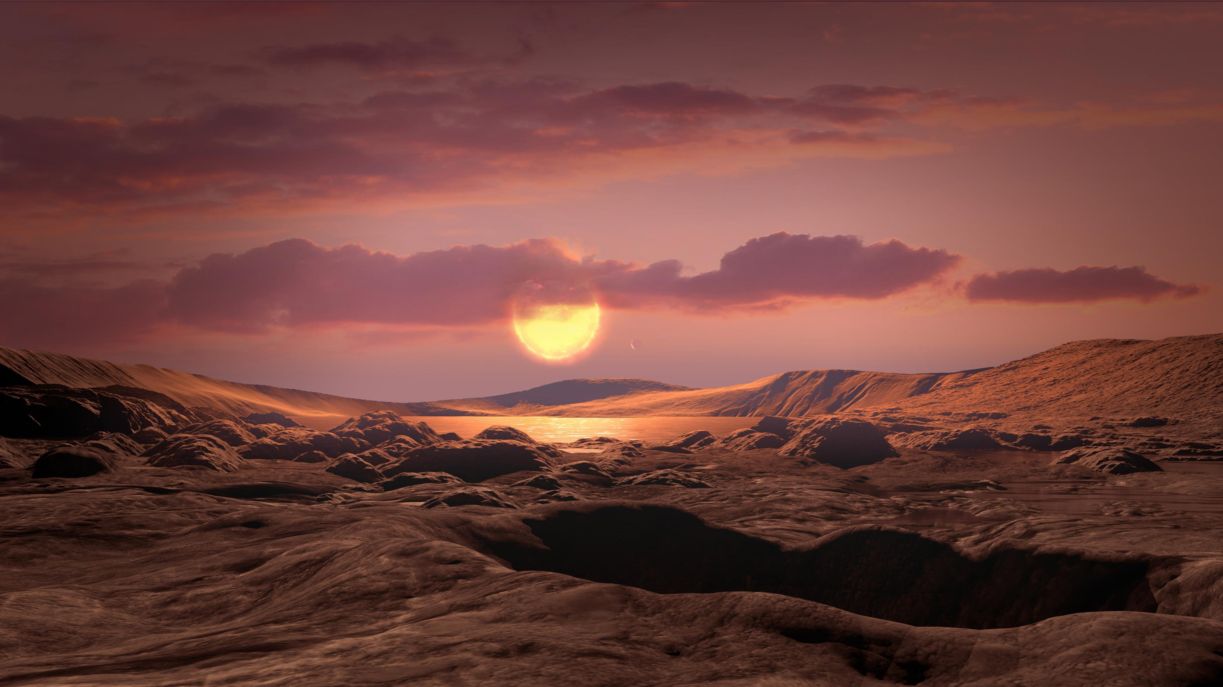

Slide 3
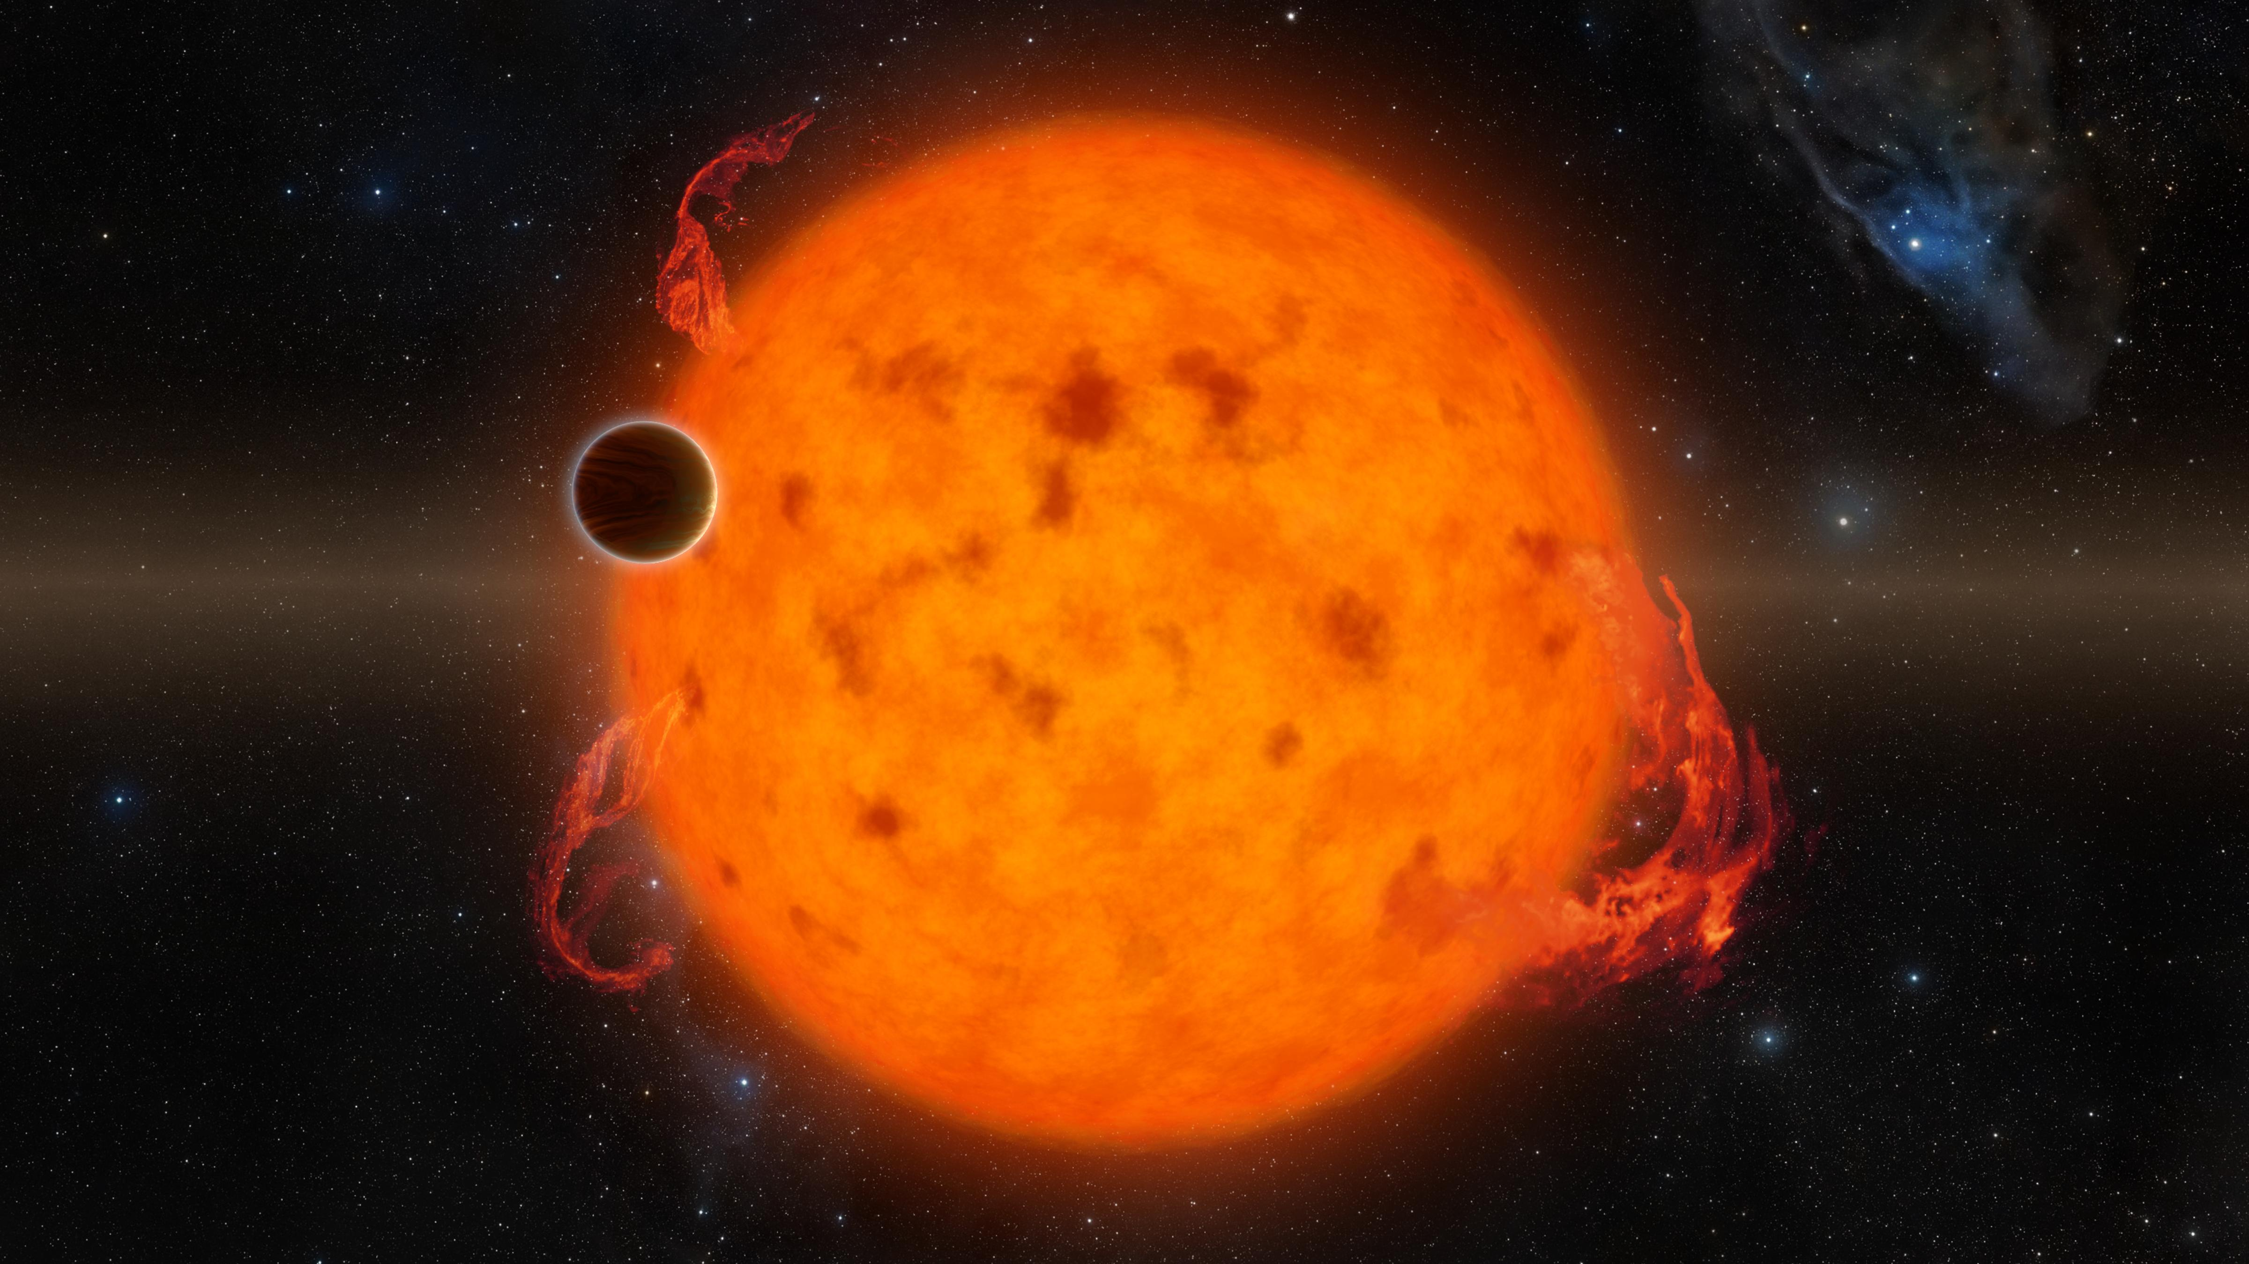

Slide 4
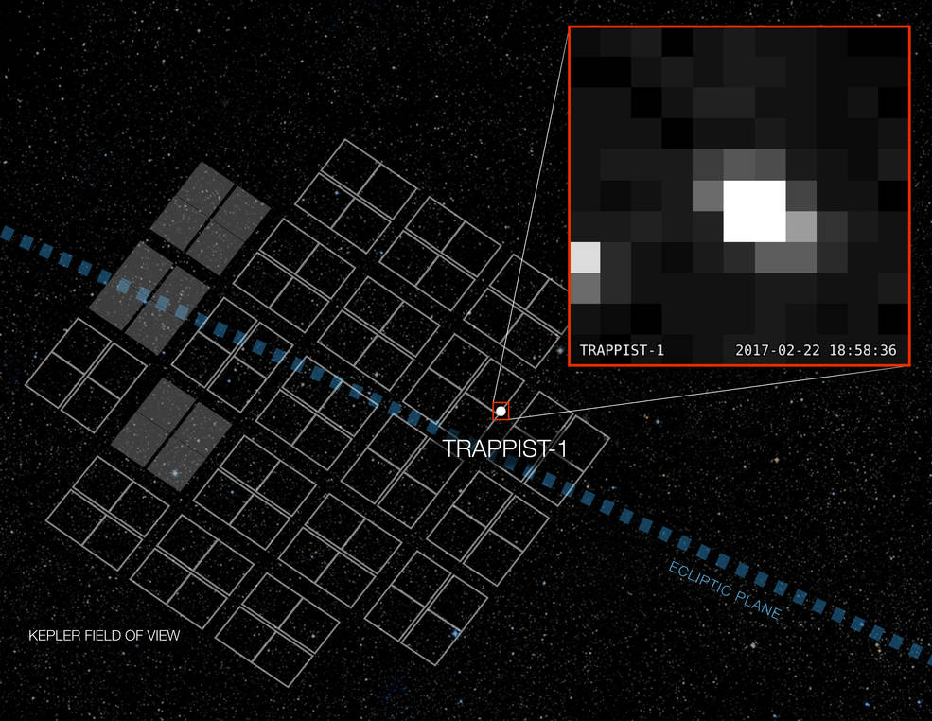
All we see of a star (not a planet)
These pixels are all we got from Star TRAPPIST-1
Notes:
TRAPPIST: Cool red dwarf stars, 40 light years away, has 7 detected exoplanets, 7.6. billion years old
Star is slightly larger than Jupiter, Mass 9% of sun, four planets are in the right distance to have liquid water

Slide 5
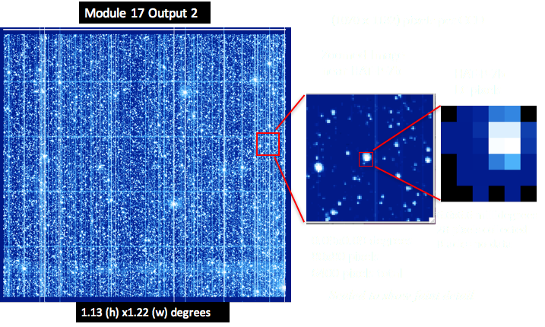
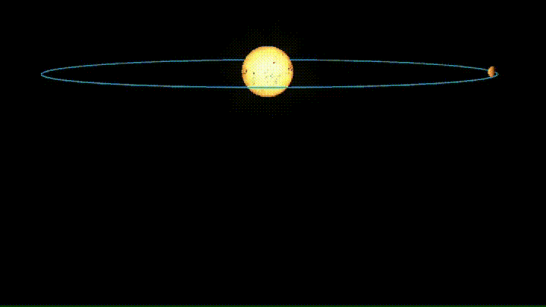
Transit method for planet discovery
Transiting exoplanets can be detected by taking low-resolution images of stars (in average, 35 pixels for each star in Kepler telescope)

Slide 6
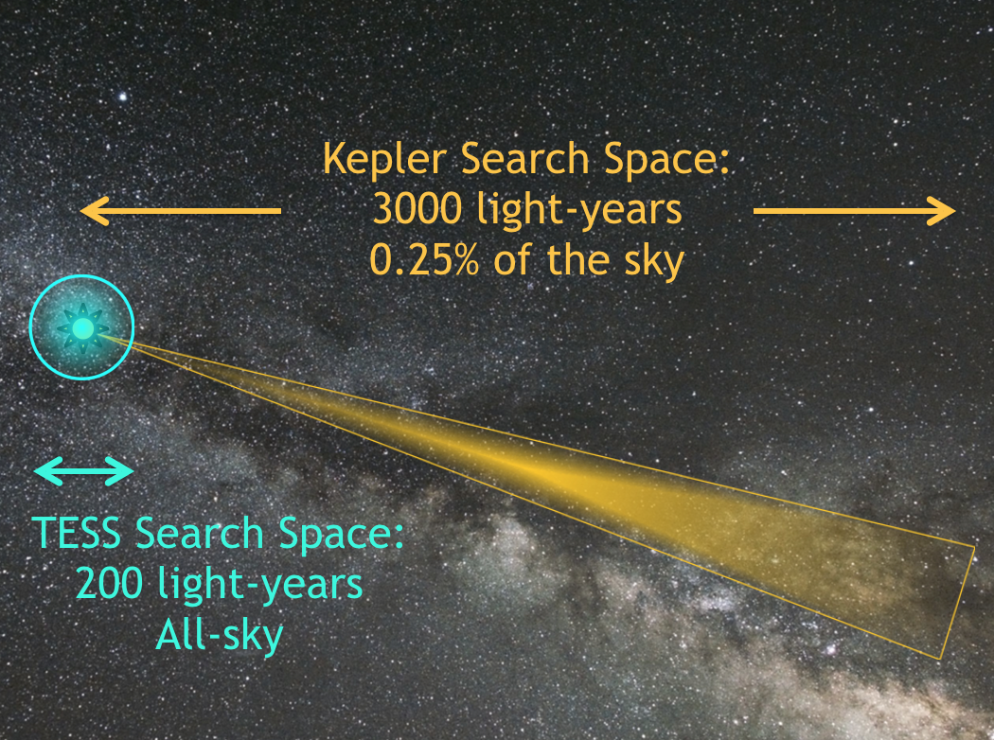
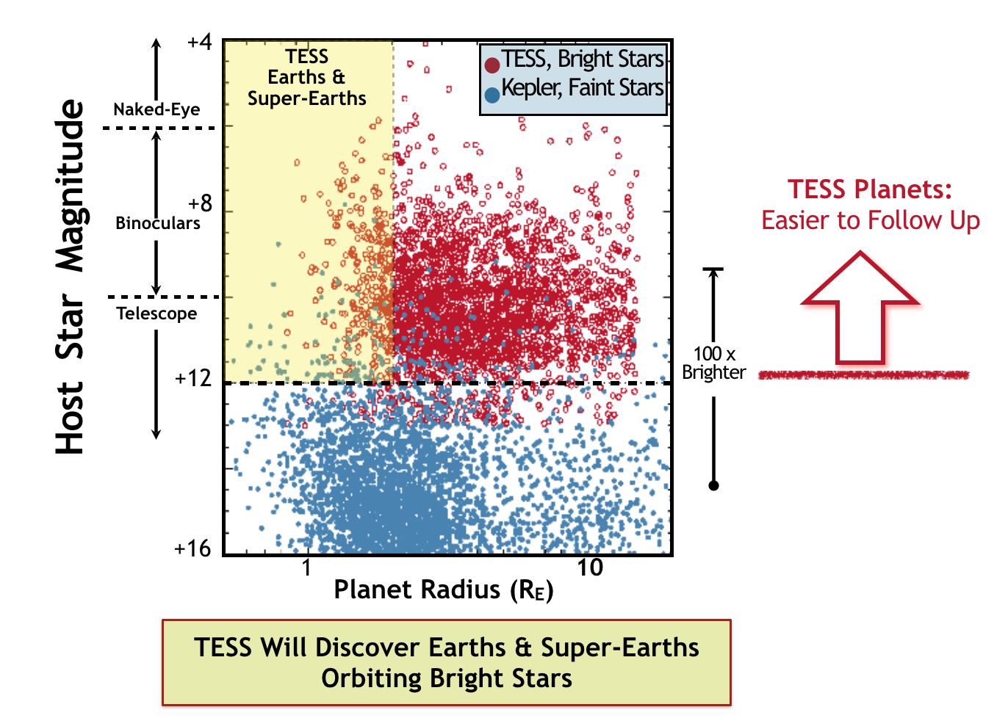
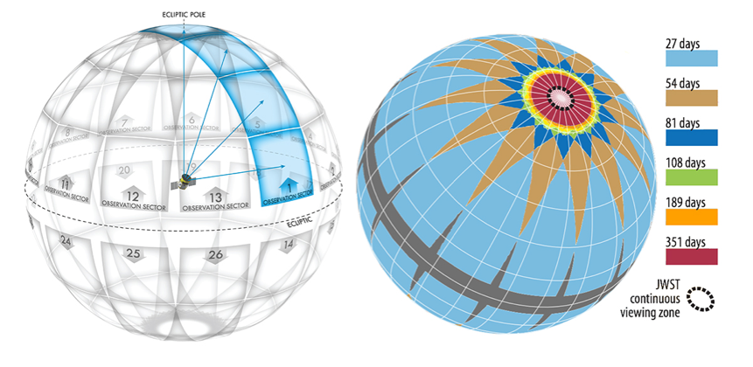
Kepler vs TESS Mission
Kepler
Designed to survey a small portion of milky way (~200k stars) & discover earth-size planets on near habitable zone
  Photographed each star every 30 mins for 4 years
Lunched on March 2009
More than 50% of all confirmed exoplanets (2779) are discovered by Kepler
TESS
Designed to survey a much larger (400 times) space compared to Kepler (500k stars). 90% is surveyed so far
  Photograph each sector every 2 mins for 27 days
  Some sectors overlaps
Expected to find 15k rocky planet (500-1000 earth-size)
  Around 430 confirmed so far.

Slide 7
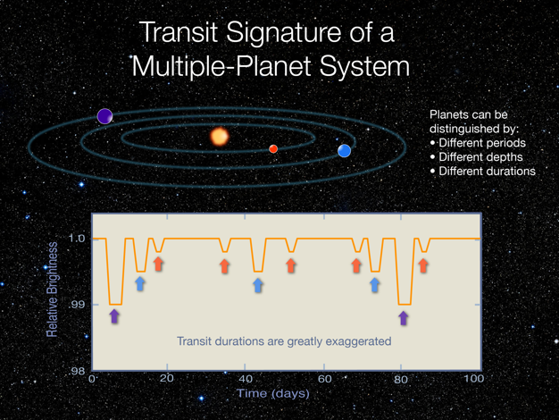
Multi-Planet System
Detection problem: find periodic transits and return them as exoplanets

Slide 8
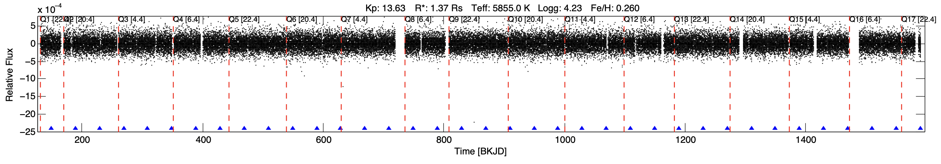
Real Flux Data
Flux data for Kepler-1861b
  Discovered by: Valizadegan et. al. 2022
  Orbital period: 40 days
Blue arrows shows the transit signals
Sometimes the signal is very weak.

Slide 9
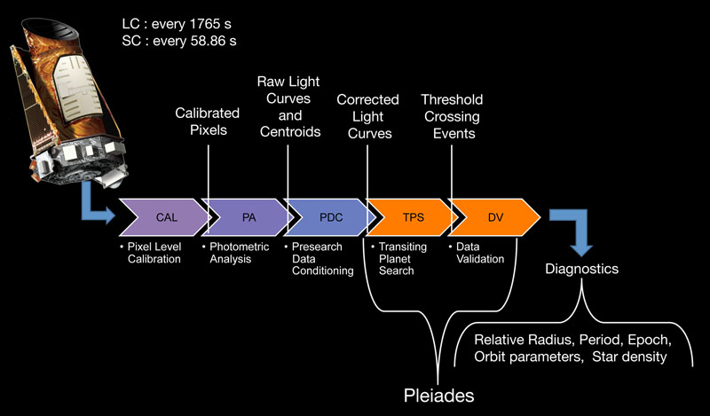
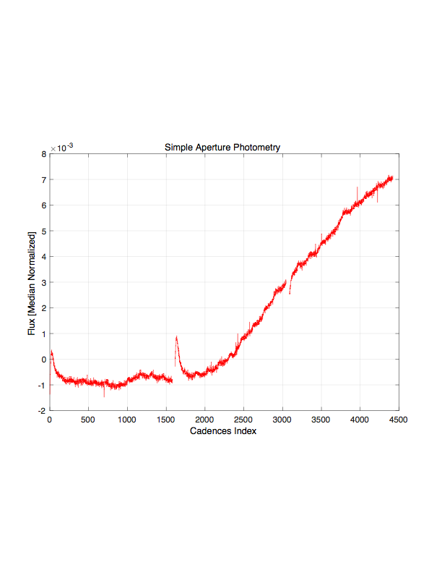
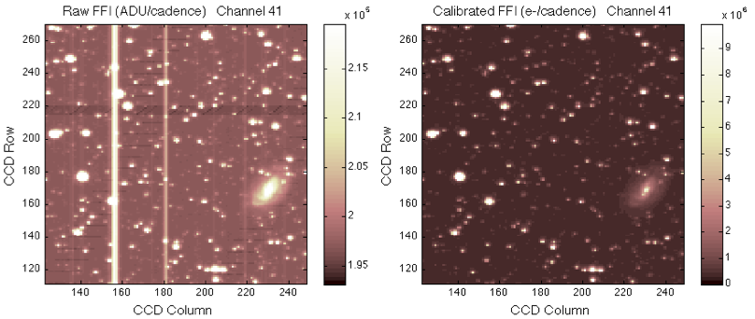
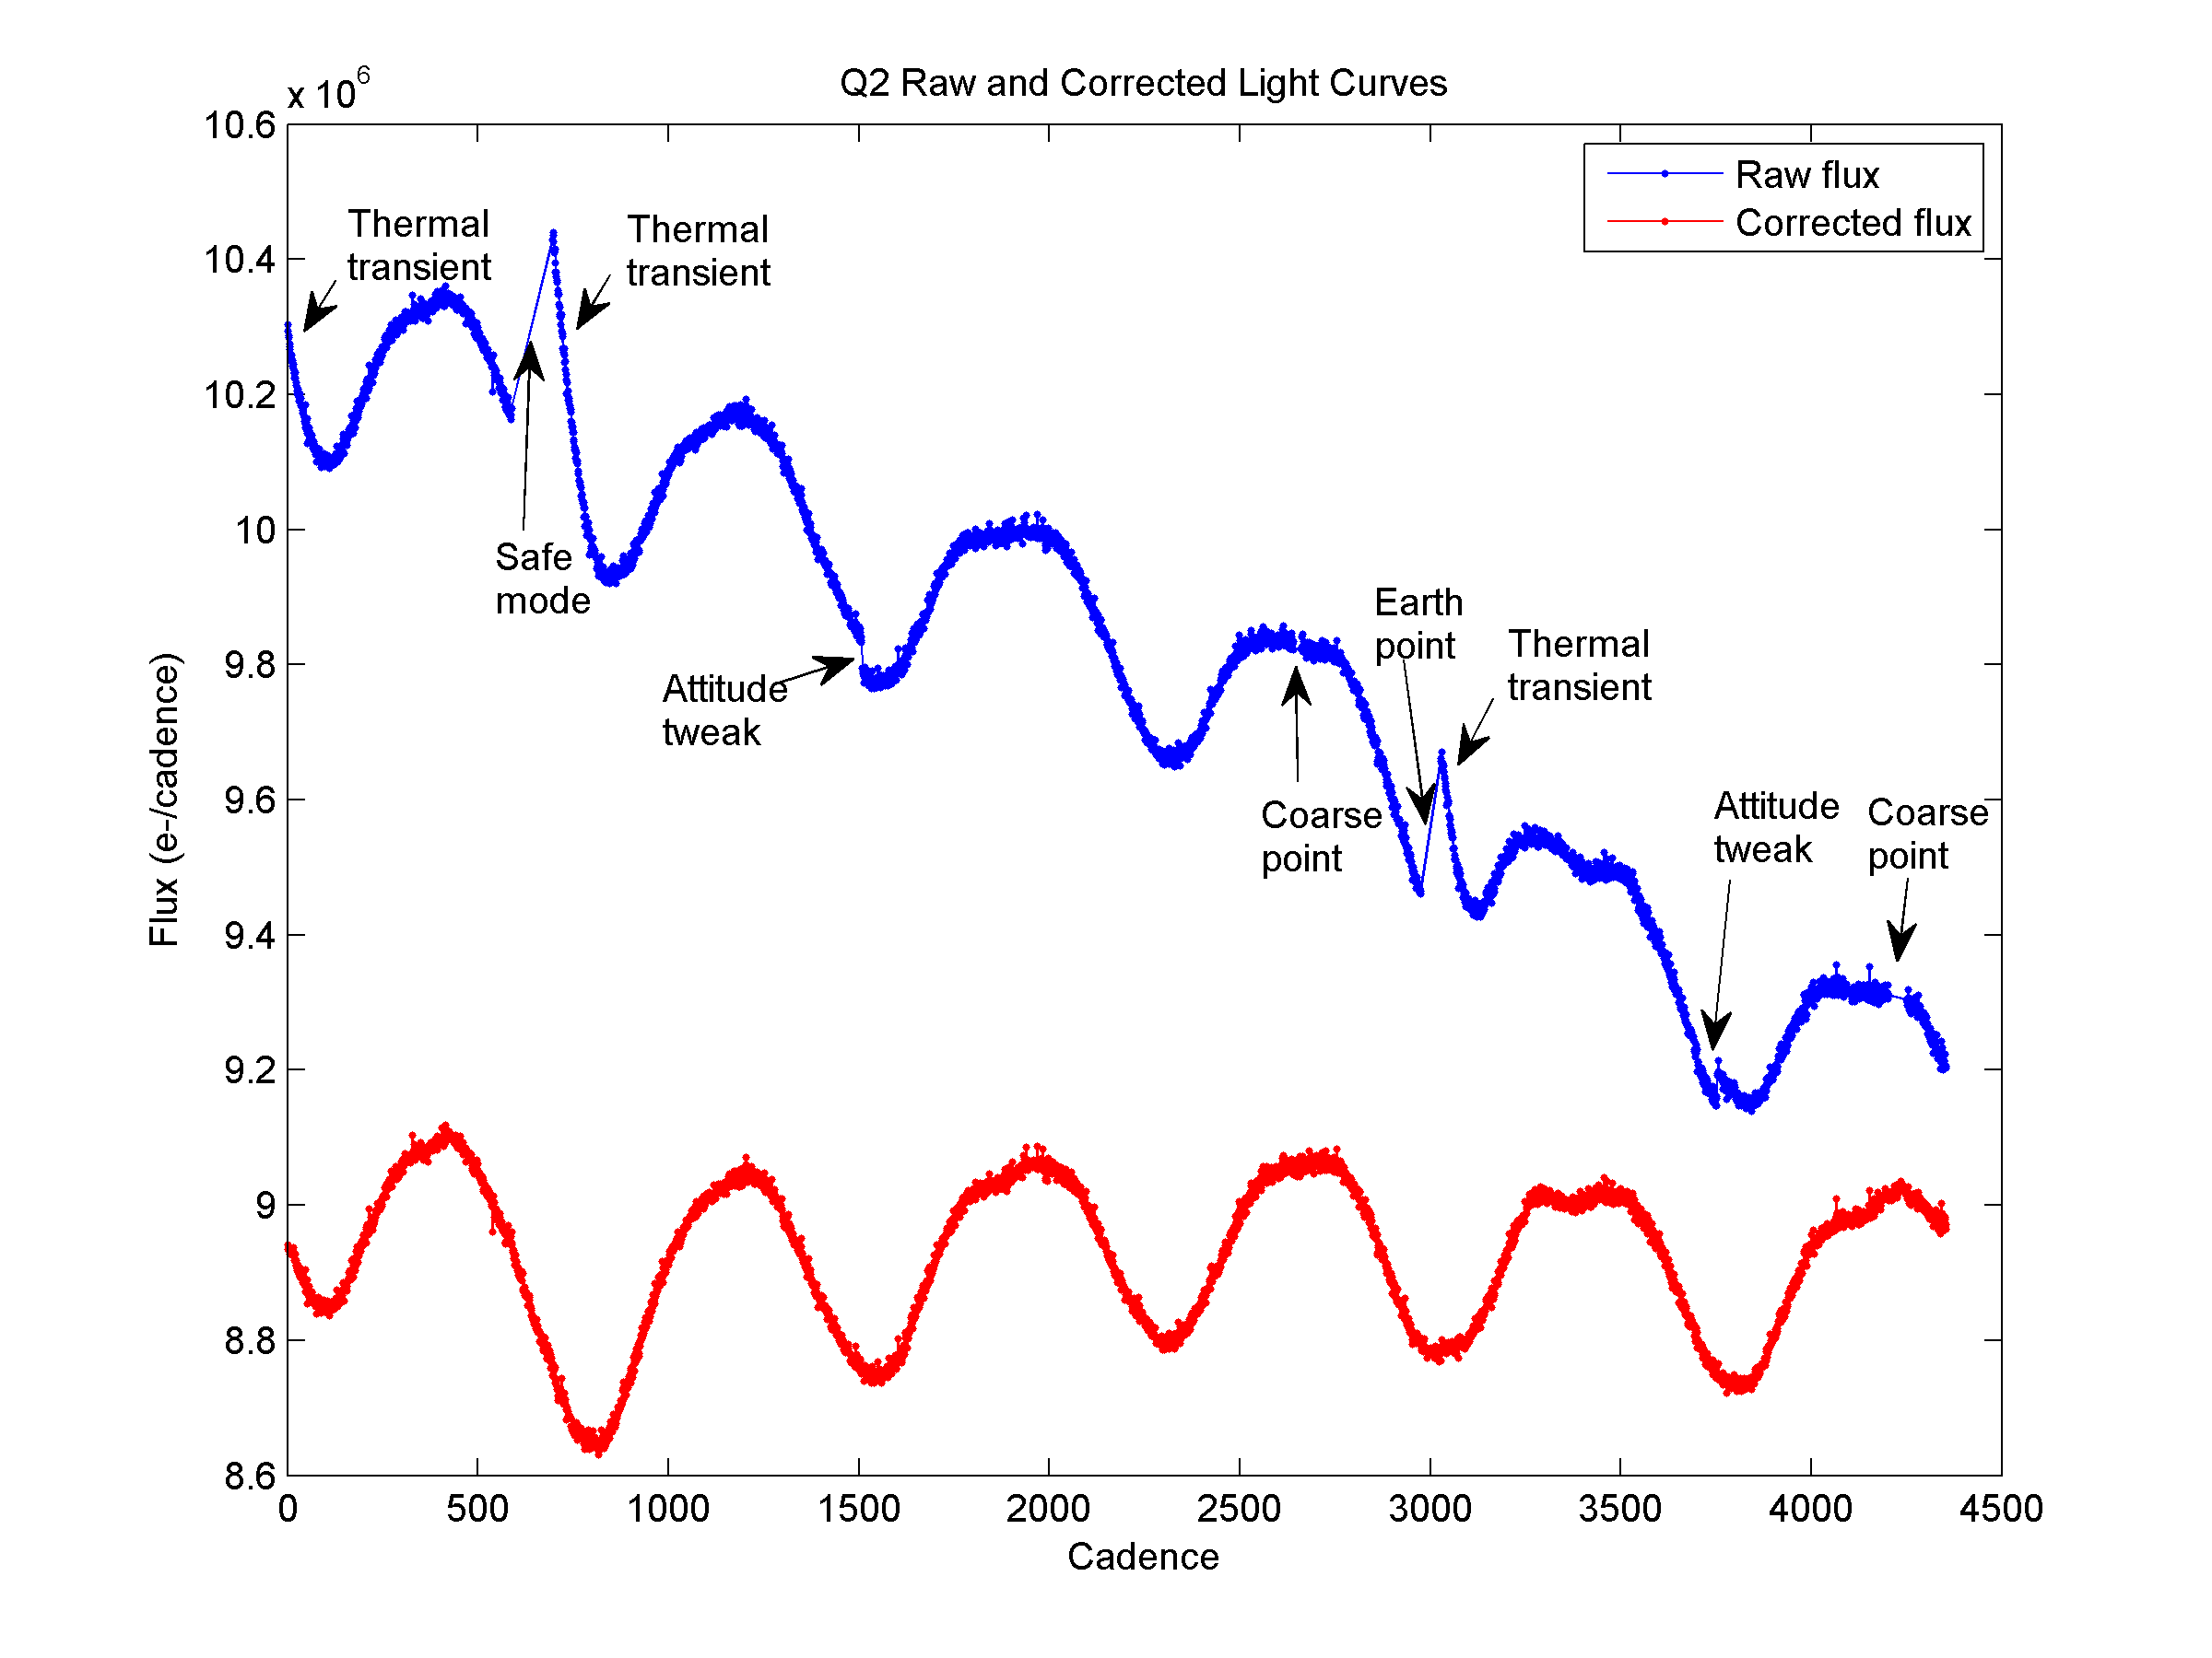
Kepler science processing pipeline (Similar Pipeline for TESS)
Detects transits iteratively by removing one transit at a time
Raw Pixels
Features
Pixels were downloaded once a month (TESS, every two weeks) and transferred to the Science Operations Center (SOC), where they were calibrated, combined to form light curves, corrected for systematic errors introduced in the photometer, and then searched for the signatures of transiting planets. When a planet passes (or transits) in front of its host star, it blocks a small fraction of the light from that star that appears as tiny, repeating pulse or beat. By measuring the frequency of these beats and the amount of light blocked, we can detect the planets and calculate their size and orbital distance.

Slide 10

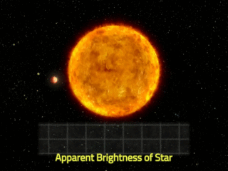
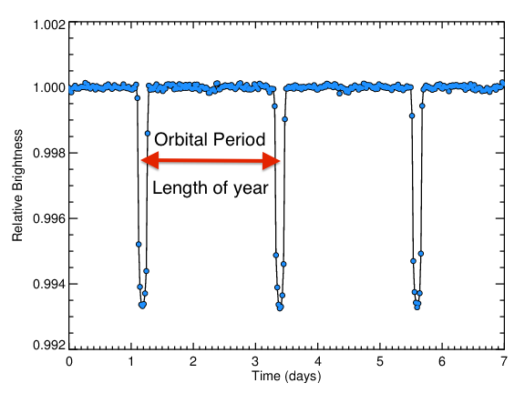
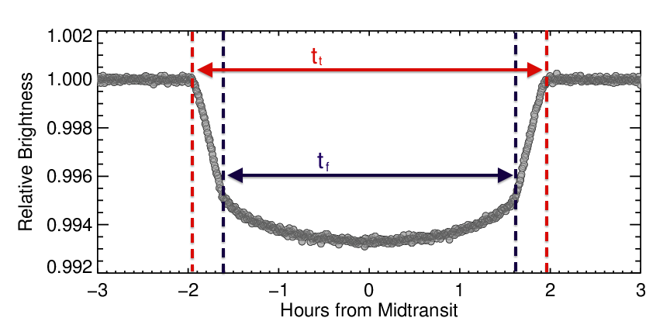
Phase Folding
Planet HAT-p-7b (Kepler-2b)
Periodic behavior
  Clock: Cycles instead of hours or minutes
  Each cycle is a year for that planet
Folding over phases/cycles
  Helps to reduce the variation due to stellar variability or noise
  Provide more reliable signal (improves SNR)
.006
Reduction
in
brightness
Phase
Folding

Slide 11
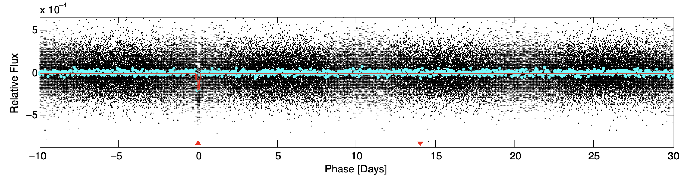
Real Flux Data
Kepler-1861b (Valizadegan et. al. 2022)
Phase
Folding
However not all detected transits are exoplanets

Slide 12
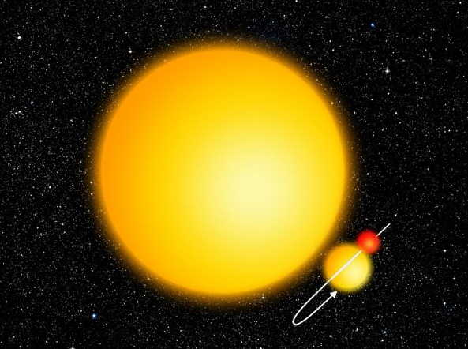
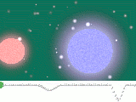
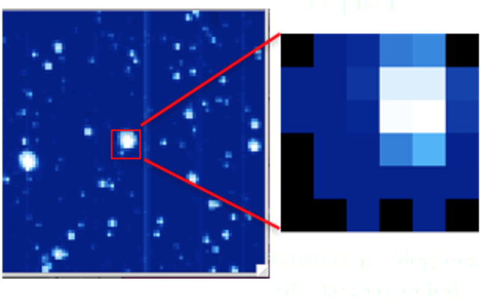
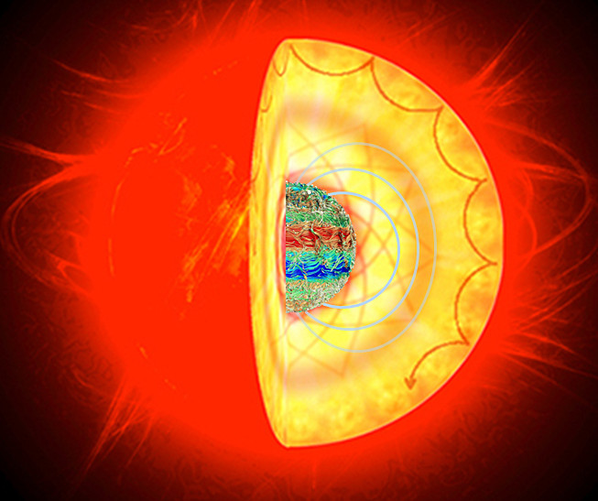
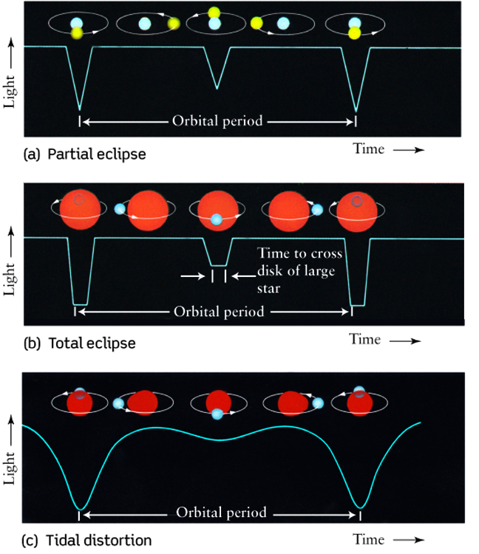
Different False Positive Sources
1. Eclipsing Binary Stars
2. Transits Due to Background Objects
3. Star Variability & systematics
Existence of false positive sources → Classification problem
4. Transits due to systematic instrumental noise

Slide 13
Machine Classifiers help finding new exoplanets :
1- Indirectly by allowing domain experts to focus on the most promising signals
2- Directly if they are highly confident (Validation)

Slide 14
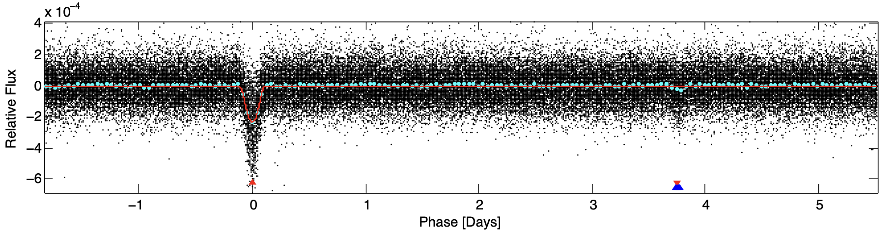
Deep Learning
A version of this was developed in 2018 (Shallue & Vanderburg 2018)
Called AstoNet, used phase folded flux data in two versions: local and global views
Precision=86.1%, Recall=88.5%
How can we improve the performance
  How about using raw pixel data?
Deep Neural Networks
Planet or FP

Slide 15
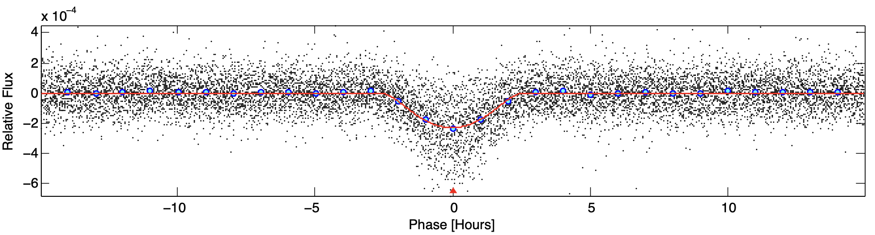
CNN: AstroNet
Global View
Local View (focused on transit)
Only phase folded flux data used in two versions: local and global views
Precision=86.1%, Recall=88.5%
How can we improve the performance
  How about using raw pixel data?

Slide 16
Raw Pixel Data
A series of images for each target star
What information they have?
Should we use them?

Slide 17
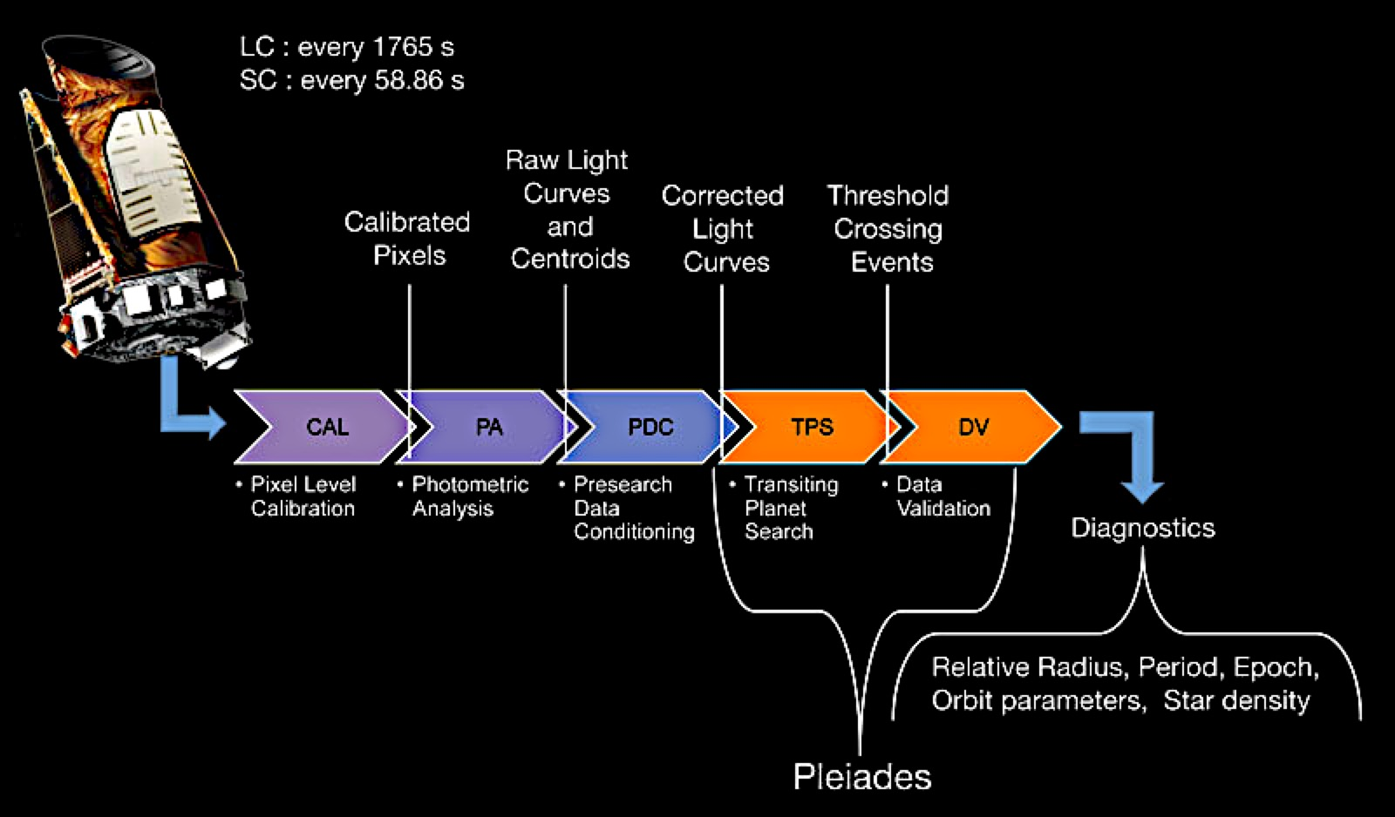
Raw Pixels, Difficult to learn from
We can find planets (or classify transits):
  IF we properly calibrate the CCD image
  IF we properly remove all instrumental artifacts in the light curves
  IF we properly account for all stellar objects around each star and know how they are behaving
  IF we properly characterize all remaining noise in the light curves
  If we properly detect the periodic dipping of the brightness (transits)
Raw pixels: Input size: (15 quarter*90 days+2 quarters*30days)*2 cadences/hours*24 hours/day=67680*32 pixels/image=2.2million pixel values, only 35k annotated data (Curse of Dimensionality)
Cleaner data, lower dimensions, less information
Raw Pixels
More information, less domain knowledge, more complex
Features

Slide 18
The right question is then:
What are we missing from pixel data?
The answer requires domain knowledge.

Slide 19
Different False Positive Sources
1. Eclipsing Binary Stars
2. Transits Due to Background Objects
3. Star Variability & systematics
By understanding different sources of false positives, we are able to understand what we need to use as input to the model.
4. Transits due to systematic instrumental noise

Slide 20
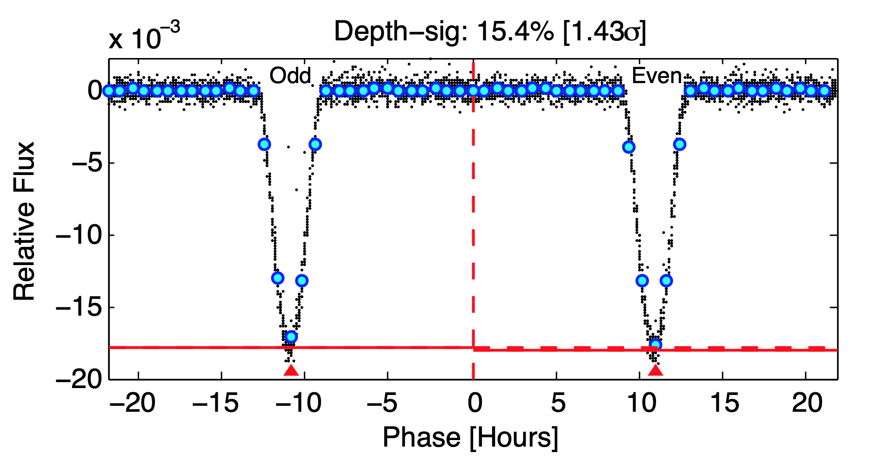
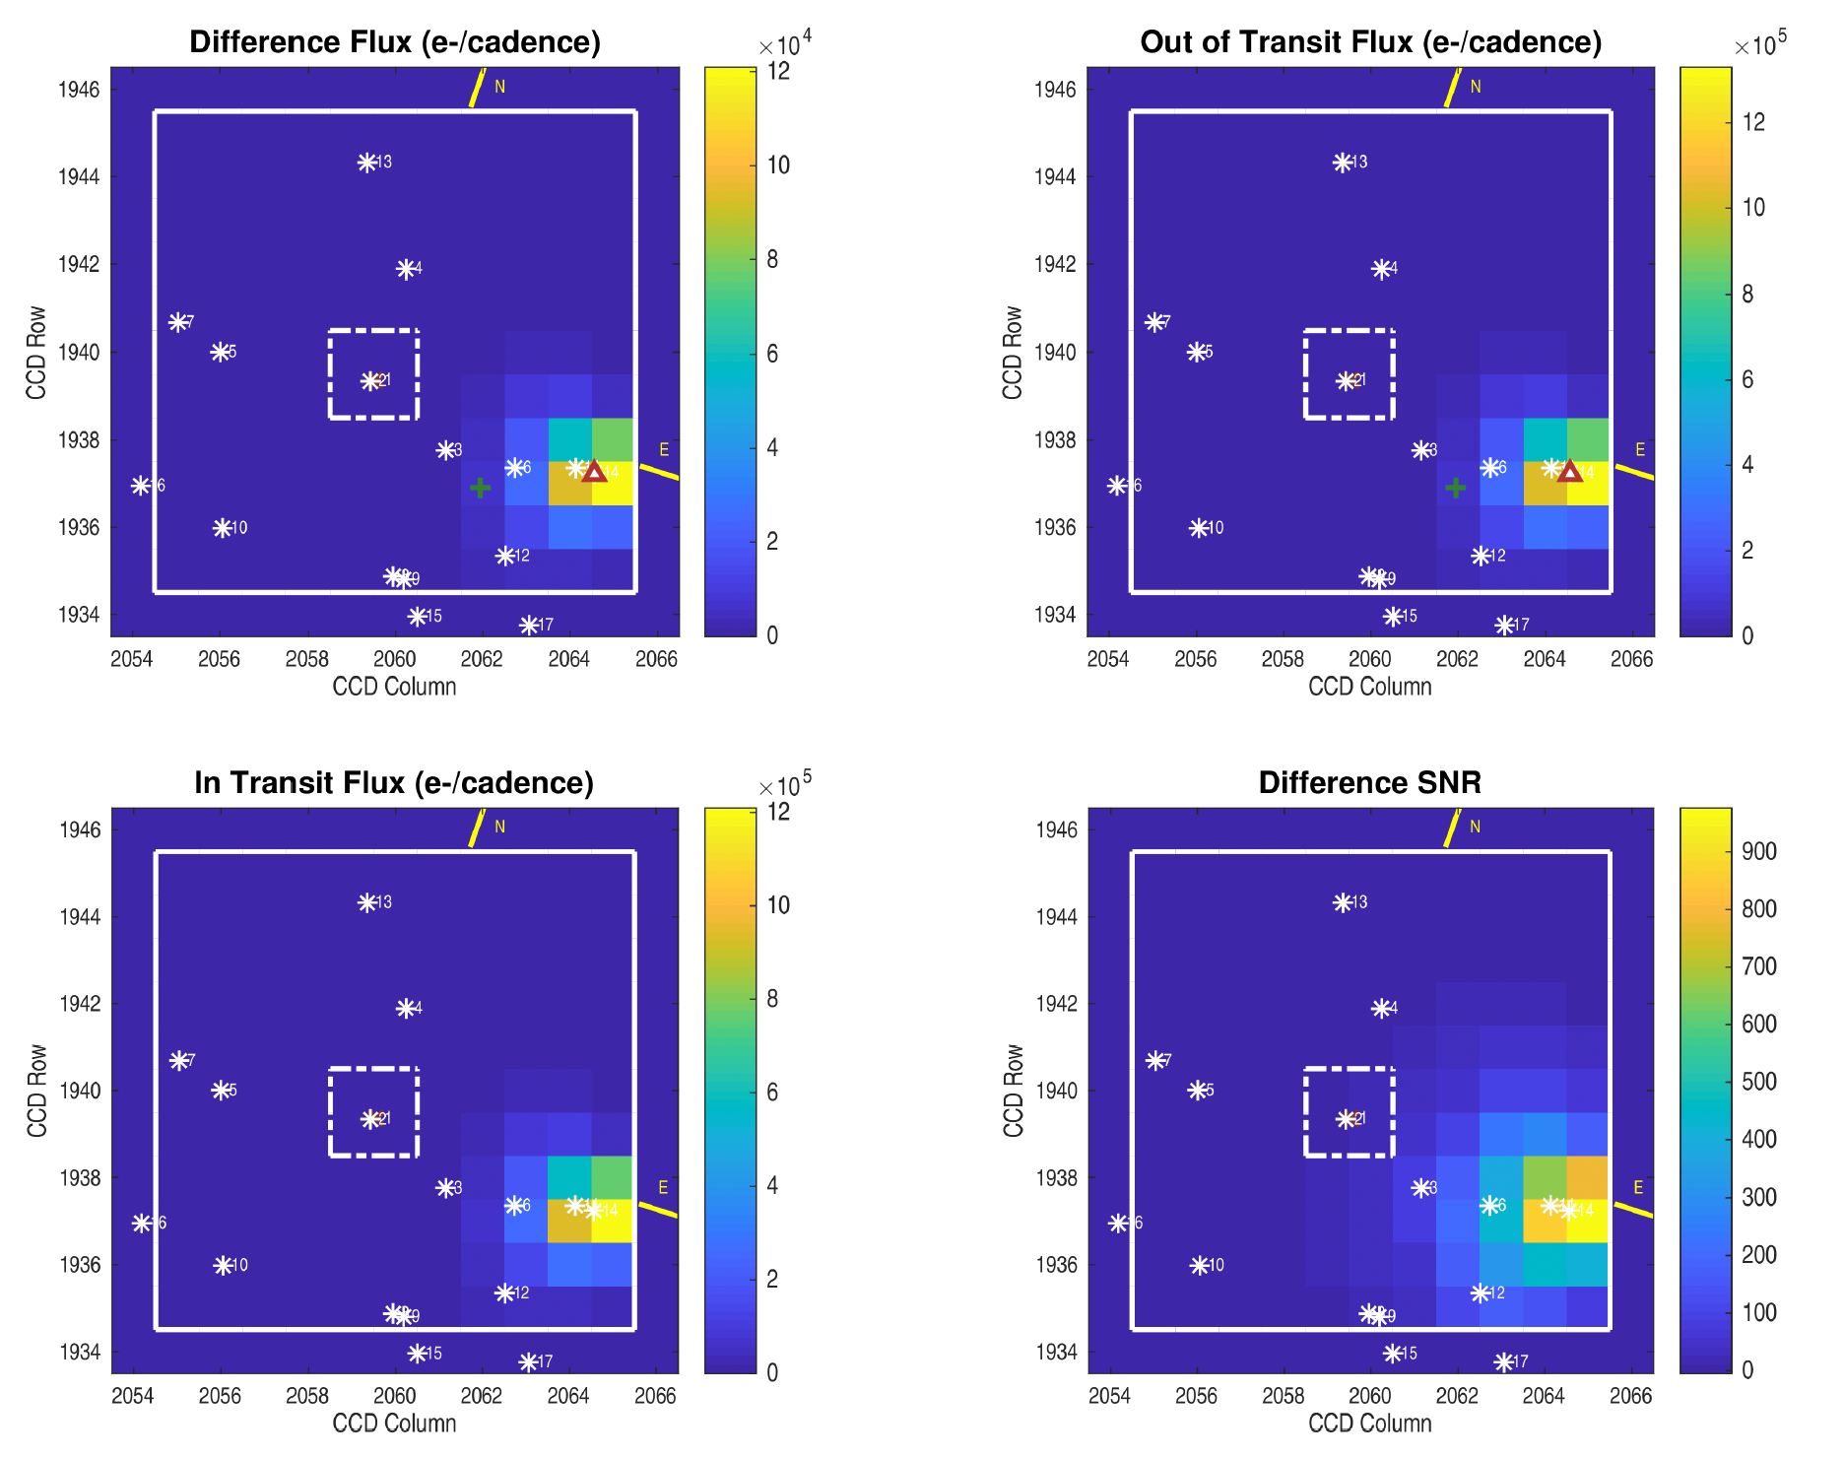
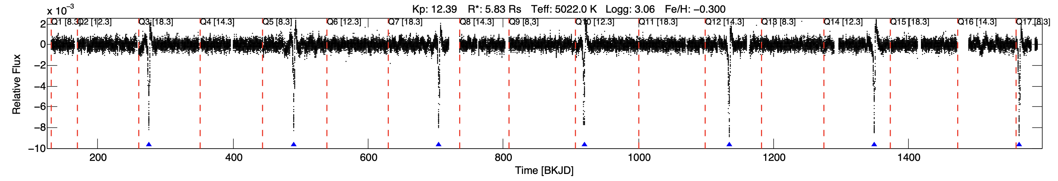
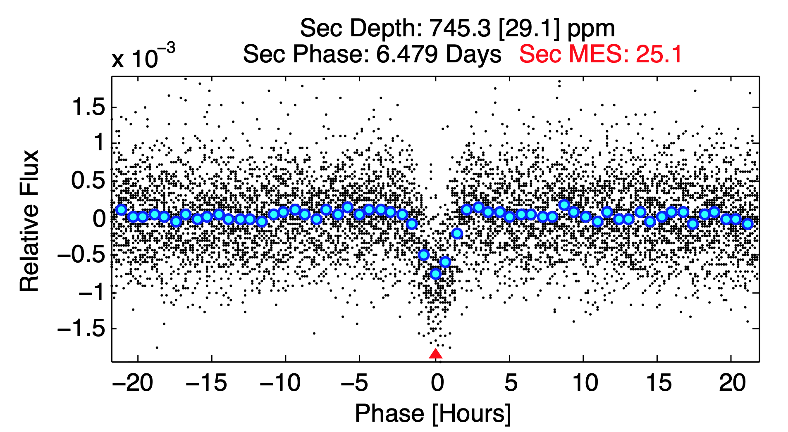
Diagnostic tests for different false positive source
1. Eclipsing Binary Stars
2. Transits Due to Background Objects
3. Star Variability & Systematics
Odd & even test
Odd and Even test
Difference Image Test
Consistency of transits in different cycles
Secondary test
Weak Secondary Test
Consistency of transits in unfolded curves

Slide 21
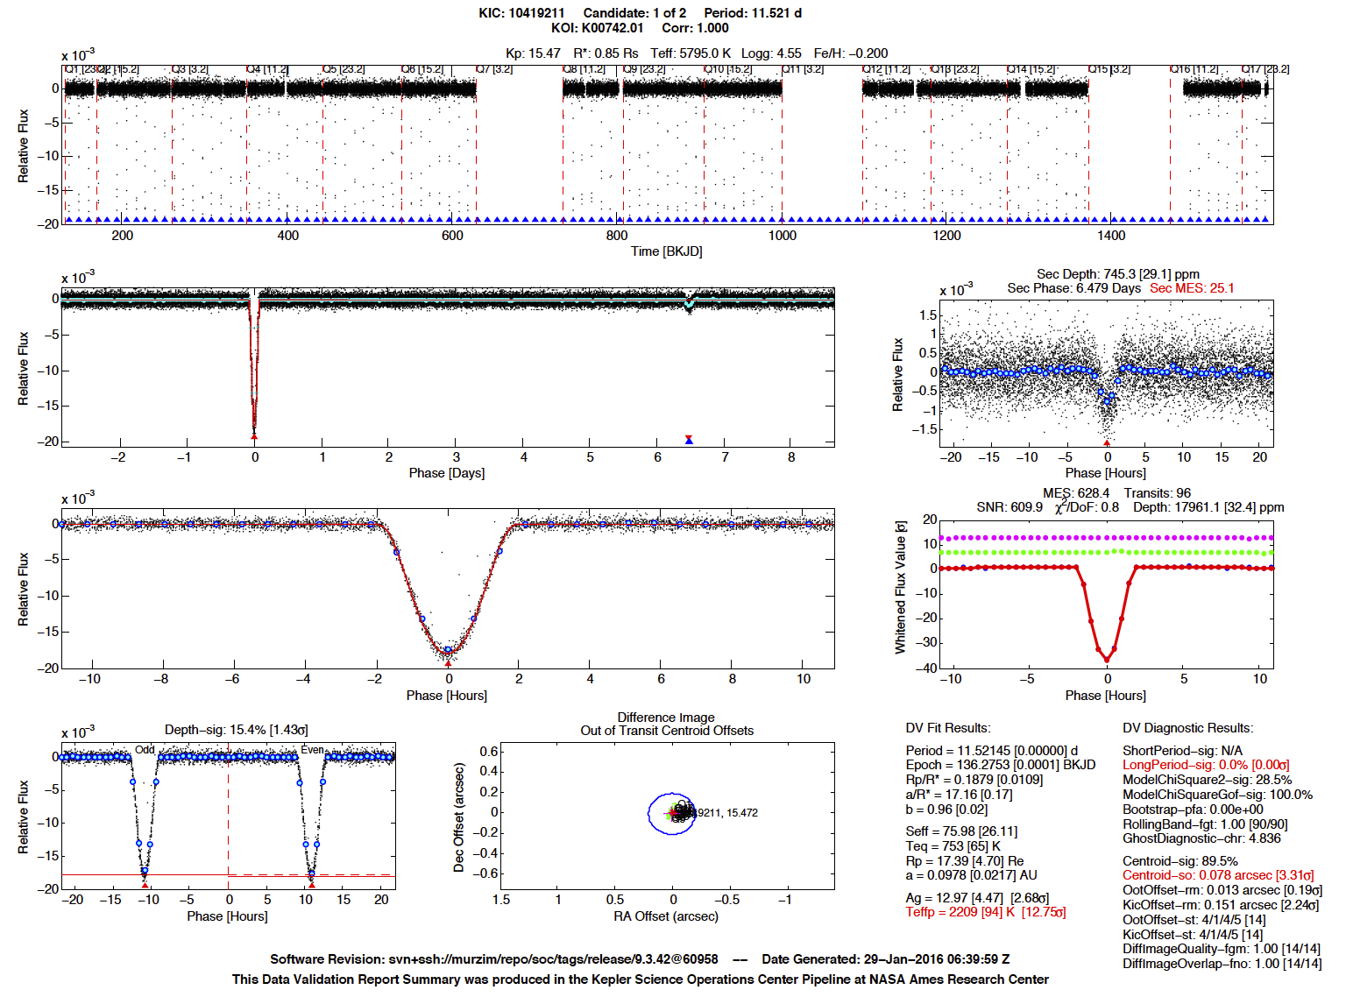
DV Summary Report
Various diagnostic tests are provided in DV report and summarized in the DV summary report
Each complex diagnostic type (time series or images) associated with scaler values summarizing it
Human experts use these DV reports to vet the transit signals
Secondary Transit
Full-Orbit View of Flux
Transit View of Flux
Whitened Transit View of Flux
Odd & Even
Centroid Test

Slide 22
Exiting Classifiers
Non-Deep Learning
Autovetter (Jenkins et. al. 2014, Cauliff et. al. 2015):
  A random forest, trained on the features extracted from different diagnostic tests
Robovetter (Coughlin 2017):
  Expert Systerm, manual designed using domain knowledge
vespa (Morton et. al. 2016),
  A Bayesian classifier that only uses the variables explaining the shape of the transit, super simplified.
  The holy model of the exoplanets at the time.
RFC (Armstrong et. al. 2020)
  A random forest classifier
  Used Self-organizing maps (SOM) to extract features from flux data
  Combines it with features extracted from other diagnostic tests
GPC (Armstrong et. al. 2020)
  A Gaussian process classifier
  Uses flux and features extracted from other diagnostic tests.
Deep Learning
AstroNet (Shallue & Vanderburg 2018)
  A CNN model
  Only used the flux data
Exonet (Ansdell et. al. 2018)
  A CNN model similar to AstroNet
  Added the flux weighted motion time series for background objects
  Added stellar parameters

Slide 23
Our Classifier: ExoMiner
ExoMiner was deigned to receive different components of a DV summary report as input.
The original model did not accept two diagnostic tests due to their complexity.
DV report
ExoMiner
Exoplanet/FP
Challenge:
Preprocess each diagnostic test suitable for machine to use

Slide 24
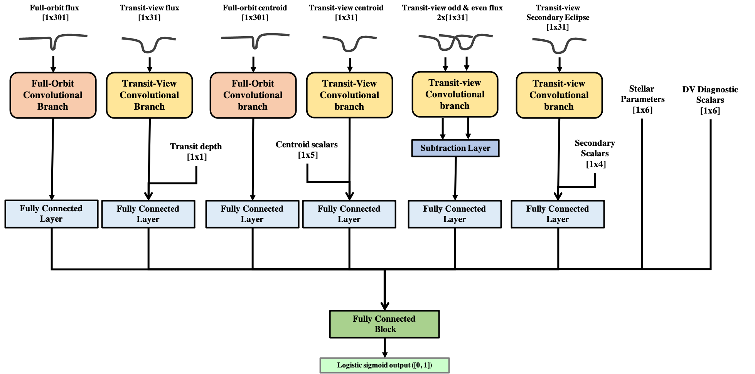
ExoMiner Architecture
Using the test on DV summary reports led to a highly accurate classifier ideal for discovering new exoplanets
The general architecture inspired by how domain experts vet transit signals.
  Leads to better explainability and transferability across missions
Each data input requires special preprocessing and handling using a combination of domain knowledge and machine learning

Slide 25
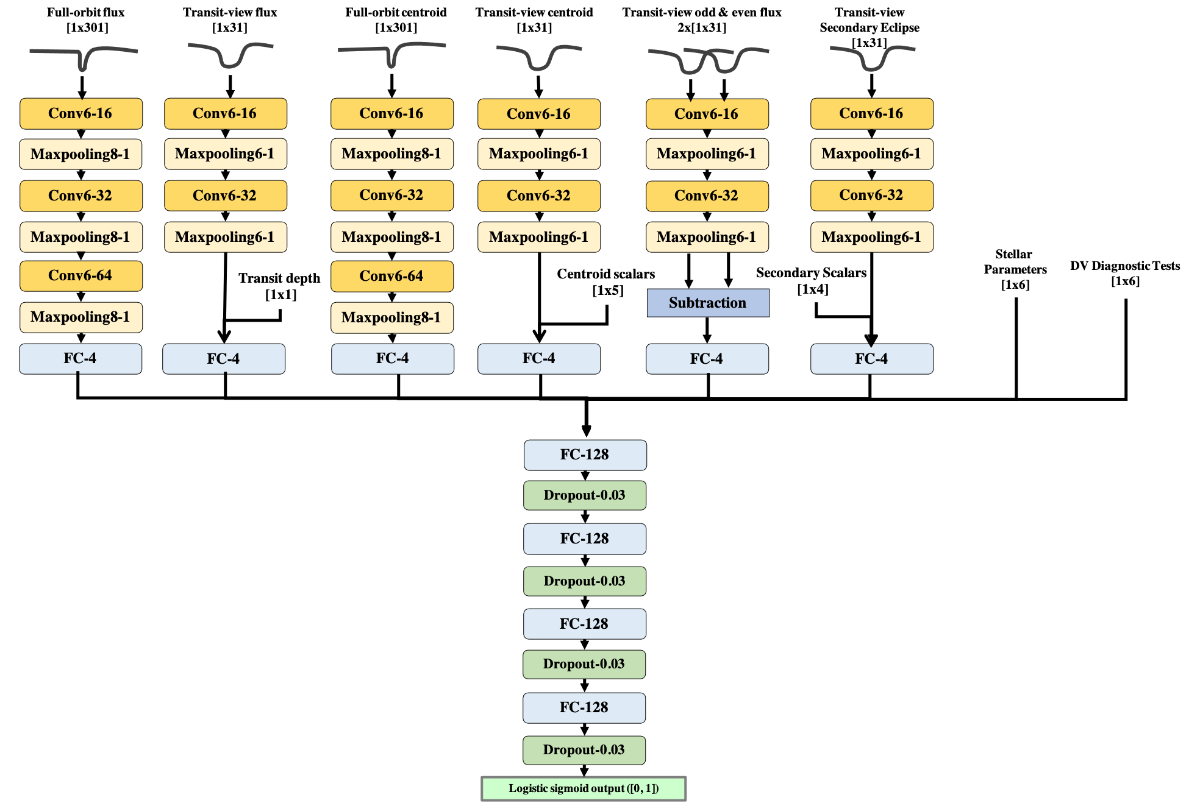
Optimized CNN Architecture
Fully data-driven approach
Specifics of architecture are optimized using a hyper-parameters optimization
Connection weights are learned from data
Allowed for a consistent classifier
  Compared to biases that comes with human labeling

Slide 26
Results (All Metrics)
Model/Metric | Precision & Recall | Accuracy | PR AUC | ROC AUC
Robovetter [Coughlin 2017] | 0.951 & 0.975 | 0.994 | 0.958 | 0.994
AstroNet [Shallue & Vanderburg 2018] | 0.861 & 0.885 | 0.981 | 0.925 | 0.993
ExoNet [Ansdell et. al. 2018] | 0.925 & 0.864 | 0.985 | 0.956 | 0.995
GPC [Armstrong et. al. 2020] | 0.921 & 0.964 | 0.991 | 0.982 | 0.998
RFC [Armstrong et. al. 2020] | 0.929 & 0.955 | 0.991 | 0.979 | 0.998
ExoMiner [Valizadegan et. al. 2022] | 0.968 & 0.974 | 0.996 | 0.995 | 1.000
  PR AUC: Precision-Recall Area Under the Curve
  ROC AUC: Receiver Operating Characteristics Area Under the Curve
  Accuracy and ROC AUC are not the best metrics because the data are highly imbalanced

Slide 27
Results (Precision-Recall Curve)
Precision Recall Curve
Recall value at Precision=0.99
(gray dotted line on precision recall plot)
Model/Metric | Recall@0.99
Robovetter [Coughlin 2017] | 0.000*
AstroNet [Shallue & Vanderburg 2018] | 0.001**
ExoNet [Ansdell et. al. 2018] | 0.506
GPC [Armstrong et. al. 2020] | 0.763
RFC [Armstrong et. al. 2020] | 0.677
ExoMiner [Valizadegan et. al. 2022] | 0.936
* Robovetter assigns a score of 1.0 to 1312 TCEs from which there are 44 non-PCs
** There exist false positives with very high AstroNet scores
Interestingly, the other two deep learning models (AstroNet and ExoNet) performs the worst
  Indicating the lack of access for enough information
ExoMiner performs much better than existing classifiers

Slide 28
Results (Precision@k)
Ranking Performance
Precision@k is the percentage of Exoplanets on the top k signals ranked by a model.
ExoMiner is very reliable in putting exoplanats on the top, unlike the existing classifiers
ExoMiner is much better than existing classifiers for ranking transit signals.
Models with better rankings are more useful for follow up studies and aiding domain experts.

Slide 29
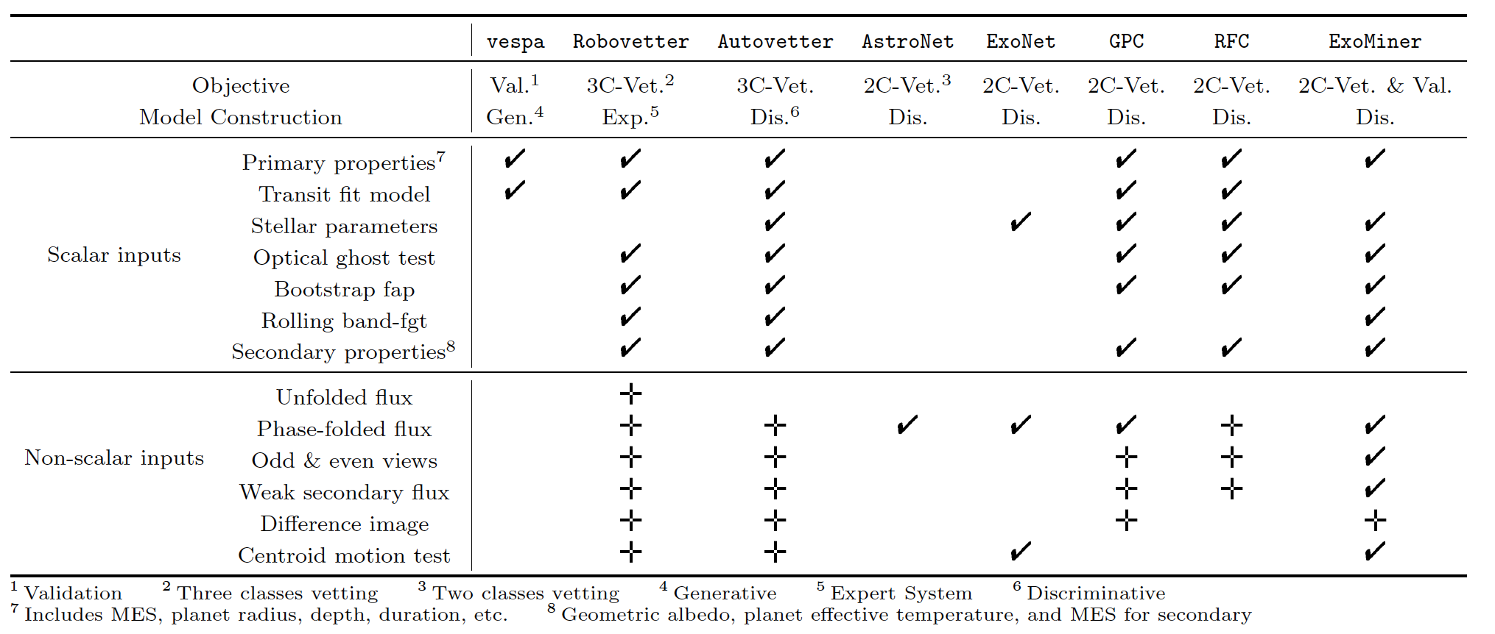
Summary of Existing Classifiers
Deep Neural Networks are highly flexible; able to process various types of diagnostic tests available in DV reports
Lack of representative data as input → Poor performance of existing deep learning models

Slide 30
Confirmation vs Validation
Confirmation: Using follow up studies/observations confirming that the transit signal is not a FP
  E.g., by rejecting Eclipsing binaries (EBs) or background EBs using telescope observations.
Validation: Statistically showing that the FP probability of transit signal is very slim.
  A model to calculate the posterior is developed;
  If FP probability of exoplanet is low enough (usually < 0.01), the transit signal is Exoplanet;
  High Precision (w.r.t. exoplanet class) of such statistical models is critical.

Slide 31
ExoMiner for Exoplanet Validation
Domain Experts concerns
  Size of the training set is not enough: Data scenarios unseen to the model.
  Label noise could lead to incorrect validation.
  A need for outlier detection to prevent unknown objects getting validated
  Model calibration is required to obtain probability scores.
These are well-studied topics in ML.
However, we needed to convince the domain experts.
  Subject of the next four slides.

Slide 32
ExoMiner for Exoplanet Validation (Cont’d)
Effect of training set size on performance
Domain experts’ concern:
Size of data is not large enough.
There could exist unknown scenarios.
So, the classification result is not reliable.
Test:
Study the effect of training set size on the performance (top figure) and confidence of the model (bottom figure)
Results:
Stable performance even with 5% of the training set
Decrease in confidence with smaller size of training set (good property for validation)
  Due to early stopping to prevent overfitting
Smaller training set
Effect of training set size on confidence

Slide 33
ExoMiner for Exoplanet Validation (Cont’d)
Effect of label noise on performance
Domain experts’ concern:
The labels are noisy.
Thus, classifier learns the wrong concept.
Test:
Study the effect of label noise on the performance (top figure) and confidence of the model (bottom figure).
Results:
Stable performance even with 40% label noise,
Decrease in confidence with more label noise (good property for validation).
  Due to early stopping to prevent overfitting.
Noisier labels
Effect of label noise on confidence

Slide 34
ExoMiner for Exoplanet Validation (Cont’d)
Domain experts’ concern: You should use outlier detection to remove the outliers (unknown scenarios) from validation
Response: That’s ad-hoc. Instead: classification with rejection
  Validating cases with very high scores automatically excludes uncertain cases. Think about the posterior probability.

Slide 35
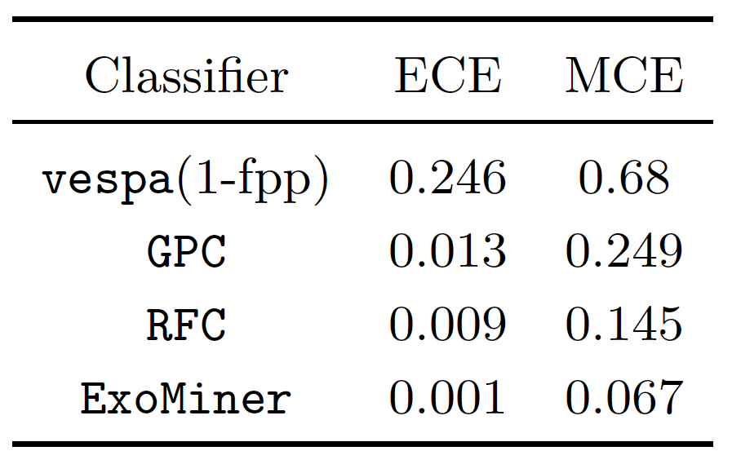
ExoMiner for Exoplanet Validation (Cont’d)
Classifier Calibration: Required to make decision based on the classifier’s output
  Definition: Calibrated classifier score=s → classifier is correct s% of time
  Cailbration/reliability plots show how calibrated a classifier is
Concern: Classifier should be calibrated
  ECE: expected Calibration Score, MCE: Maximum Calibdarion score

Slide 36
Using ExoMiner to Validate Exoplanets
To validate new exoplanets, we
  Used ExoMiner scores > 0.99
  Vetoed signals with MES <10.5 (MES is a measure of S/R)
This led to the validation of 301 new exoplanets
  Increased the total number by 6.5% (from around 4500 to 4800 exoplanets)
Full results and analysis in Valizadegan et. al. 2022

Slide 37
Multiplicity Boost of ML Classifiers
Domain Knowledge: finding exoplanets on stars with already known planets is more likely.
  Current classifiers are agnostic to presence of exoplanets and FPs around a star
Motivating examples
Multiplicity boost approach
  Update the ML score based on the information related to existing identified signals.
 | Information about the host star
Example | Detected Transits | Known Exoplanets | FPs | ML score | Validate?
1 | 4 | 3 | 0 | 0.95 | ?
2 | 3 | 0 | 2 | 0.991 | ?
3 | 4 | 0 | 0 | 0.98 | ?
Number of Planets
Classifier
Number of FPs
Number of Transits
New (multiplicity) Score
Original Score

Slide 38
Multiplicity Boost of the ML Classifiers (Cont’d)
Train an ML classifier model to map the inputs to output using existing labeled data.
Can be done for any given classifier
Multiplicity boost improves the performance of all classifiers
Model/Metric | Precision & Recall
Model/Metric | Original Scores | Multiplicity Boost
Robovetter [Coughlin 2017] | 0.951 & 0.975 | 0.955 & 0.980
AstroNet [Shallue & Vanderburg 2018] | 0.861 & 0.885 | 0.875 & 0.921
ExoNet [Ansdell et. al. 2018] | 0.925 & 0.864 | 0.922 & 0.933
GPC [Armstrong et. al. 2020] | 0.921 & 0.964 | 0.920 & 0.975
RFC [Armstrong et. al. 2020] | 0.929 & 0.955 | 0.928 & 0.973
ExoMiner [Valizadegan et. al. 2022] | 0.968 & 0.974 | 0.971 & 0.977

Slide 39
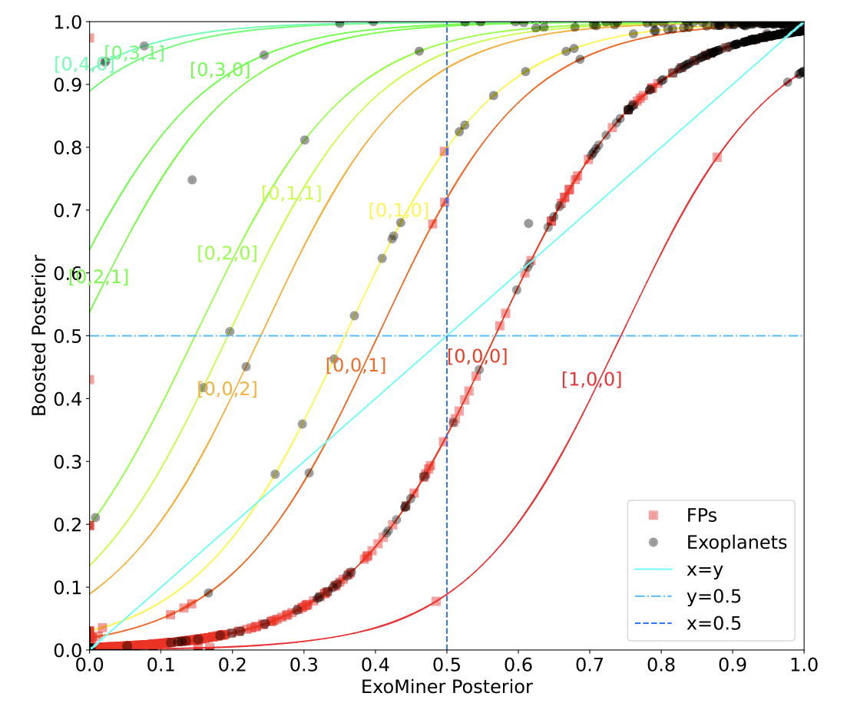
Multiplicity Boost of the ML Classifiers (Cont’d)
[x,y,z]: x= number of certified false positives, y= number of confirmed planets, z=number of unknown transits
Led to validation of 69 new exoplanets
Valizadegan et. al. 2023

Slide 40
Ongoing Direction: Application on TESS
Challenges:
  Low S/N compared to Kepler
  Larger exoplanets makes distinguishing between Eclipsing binaries and Exoplanet difficult.
  Lack of enough high quality labels
Transfer Learning: classifying TESS signals using ExoMiner trained on Kepler data with little fine-tunning
Preliminary results are encouraging but not great.
  Satisfactory for ranking and suggestion for follow up study
  Not accurate enough for validation yet.
Improved ExoMiner in multiple ways:
  New model: ExoMiner++ (paper will be out soon)

Slide 41


ExoMiner++
Three new branches: 1- unfolded flux, 2) difference image, 3) momentum dumps
Added branches

Slide 42
ExoMiner++
Same type
Three branches of the original ExoMiner should extract similar features from the input: 1) Folded Flux, 2) Secondary, and 3) odd & even test

Slide 43
ExoMiner++
Valizadegan et. al 2024, Under Prep.
Merged Feature extractor
This Photo by Unknown Author is licensed under CC BY-SA

Slide 44

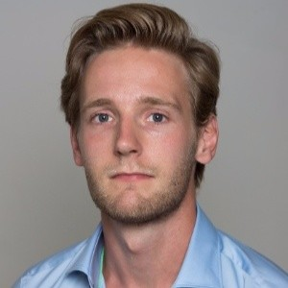
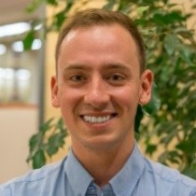
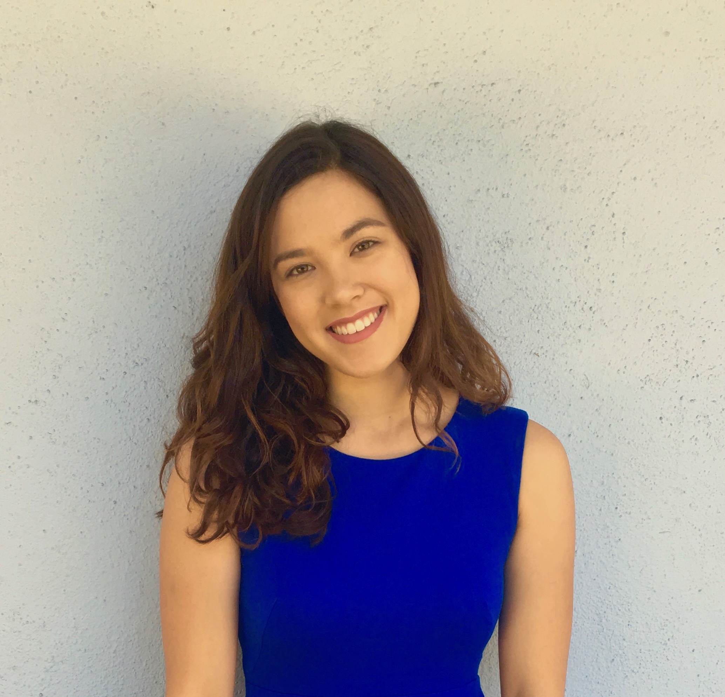

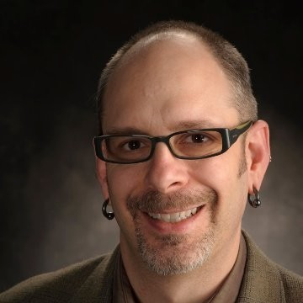
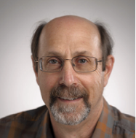
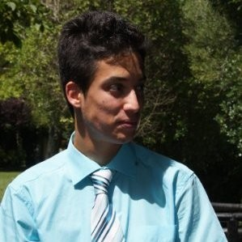
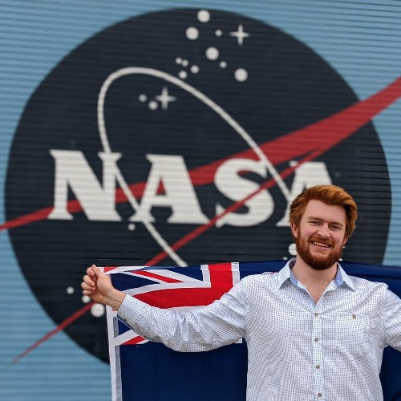
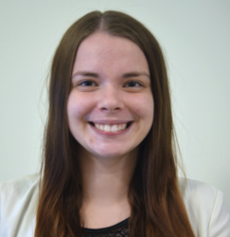
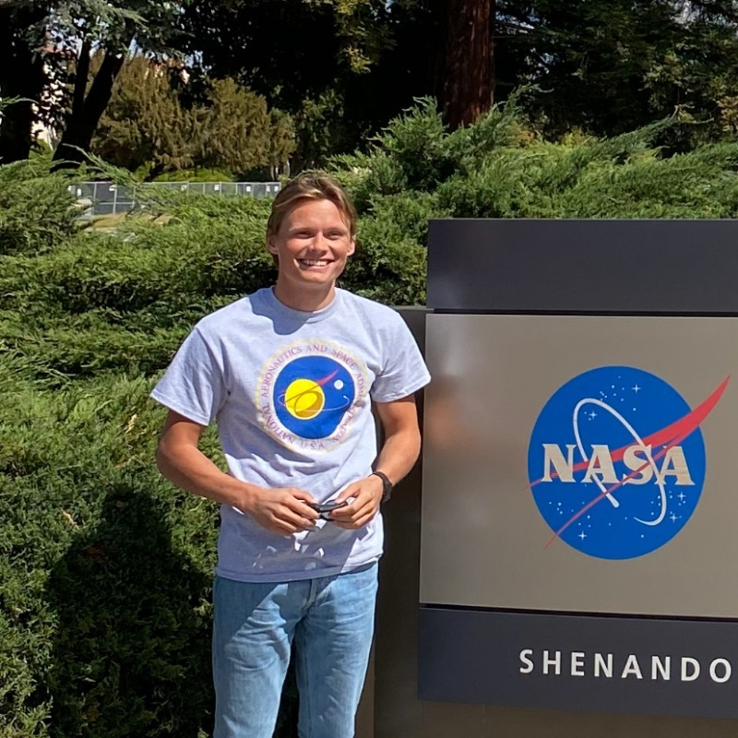
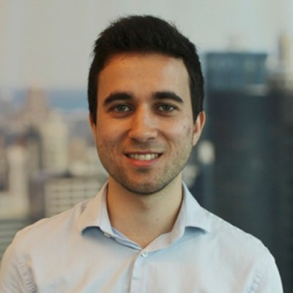
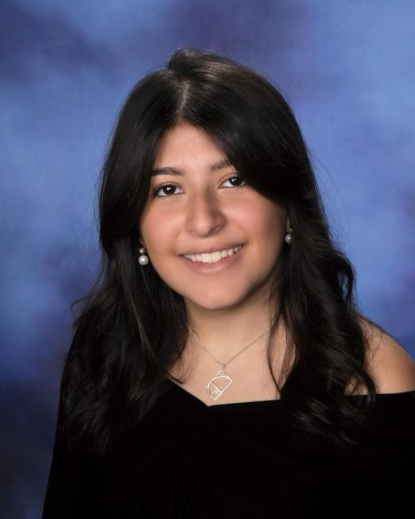

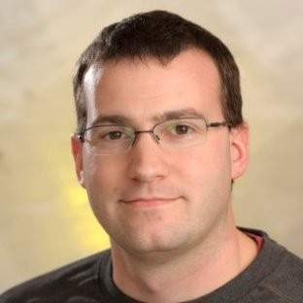
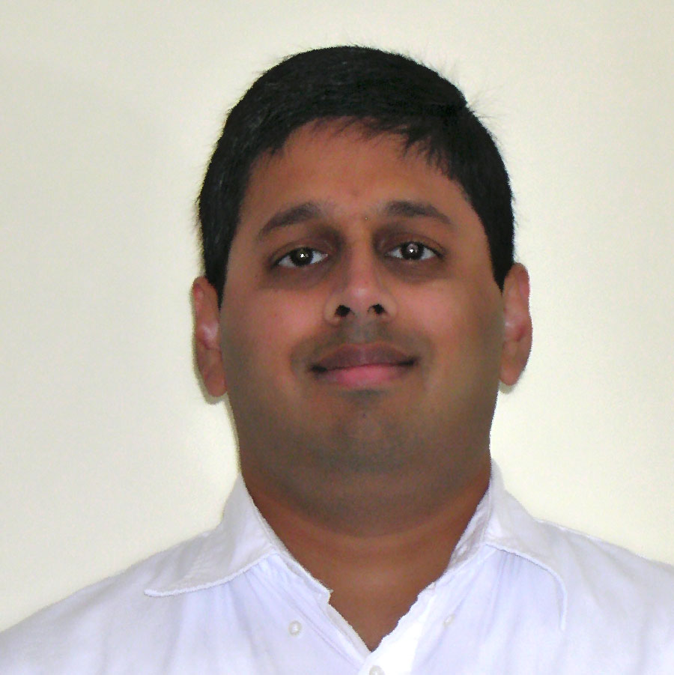

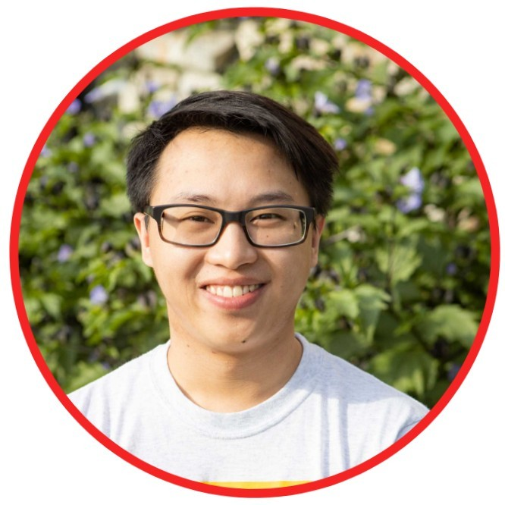



Contributors
Interns: Deep Learning
Data Science Group:
Machine/Deep Learning
Domain Experts
Noa Lubin
I^2 intern, Israel
LSTM and CNN
Laurent Wilkens
USRA Intern, Netherlands
CNN & HPO
Pedro Gerum
I^2 intern, Brazil
Non-TCE classification
Sabrina Berger
USRA intern, US
data conversion
Nikash Walia
USRA intern, UIUC
Odd/Even Test
Jon Jenkins
Science PI for TESS &
CO-I for TESS data processing,
NASA ARC Computer Scientist
Joseph Twicken
TESS Lead Data Scientist,
SETI Institute
Miguel Martinho
USRA Scientist
Core Developer
Sam Donald
I^2 intern, New Zealand
Transfer Learning
Jennifer Andersson
I^2 intern, Sweden
Transfer Learning
Martin Koling
I^2 intern, Sweden
Transfer Learning
Fellipe Marcellino
USRA intern, UC Berkeley
Transit Detection
Kaylie Hausknech
OSTEM intern, Harvard University
Explainability
Douglas Caldwell
Kepler/TESS instrument
Scientist, SETI Institute
Jeff Smith
TESS Data Scientist, SETI Institute
Nikunj C. Oza
Data Science Lead
@ NASA ARC
Patrick Maynard
OSTEM intern, Harvard University
Transfer learning
Yang Theng
OSTEM intern, U of Alaska
Label Noise
Hongbo Wei
OSTEM intern, High School student
Non-TCE and Transfer Learning
Andres Carranza
OSTEM intern, High School student
LSTM and Transformer
Stephan Bryson
NASA ARC Scientist

Slide 45
Conclusion
Domain knowledge is critical for using ML in scientific discovery.
  More effective models
  Smaller data set
  Better communication with the domain experts
Using ML in science is fun, a lot of fun.
  Continuous learning
  Working with amazing people.
  Solving real-world problems.

Slide 46
Thank you!
Hamed Valizadegan, PhD
Intelligent System Division,
NASA Ames Research Center (USRA)
hamed.valizadegan@nasa.gov

