Slide 1


Generative AI for Text to Audio Generation
Wenwu Wang
Centre for Vision, Speech and Signal Processing (CVSSP)
& Institute for People Centred Artificial Intelligence
University of Surrey
United Kingdom
Email: w.wang@surrey.ac.uk
Web: http://personal.ee.surrey.ac.uk/Personal/W.Wang/

Slide 2



Many thanks to…
Haohe Liu
Xubo Liu
Xinhao Mei
Yi Yuan
Zehua Chen
Qiuqiang Kong
Mark Plumbley
Danilo Mandic
Jianyuan Sun
Jian Guan
Feiyang Xiao
Yong Xu
Yin Cao
Turab Iqbal
Yuxuan Wang
Funding from:
UK Engineering and Physical Sciences Research Council (EPSRC) & British Council Newton Institutional Links Award

Slide 3
Outline
Introduction
AudioLDM: text to audio generation with a latent diffusion model
AudioLDM 2: text to audio generation with a foundational model
WavJourney: compositional audio generation based on text prompts
AudioSep: text prompted audio source separation
WavCaps: a large-scale dataset for text-audio cross model learning
Conclusion/Future Work

Slide 4

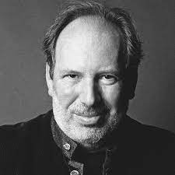
Text to Audio Generation
Computational “foley artist”: (e.g., https://www.thefoleybarn.com )
  Game developer: e.g., A ghost is haunting a house.
  Audio producer: e.g., high heels hitting metal ground.
  Movie producer: e.g., the laser sound from a laser gun.
  …
Automatic content creation (> 60 startups¹)
  Endless music
  Audiobook with ambient noises
  White noise for meditation
  …
Data Augmentations
Sound is often the unsung hero of the movie world
- Hans Zimmer
¹https://github.com/csteinmetz1/ai-audio-startups

Slide 5
Related Works
Label-to-Audio Generation
  Acoustic Scene (Kong et al., 2019), Sound event (Liu et al., 2019), FootStep (Comunit et al. 2019), …
Text-to-Audio Generation
  DiffSound (Yang et al., 2022), AudioGen (Kreuk et al., 2022), Make-an-Audio (Huang et al., 2023)
Text-to-Music Generation
  MusicLM (Andrea et al., 2023)
  Moûsai (Flavio et al., 2023)
  Noise2Music (Huang et al., 2023)
Others
  JukeBox (Dhariwal et al., 2020), AudioLM (Borsos et al., 2022), SingSong (Donahue et al., 2023),…

Slide 6
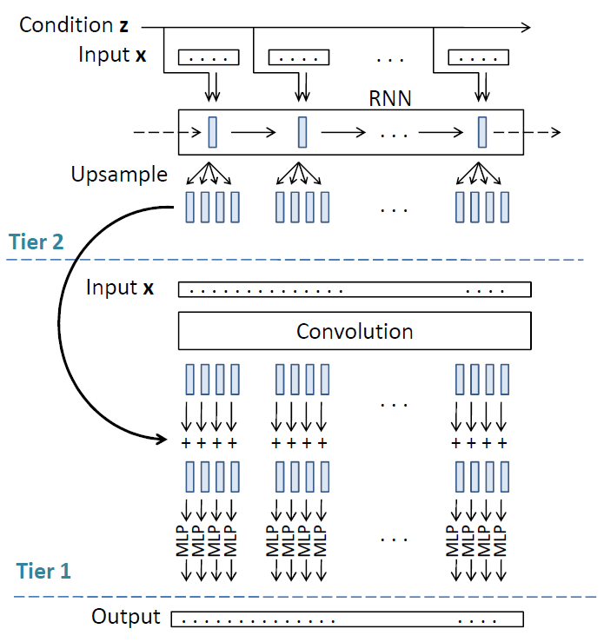
Label to Audio Scene Generation
Q. Kong, Y. Xu, T. Iqbal, Y. Cao, W. Wang, and M. D. Plumbley, "Acoustic scene generation with conditional SampleRNN", in Proc. IEEE International Conference on Acoustics, Speech and Signal Processing (ICASSP 2019), Brighton, UK, 12-17 May, 2019.

Slide 7
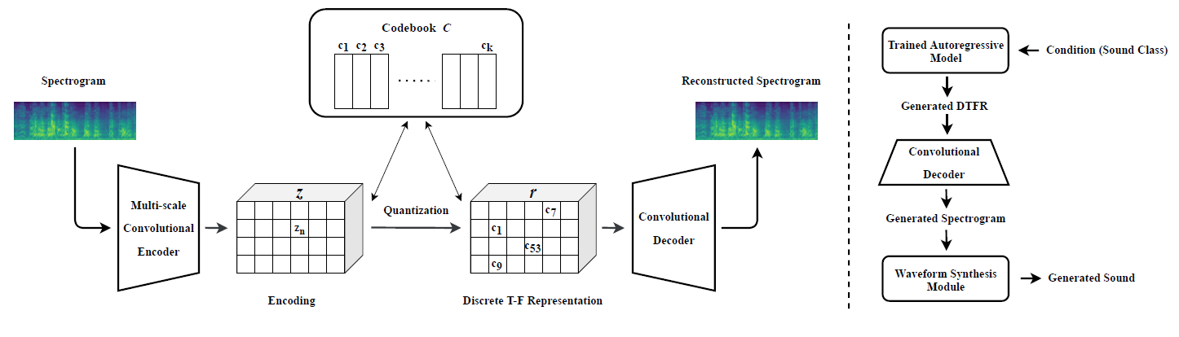
Label to Audio Event Generation
X. Liu, T. Iqbal, J.Zhao, Q. Huang, M.D. Plumbley, and W. Wang, "Conditional Sound Generation Using Neural Discrete Time-Frequency Representation Learning", in IEEE 31st International Workshop on Machine Learning for Signal Processing (MLSP 2021), 2021

Slide 8
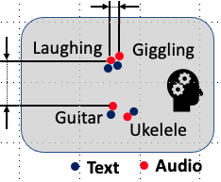
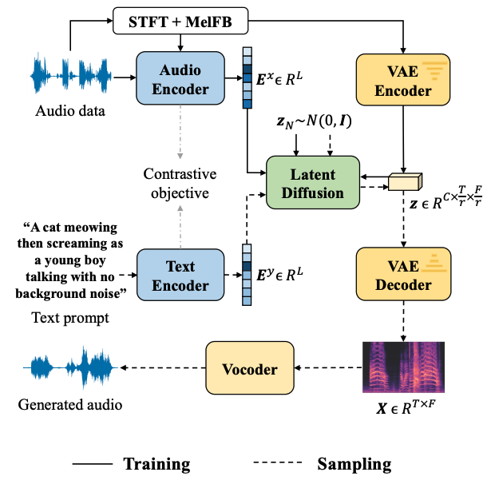

AudioLDM
Self-supervised training
Contrastive Language-Audio Learning (CLAP) Encoders
  Align audio and text in one space.
Latent Diffusion Models
  Learn to generate VAE latent conditioned on CLAP embedding
Mel-spectrogram Autoencoder
  Learn latent representations.
Mel-to-Waveform Vocoder
  Reverse Mel back to waveform
H. Liu, Z. Chen, Y. Yuan, X. Mei, X. Liu, D. Mandic, W. Wang, M. D. Plumbley, "AudioLDM: text-to-audio generation with latent diffusion models," in Proc. IEEE International Conference on Machine Learning (ICML 2023), Hawaii, USA, 23-29 July, 2023.

Slide 9
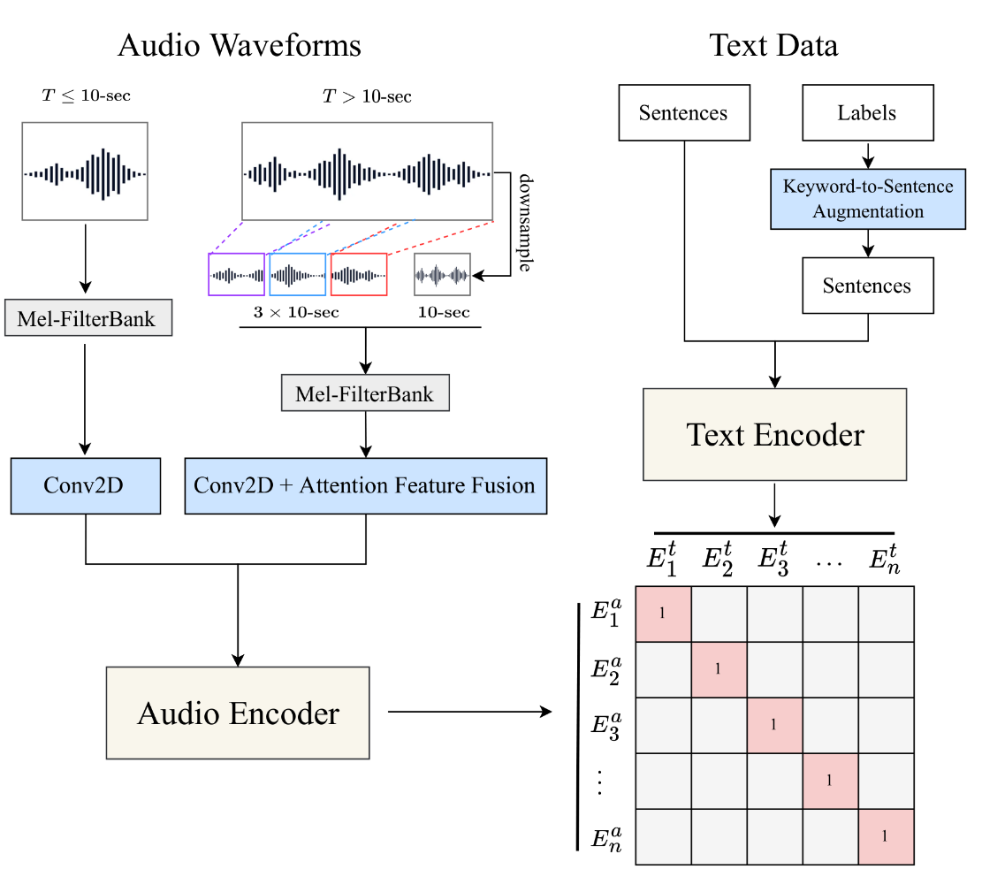
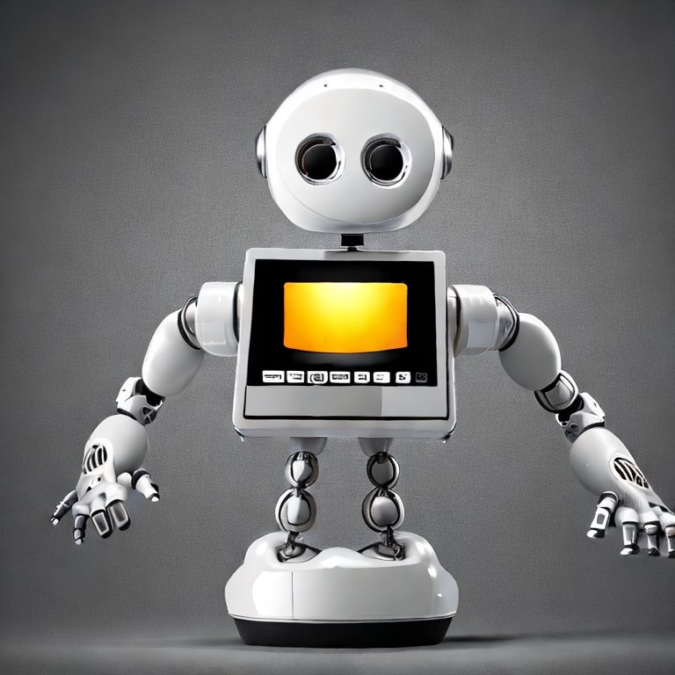
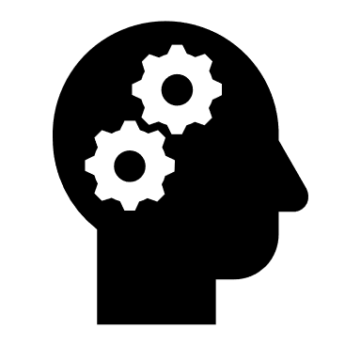


Step 1: Contrastive Language-Audio Pretraining
OK Got it
Laughing is similar to Giggle (Text).
Laughing also sounds like Giggle (Audio).
Laughing is not similar to Guitar (Text).
Laughing does not sound like Guitar (Audio)
AI
New data
Latent Space
Laughing
Giggling
Guitar
Ukelele
Text
Audio
Audio
Text
Contrastive Language-Audio Pretraining (Wu et al., 2022)

Slide 10
Step 2: Self-Supervised Audio Generation Training
Human Developer:
Here are more audio data,
Try to figure out how to generate them
using your knowledge!
Nobody knows audio better than me!!!
Tell me what you want!
Audio
Can we build a system that is
EFFICIENT to train,
need LESS audio-text pairs,
and have BETTER quality and flexibility?

Slide 11
Overall Advantages
Less computation cost
  Latent Diffusion Models
Less dependency on audio-text pairs
  Train LDMs by self supervision
Continueous latent space
  Zero-shot audio style transfer
  Zero-shot audio super-resolution
  Zero-shot audio inpainting
  …

Slide 12
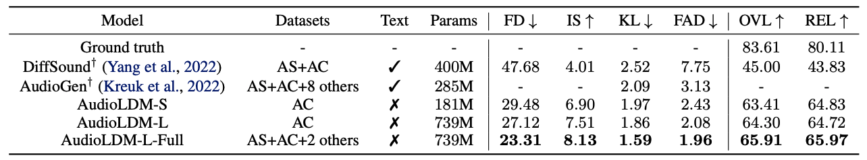
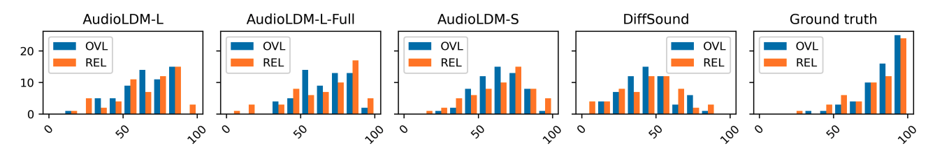
Result – SOTA Comparison
Trained on a single 3090 or A100 GPU!

Slide 13
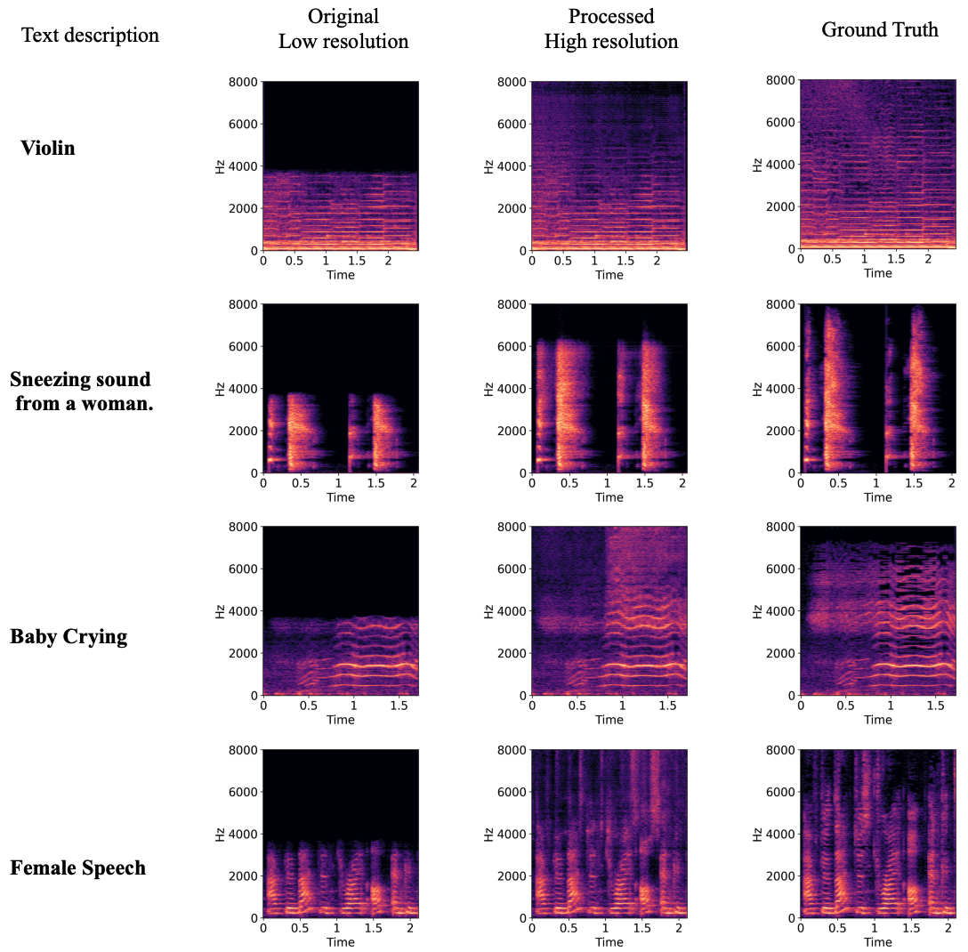
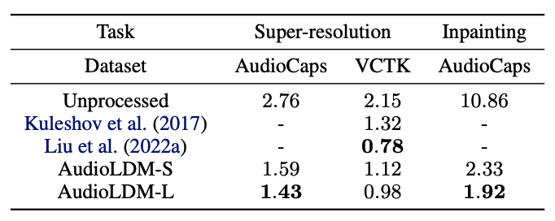
Result – Super-resolution and Inpainting
Super-resolution
  VCTK (Speech)
  AudioCaps (General Audio)
Inpainting
  AudioCaps
Super-resolution: Log-spectral distance
Inpainting: Frechet audio distance

Slide 14
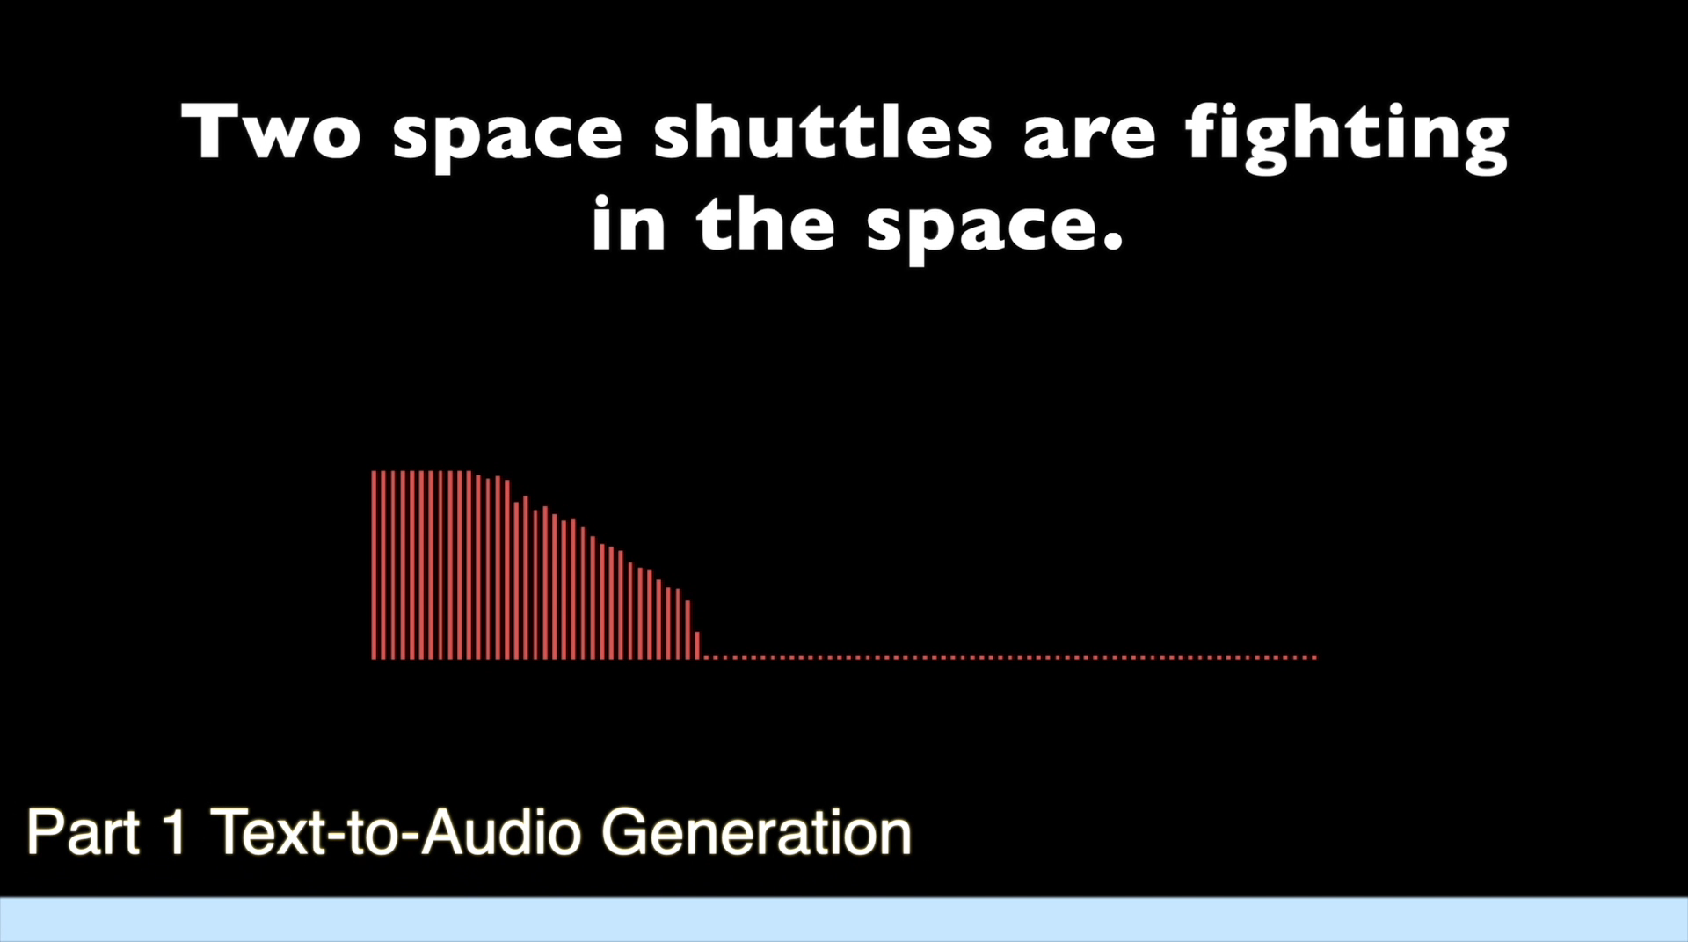
AudioLDM: Demos

Slide 15
Impact of AudioLDM
Accepted by the top machine learning conference ICML 2023
One of the 25 most-liked machine learning apps on Hugging Face Spaces among 25000+ apps
Received more than 1400 stars on Haohe’s Github page.
Widely used by people for creating albums, games, 3D animations
Widely reported and shared on social media & official news channels (Youtube, Twitter, LinkedIn, Note, MarkTechPost, MachineHeart, Reddit, Zenodo, Replicate, University Press release, and many more)
Search “AudioLDM” will pop out more than 10 pages of entries

Slide 16
Retrieval-based TTA for the Long-Tail Problem
Proposed techniques
  Retrieval-augmented TTA generation, Re-AudioLDM.
  Address the long-tail problem in audio datasets.
  Improve the overall model performance.
  Capable on generating rare, unique or even unseen sound events.
Statistic analysis of different event frequency. Audio clip for baseline model (Left) and Re-AudioLDM (Right) including rare events.
Notes:
As we can see on the right audiocaps datasets, here is the statistic analuysis which is obvious that there is a large amount of low-frequency events, like poping the champagne, these low-quality results may significantly affect the overall performance.
So based on previous research, we proposed our model to address this long-tailed problem. The retrieval-argument text-to-audio generation model, Re-audioLDM.
In our ablation studies which will be discussed later, we illustrate that Re-audioLDM can effectively alleviate the low quality results on rare and unique sound events, also improve the overall model performance on tta task

Slide 17
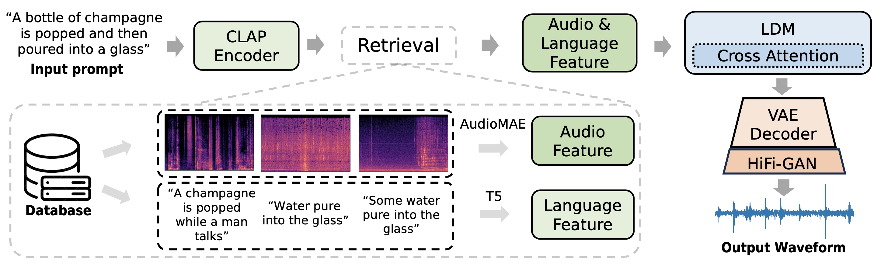
Re-AudioLDM
  Model Framework
  Retrieve related text-audio pair after the CLAP embedding.
  T5 for retrieved text embedding and AudioMAE^{[1]} for audio embedding.
  Retrieved feature forward through the cross attention module of LDM model to learn external audio feature.
The structure of Re-AudioLDM.
[1] Xu, et al. “Masked autoencoders that listen.” arXiv:2207.06405. 2022
Notes:
Let‘s look into some details, this figure shows the structure of our Re-audioLDM, our model applies AudioLDM as the backbone, which has a similar structure, a CLAP encoder, an LDM model, VAE decoder, and a hifi-gan model.
So in detail for audioLDM, there is a clap encoder to generate the condition embedding for the LDM model, using this condition, the diffusion model outputs with the audio feature in latent space, followed by a VAE decoder to reconstruct into mel-spectrogram and a hifi-gan vocoder to generate the final waveform as output.
In our framework with the retrieval based strategy, we first find the nearest neighbours of the input text embedding to retrieve the most relevant text-audio pairs in the database.
Then, these features are encoded by an AudioMAE and a T5 encoder respectively, all these features are forwarded into the cross-attention module of the LDM for generating the latent space audio feature.
By giving these paired audio—text features, we try to guide the model to learn some external information on the target audio events. In this way the model could learn these rare or unique sound event features during the inference stage.

Slide 18
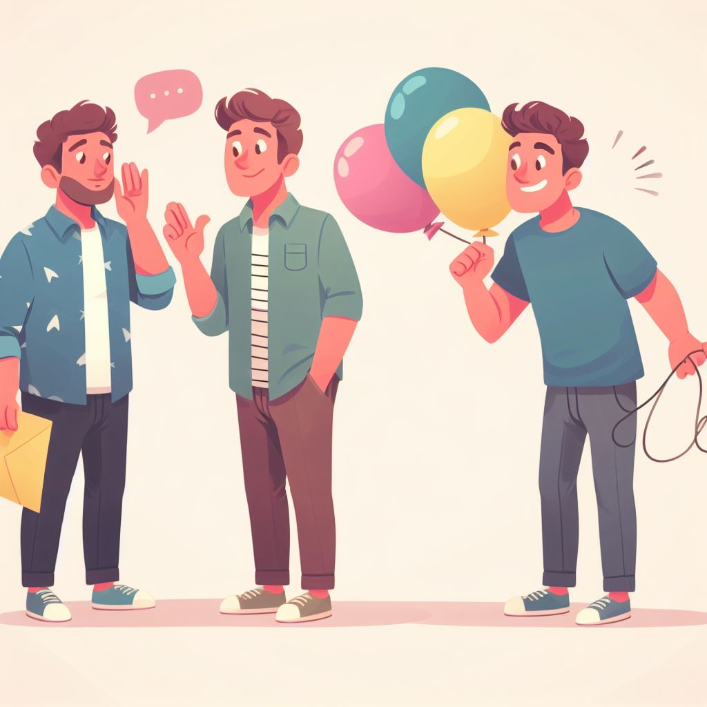
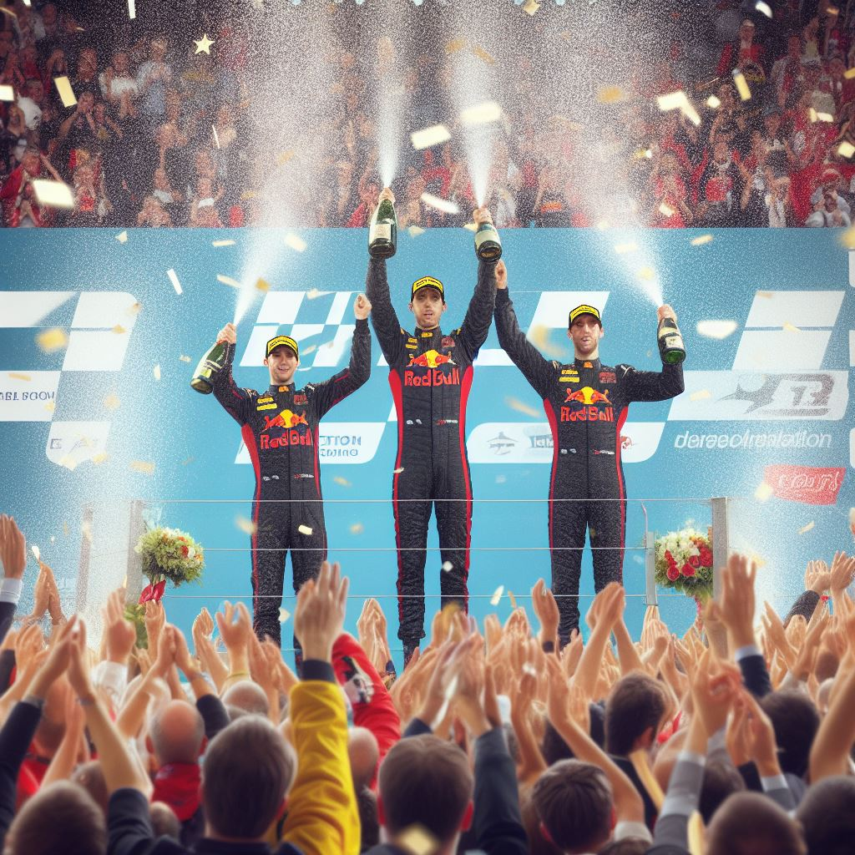

Re-AudioLDM Demo
  Generating rare and complex sound events
  A man is talking while someone pops a balloon and laughs.
  The three winners pop the champagne and the audience cheers.
Notes:
So here are some results of or Re-AudioLDM
I just try to present several samples that including rare sound events
Like this one, we give the prompt a man is talking , while someone pops a balloon and laughs, similar to this image, this man is talking and someone behind has some balloon, he pop this balloon and then laugh.
Lets hear how our Re-audioLDM does,
And then, here is another one that three winners pop the champion and the audience cheers.
Let have a try on this.

Slide 19
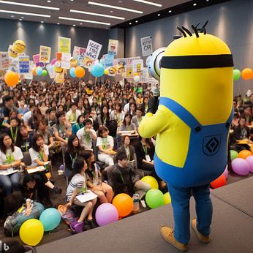
Re-AudioLDM Demo
Y. Yuan, H. Liu, X. Liu, Q. Huang, M. D. Plumbley, W. Wang, “Retrieval-Augmented Text-to-Audio Generation,” IEEE ICASSP 2024, submitted.
https://arxiv.org/abs/2309.08051
  Unseen events
  A minion tries to speak and then people start to cheer.
  Two audios are given as the retrieval-based feature for “minions speak” :
  Generate results:
Notes:
Also we have tried the capability of Re-audioldm on some unseen scenes, like we try to let Re-audioLDM generate a minion is talking and then people cheers.
Not exactly like zero-shot, so we try to give this model some audio for minions speak as the retrieval data, like this one and this one
Then the model can try to generate some taking similar like the minions we provide.
Yes so we can here a quite similar flunt or voice in this result, although it not perfect enough, but I still believe that this is a pertenial direction of Re-audioldm and maybe our next step, we will try to improve the performace on these unseen cases.

Slide 20
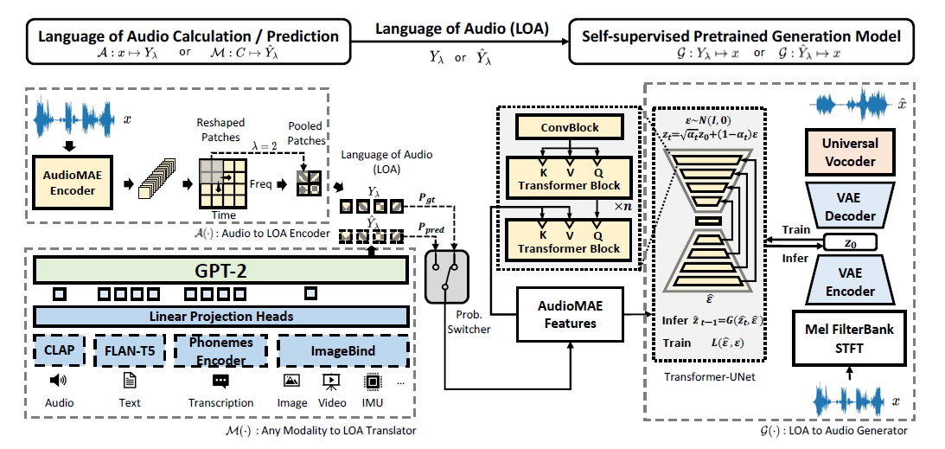
AudioLDM 2
H. Liu , Q. Tian, Y. Yuan, X. Liu, X. Mei, Q. Kong, Y. Wang, W. Wang, Y. Wang, and M. D. Plumbley, “AudioLDM 2: Learning Holistic Audio Generation with Self-supervised Pretraining,” IEEE/ACM Transactions on Audio Speech and Language Processing, under review, 2024.

Slide 21
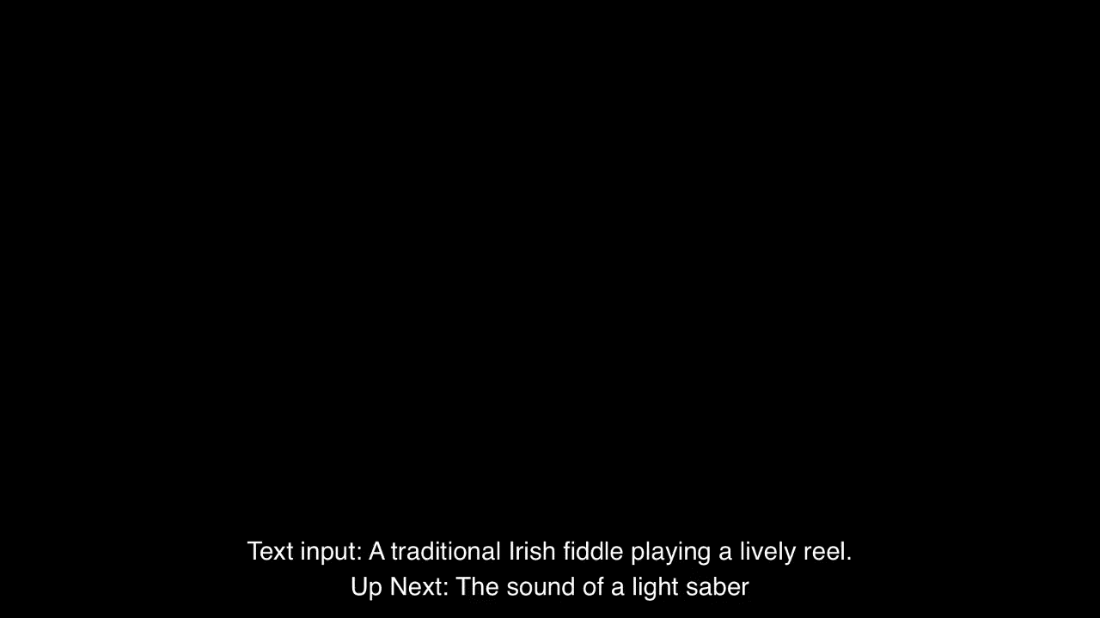
AudioLDM 2 Demo
We generated a total of 350 audio files with prompts (generated by ChatGPT) without cherry-picking.
Paper:
https://arxiv.org/pdf/2308.05734.pdf
Code:
https://github.com/haoheliu/audioldm2
Demo:
https://huggingface.co/spaces/haoheliu/audioldm2-text2audio-text2music

Slide 22
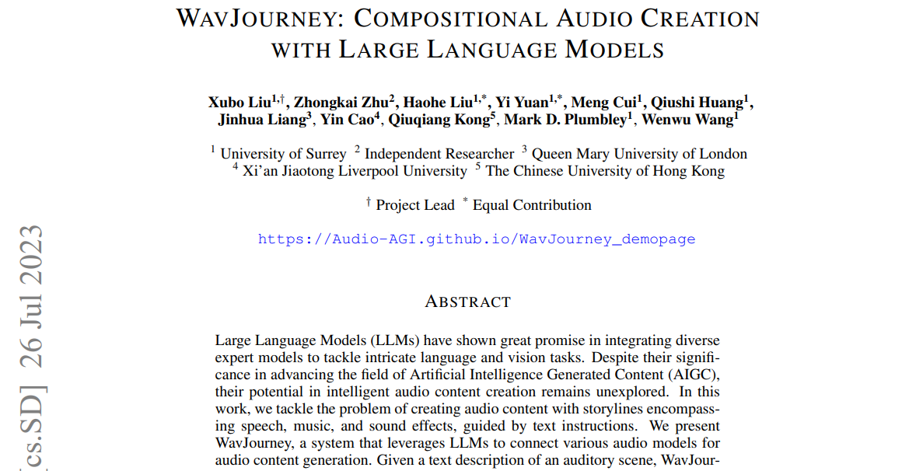
WavJourney
Paper:
https://arxiv.org/abs/2307.14335
Code:
https://github.com/Audio-AGI/WavJourney
Demo:
https://huggingface.co/spaces/Audio-AGI/WavJourney

Slide 23
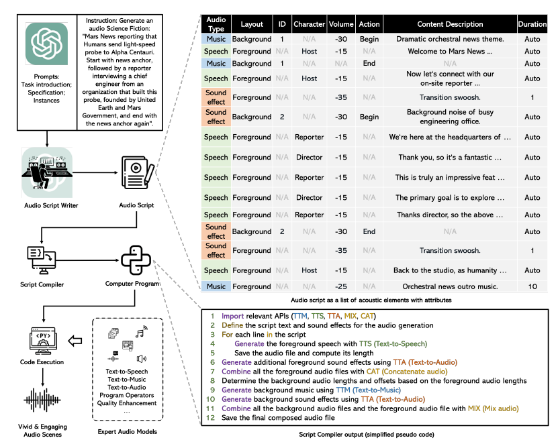
WavJourney

Slide 24
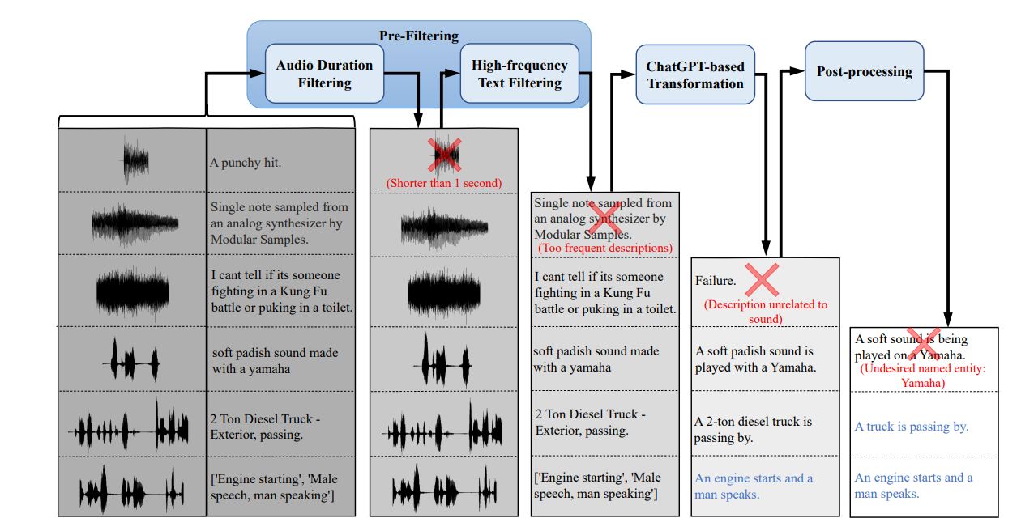
WavCaps – A ChatGPT Refined Dataset for Audio-Text Learning

Slide 25
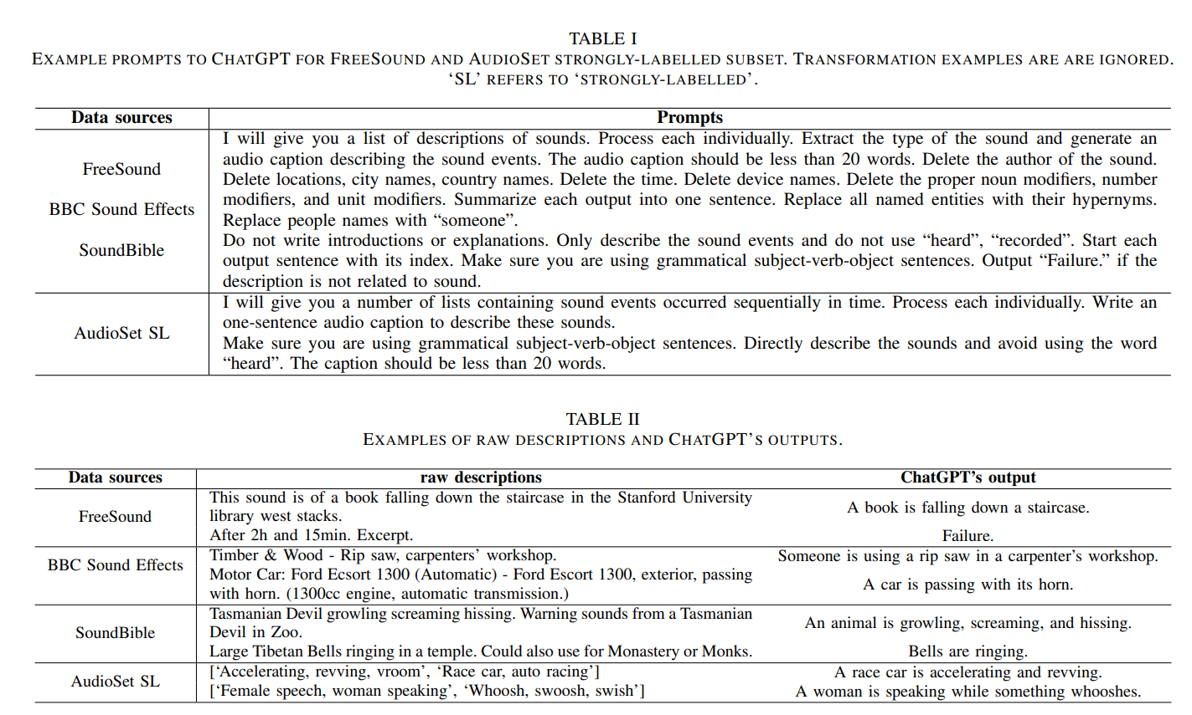
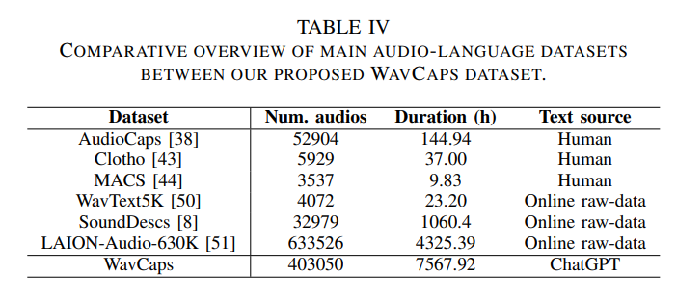
WavCaps
Paper:
https://arxiv.org/abs/2303.17395
Code:
https://github.com/xinhaomei/wavcaps

Slide 26
Conclusion & Future Works
Summary
  We have discussed several methods: AudioLDM, Re-AudioLDM, AudioLDM 2, WavJourney, and WavCaps.
  AudioLDM 2 & WavJourney offer state of the art performance in text-to-audio generation.
  WavCaps is a large-scale dataset suitable for a number audio-text cross modal tasks including text to audio generation, audio to text generation, and text promoted audio source separation.
Future Works
  Improving contrastive language-audio pre-training models
  Leveraging reasoning with large language models & generation with audio models
  Towards controllable & fine-grained sound generation
  Physics based model + data driven model

Slide 27


Thank you for listening!
This work was sponsored by a Newton Institutional Links Award from the British Council, titled “Automated Captioning of Image and Audio for Visually and Hearing Impaired” & EPSRC projects titled “Making Sense of Sounds” and “AI for Sounds”.

